Slide 1
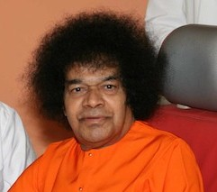
Zone 9 B Middle East & Gulf Countries
November 2014

Slide 2
ACTIVITIES IN ZONE 9B
Study Circles on two study guides – Love & Service, for Pre-World Conference– All Countries
Akhanda Bhajan 24hrs – Dubai/Abudhabi, Bahrain, Saudi Arabia
Birthday Celebrations– 6 to 9 weeks Dubai/Abudhabi/ Bahrain
Mahasamadhi day– All Countries
Study Circle –Every week -Turkey

Slide 3
SSEHV ACTIVITIES – ZONE 9B
Essay Poster Making Competition-3,135 children -229 schools - Oman
Special Program for Birthday: Children – Saudi Arabia
Gratitude Ceremony– Bahrain
SSEHV for Parents– Turkey
Human Values Workshops -40 completed - Oman

Slide 4
SSEHV ACTIVITIES – ZONE 9B
Balvikas Gurus Training – All Centers
Educare for All – Dubai/ Bahrain
Easwaramma Day – All Centers
Parent Contact Program – All Centers
Meditation Guidance Session -9 days - Oman

Slide 5
SEVA ACTIVITIES – ZONE 9B
Narayana Seva -280 pkts food – Saudi Arabia
Mega Grain Support -306 workers– Bahrain
EEG –Clean Up / Can Collection – Dubai
Feeding the Poor: all Monday/ Wednesday – 240 persons - Turkey
Grama Seva – monthly 1,200 workers - Abudhabi
Mahila Seva -140 workers monthly- Kuwait

Slide 6
SEVA ACTIVITIES – ZONE 9B
Medical Camps – 595 patients served- Dubai
Health Awareness: 23 camps – Abudhabi / Oman
Blood Donation Camps – All Countries
Grama Seva – Very Low Income Group – 100 packets distributed monthly – Oman
Healthy Body–Healthy Mind – Dubai

Slide 7
YOUTH ACTIVITIES – ZONE 9B
Special Children Group –(Autism) – Oman
Shanti School Sports Day– Kuwait
Water and Laban distribution- 117 days– Abudhabi
Sports Day for entire family- Dubai
Serve The Planet – All Centers

Slide 8
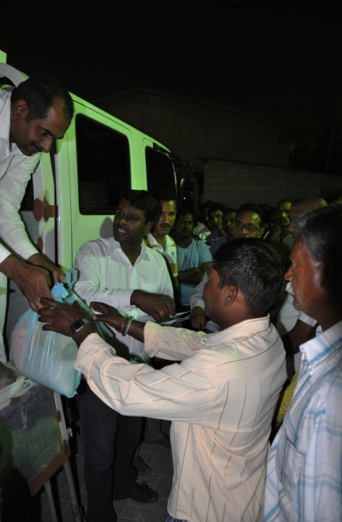
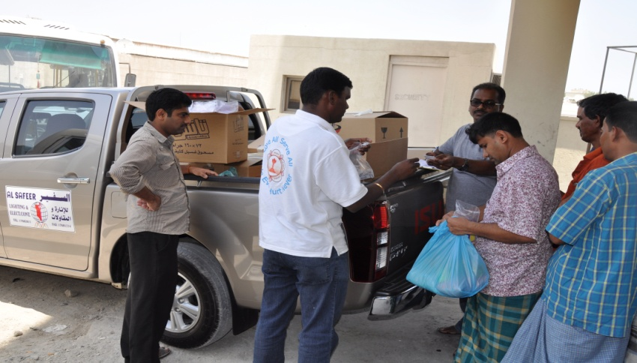
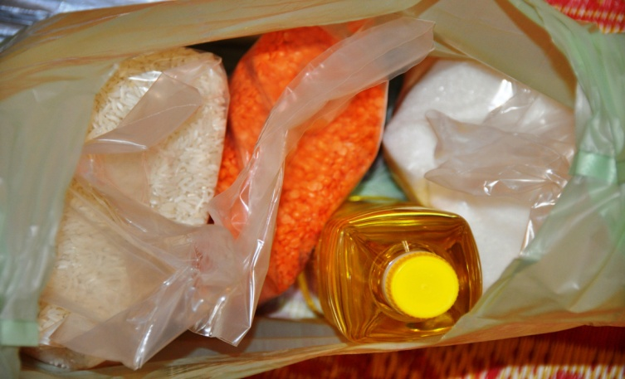
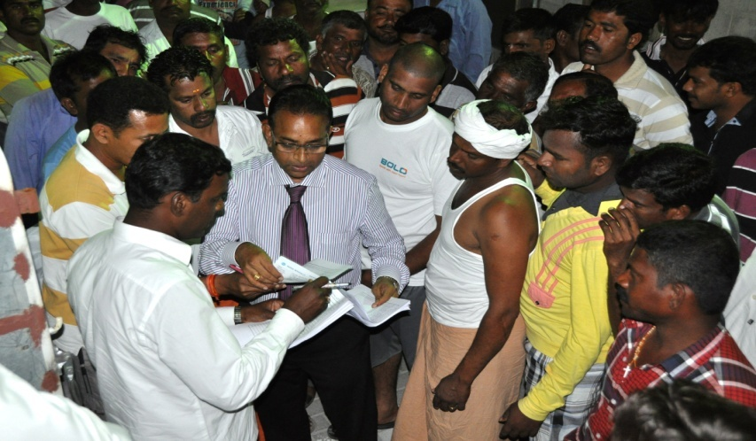
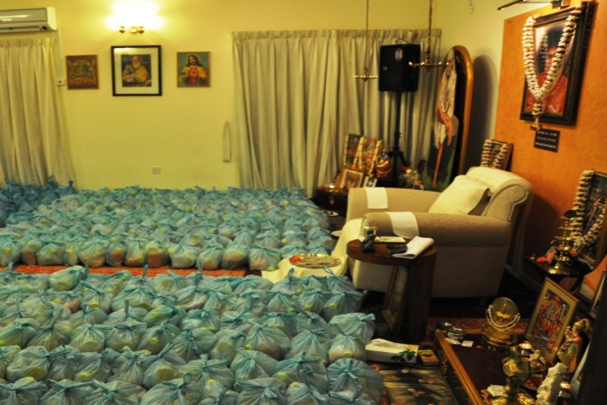
SERVE THE PLANET
MEGA GRAIN SUPPORT - Bahrain
A need based activity provided to workers at labour camps
Each worker is provided with a hamper containing 2 kg Rice, 1 kg Dal and a bottle of Oil
306 workers were served in April, 77 in May, 225 in June (total 608 workers)

Slide 9
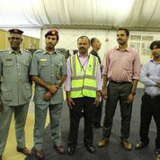
abudhabi- health awareness camp

Slide 10
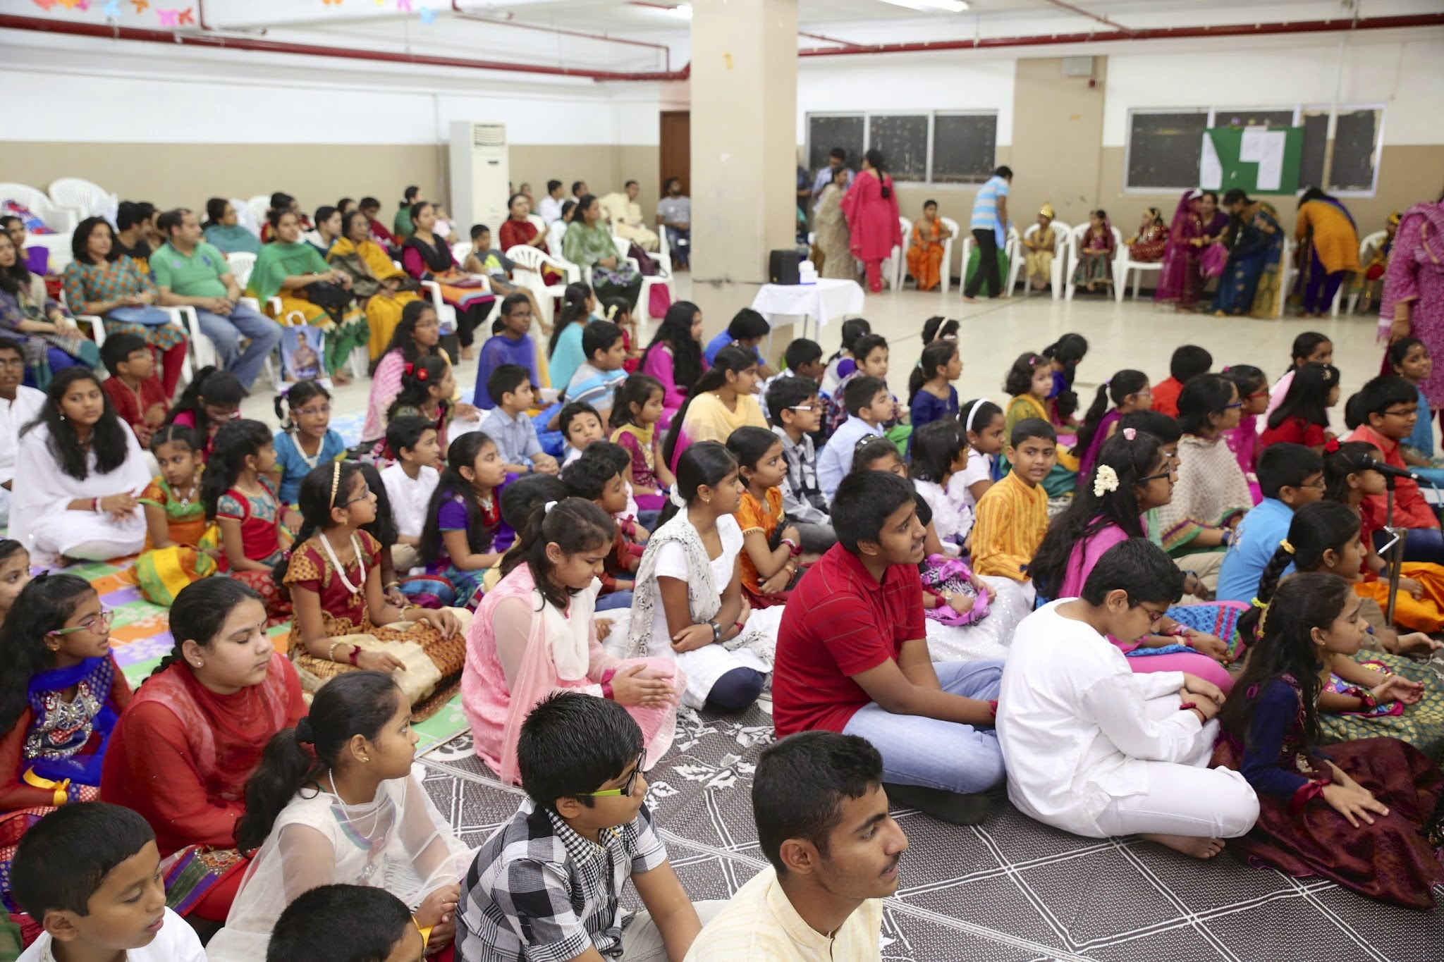
Kuwait- Eswaramma Program

Slide 11
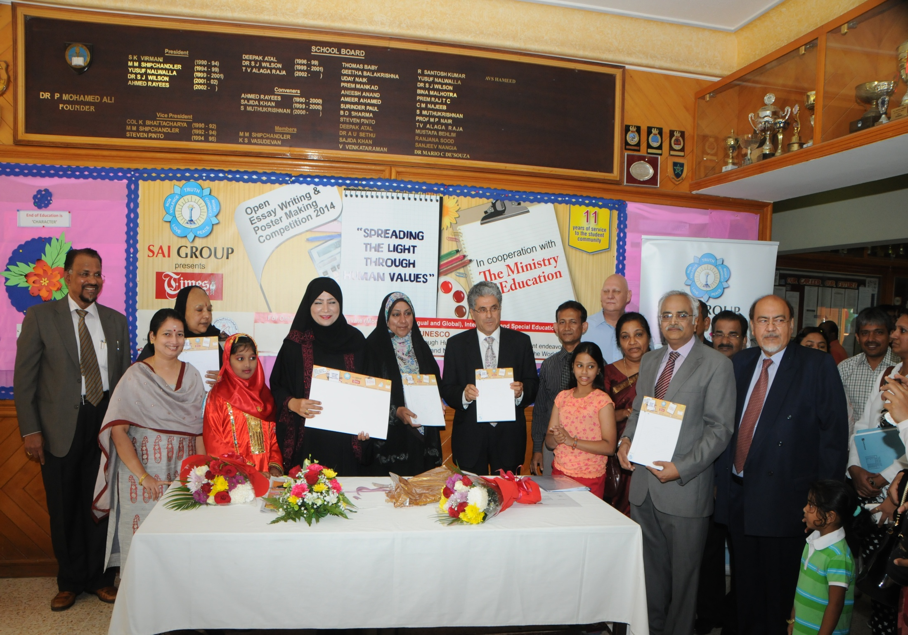
Oman- Essay Poster Competitionn

Slide 12
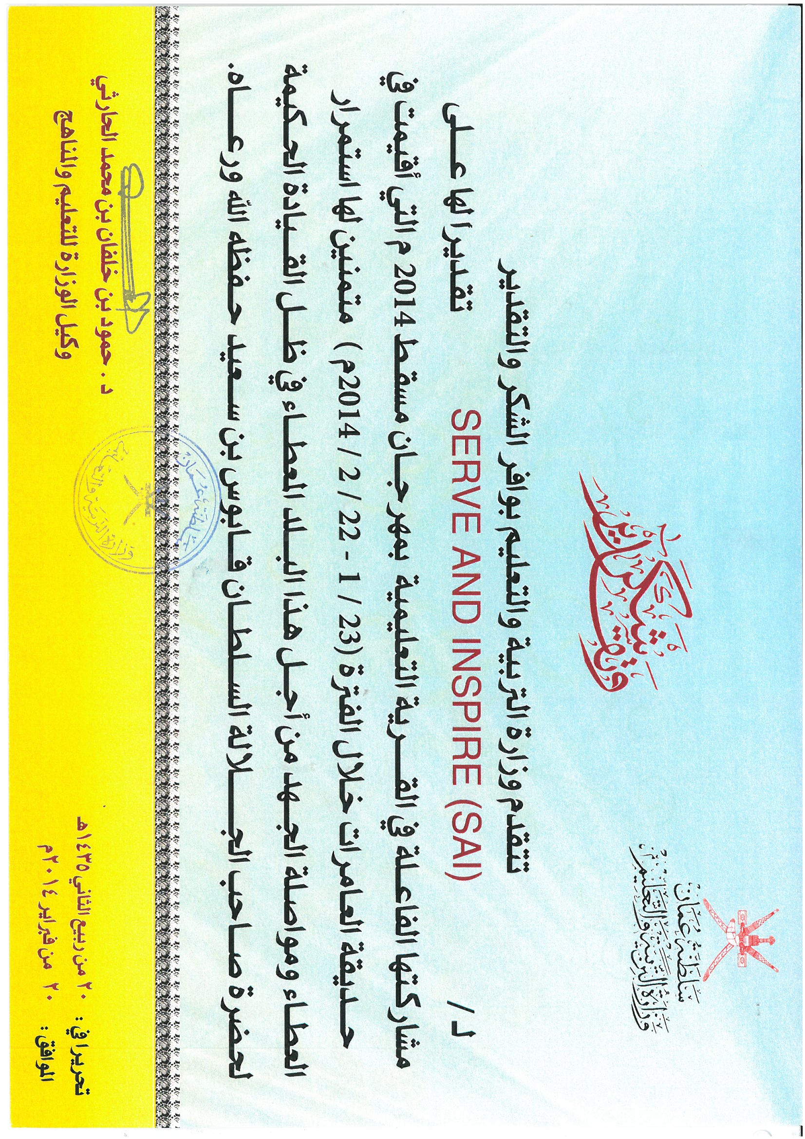

Slide 13
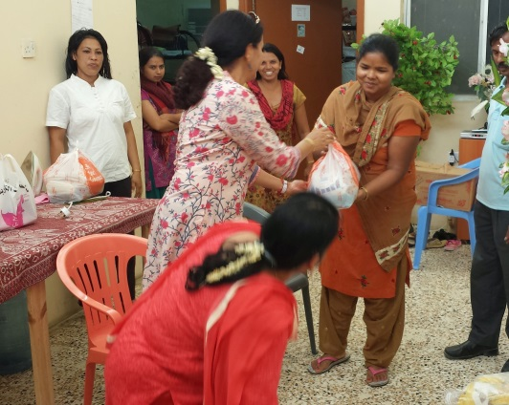
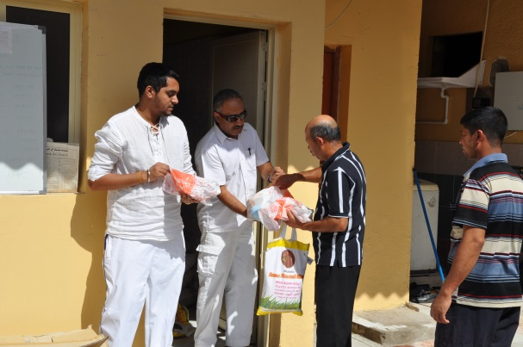
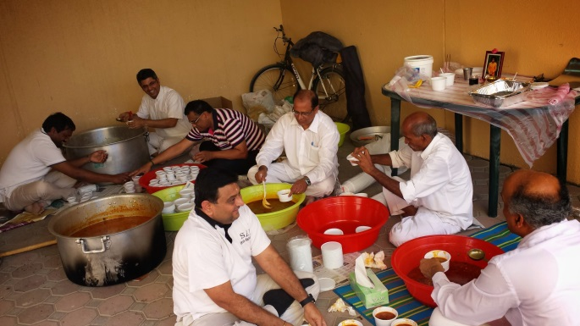
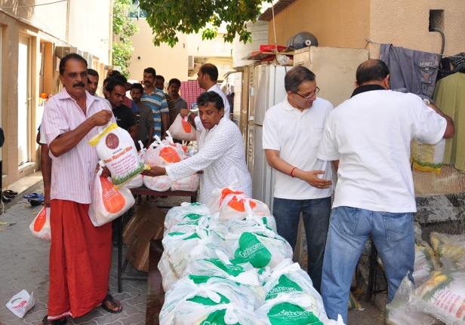
Narayana Seva - Dubai
4 Narayan Sevas were organized.
A total of 1110 needy people have been served with Dry/Cooked food during the seva.
About 15 volunteers supported each of these distributions.

Slide 14
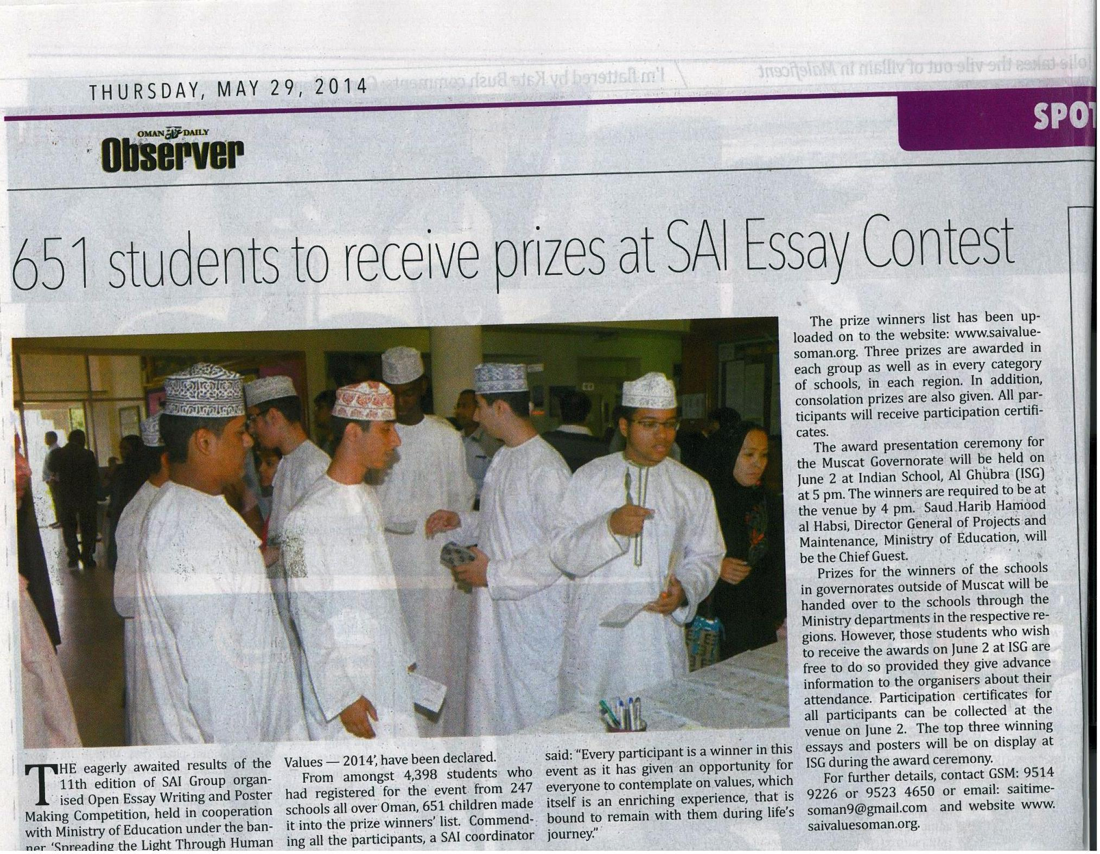

Slide 15
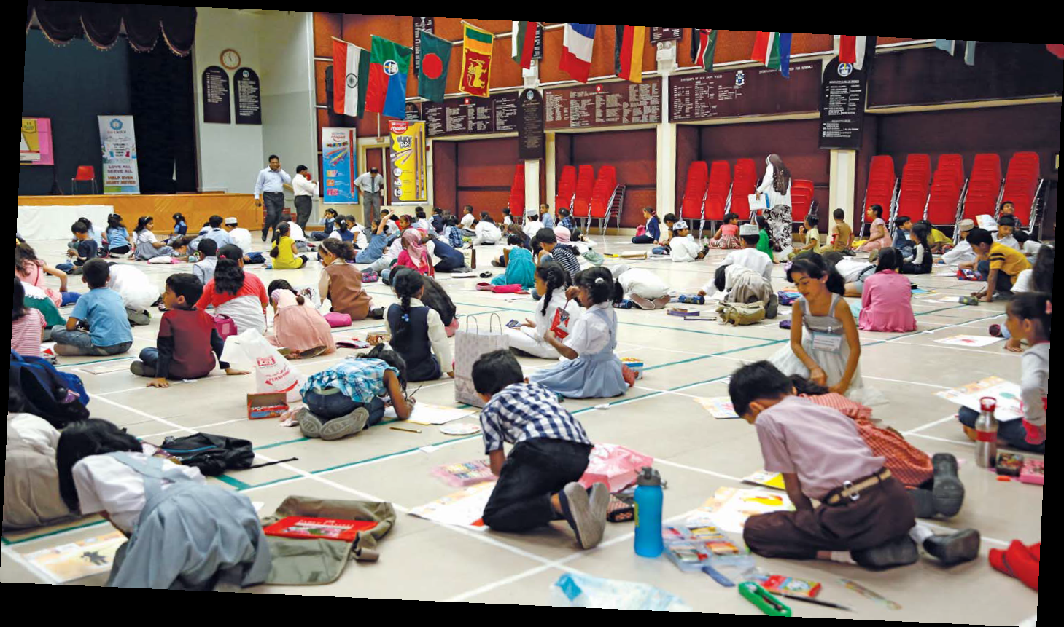
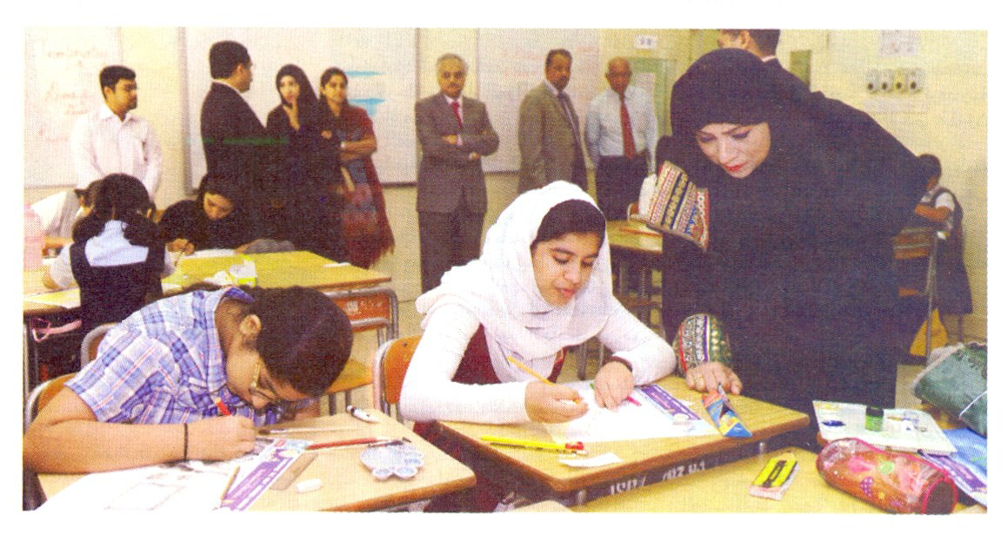
Media Coverage
Oman

Slide 16

Pranams At Thy Lotus Feet
Jai Sairam

