Slide 1

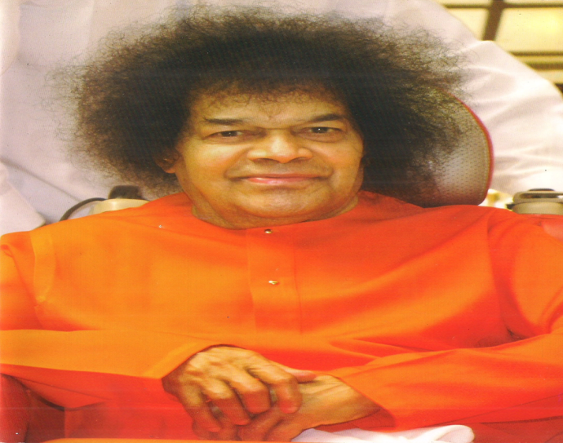
SATHYA SAI INTERNATIONAL ORGANISATION AFRICA – REGION 93
Bhagawan Sri Sathya Sai Baba

Slide 2
Africa - Region 93 has following countries:
Angola, Cameroon, Congo, Ethiopia, Kenya, Ghana, Ivory Coast, Libya, Malawi, Morocco, Nigeria, Rwanda, Senegal, Sierra Leone, Somalia, Swaziland, Zanzibar, Tanzania, Uganda, Zambia and Zimbabwe.
This presentation features reports from:
Nigeria
Ghana
Zambia
Sierra Leone
Zanzibar
Kenya

Slide 3
NIGERIA
Statistics on Medical Service in Nigeria: 1st April 2013 to 31st March 2014

Slide 4
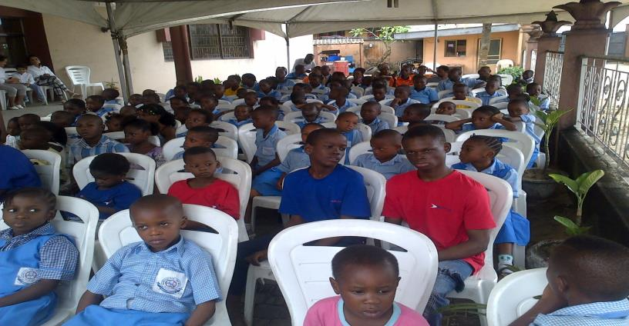
SERVE THE PLANET: 2014
REPORT FROM NIGERIA
2014 Serve The Planet programme was observed in Nigeria on Saturday, 18th October, 2014 to enable school children join other children at a central location.

Slide 5
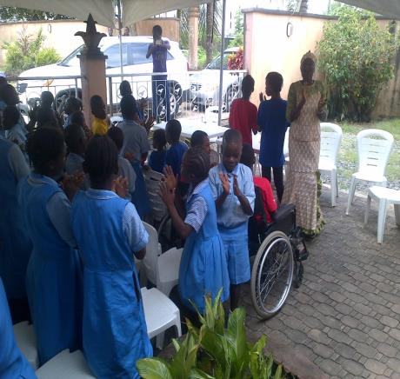
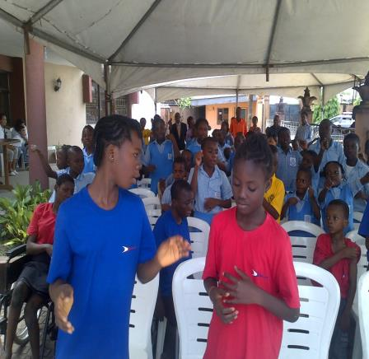
The programme was very lively as the children sang many devotional songs and chorused Baba’s Human Values teachings.

Slide 6
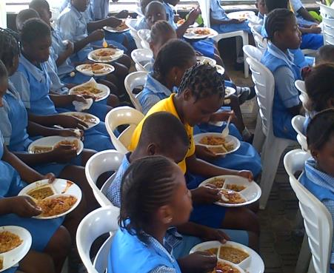
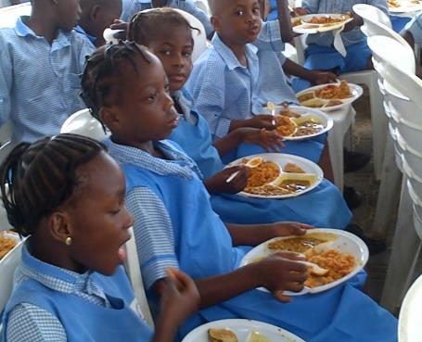
A total of 118 children from remote villages in Ajah community, some orphanages, and Sathya Sai School Lagos were served at the National Headquarters of Sathya Sai International Organisation, Lagos, Nigeria.
The children were served tasty jollof rice, beans, vegetables, samosa and soft drinks.

Slide 7
SSEHV TRAINING IN NIGERIA IN AUGUST 2014
A second batch of SSEHV Introductory Level training was conducted in Nigeria from 28th to 31st August, 2014 at the National Headquarters of SSIO of Nigeria.
The Introductory level training was organized by The African Institute of Sathya Sai Education(TAISSE) in liaison with the National Council of SSIO of Nigeria.
15 participants cutting across the Sai Centres in Nigeria had travelled from far and near to participate in the event.
TAISSE faculty members led by the Deputy Director of TAISSE, Dr. Ani Casmir facilitated the training.
Participants were enlightened about the teachings of Bhagawan Baba. The Intermediate training will be organised in the first quarter of 2015.

Slide 8
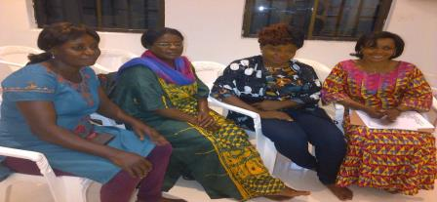
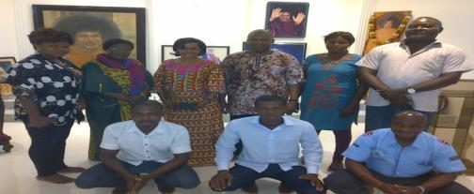
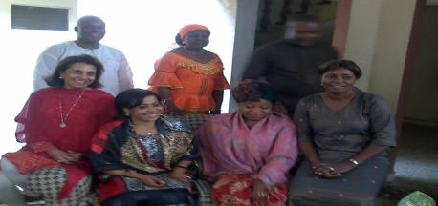
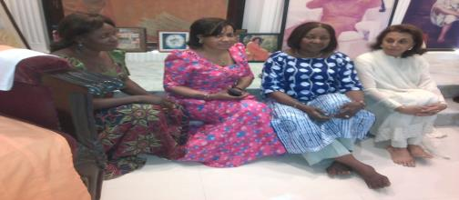
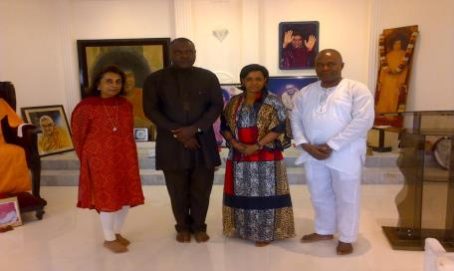
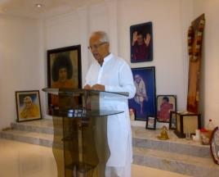
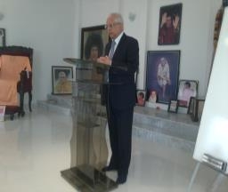
The Central Coordinator, Africa Region 93, Brother Ramesh
Hathiramani was present on the opening day and closing day to motivate the participants.

Slide 9
GHANA
SERVE THE PLANET: 2014
On 20th October, 2014, devotees from SSIO of Ghana carried out special Seva. Mother Care Orphanage Home situated in Swedru was chosen as the venue for this special day.
About 250 Children were at the centre. Volunteers and friends of devotees helped to distribute bags of rice, cooking oil, canned tomatoes, biscuits, fruits, drinks, and pure water sachets to the Home.
Devotees assisted the Home to prepare “banku” (local food from maize) and soup at the centre and serve all the children.
SSEHV lectures were given to the children and they in turn answered questions.
Devotees were later entertained by the Cadet Corps with a drill exercise.
Prayers were offered for God’s grace and guidance.

Slide 10
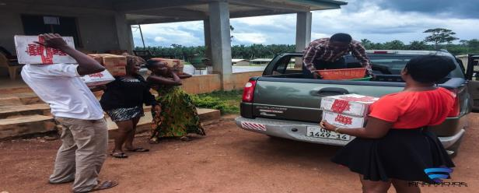
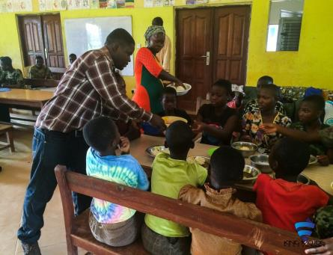
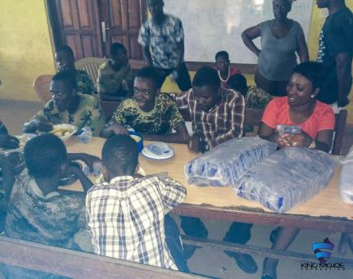
GHANA
Items being loaded in the van
Children being served with the local dish banku

Slide 11
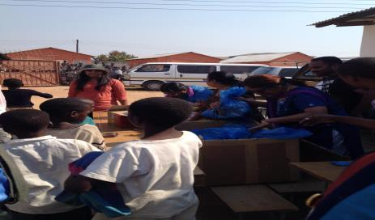
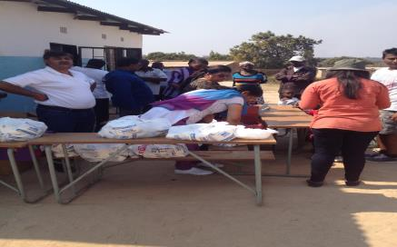
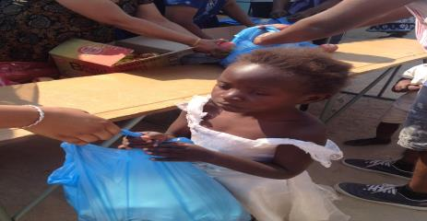
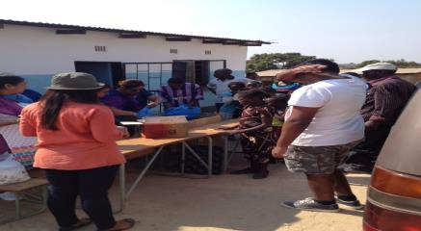
ZAMBIA
Kitwe Sai Centre: Food and clothes distributed to 300 students in the adopted school in Musonda compound, Kitwe on 17th July 2014.

Slide 12
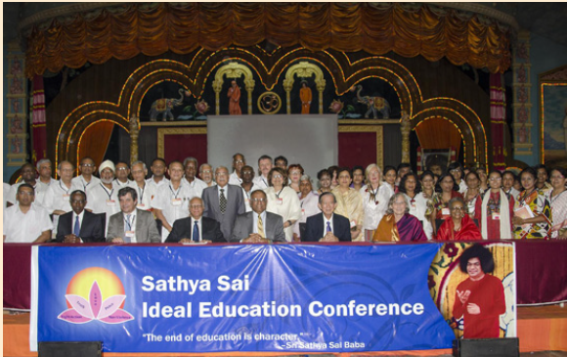
SATHYA SAI SCHOOL, KISAJU, KENYA
WORLD EDUCATION CONFERENCE AT PRASANTHI NILAYAM (6TH - 8TH JULY, 2014)
School’s Directors Bros. Kuldip Singh, Deepak Bowry and Daniel Gathuku attended a three-day conference on Sathya Sai Education at Prasanthi Nilayam from 6th–8th July 2014.
Eminent educators including 284 teachers from over 55 countries came together to participate in this landmark conference organised by the Sathya Sai International Organisation.

Slide 13
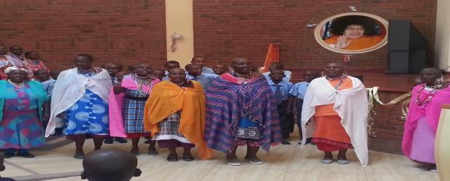
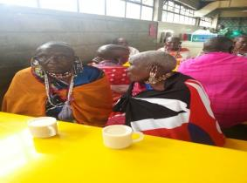
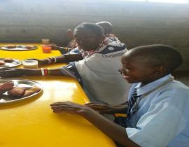
SERVE THE PLANET PROJECT / AVATAR DECLARATION DAY – 20.10.2014
By beloved Swami's grace, a Grama Seva was conducted on Avatar Declaration Day, 20th October, 2014.
From 9 AM onwards, students received the Narayanas, elderly ladies aged 65–98 years, with a hearty welcome.
They served the guests mid-morning tea with cakes, whilst interacting and sharing with them the teachings of Sai and Human Values.

Slide 14
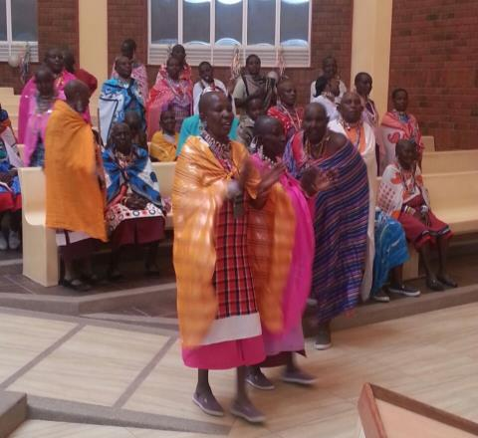
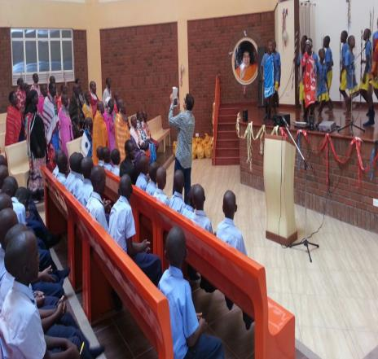
Later the Narayanas were taken to the Auditorium to view students performances . During the ongoing Masai traditional dance performed by the students , the excited guests also joined in the dance.

Slide 15
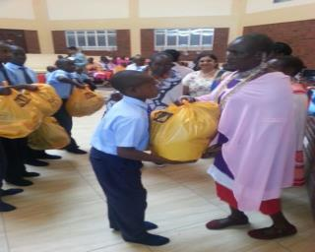
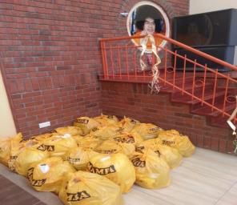
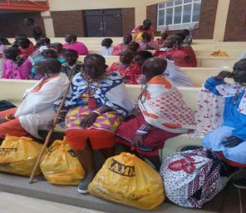
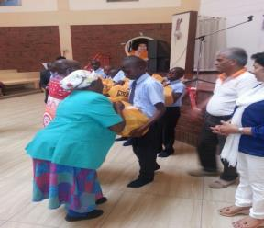
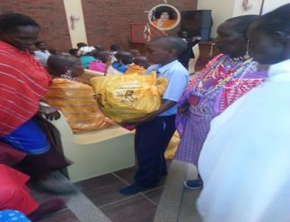
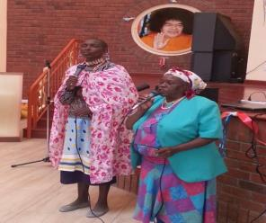
Students and devotees then served the Narayanas gift hampers. Overjoyed with the hospitality received the guests addressed and blessed the students and staff.
Some guests also shared testimonies of how the school has moulded their grandchildren (some are now graduates). They prayed that God grant Kisaju with a secondary school soon, leading to an university.

Slide 16
Zanzibar:
Mon to Sun 6.30pm: The centre is open to the public and the local community is aware of it.
Membership drive is on – encouraging others to join, making the centre more active.
Sierra Leone:
Report on Medical camp being prepared.
Some children from SSE classes in USA may donate books to the Sai Centre of Yonibana.

Slide 17

Thank you
Jai Sai Ram

