Slide 1
Sathya Sai International Organisation Zone 9A: UK
Report of Activities
July – October 2014

Slide 2
General
50 centres
42 groups
Regular attendees – over 5000
540 SSE Classes held last 6 months
1,100 SSE pupils managed by 260 SSE Gurus
Regular activities: devotional singing, study circles, interfaith participation, homeless shelters, food distribution, SSE classes, Health Awareness Clinics, blood donation, etc.

Slide 3
Theme for 2014
UK Theme for the Year: ‘One with Sai’
All activities focussed around this theme

Slide 4
National Activities
Pilgrimage to Prasanthi Nilayam: 27th July–2nd Aug 2014
Enviro-care Project
Guru Poornima Celebrations : 12th July 2014
Sathya Sai Retreat in Llandudno, North Wales: 29th–31st August 2014
Serve the Planet: Children are Our Future - 20th October 2014

Slide 5
National Pilgrimage to Prasanthi Nilayam
Theme: ‘Sai Samarpanam – One with Sai’
27th July–2nd August 2014
Preparations through 3 sadhana meetings: 18th May, 14th June, and 19th July 2014
Attended by 55 pilgrims

Slide 6
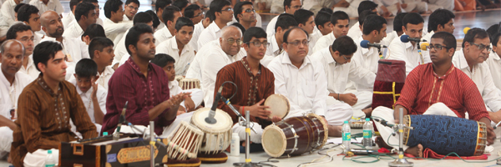
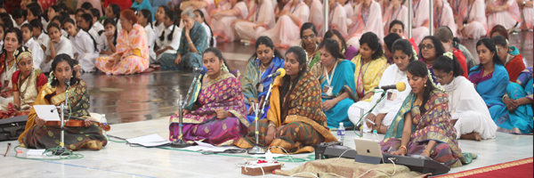
National Pilgrimage Divine Offering in Sai Kulwant Hall

Slide 7
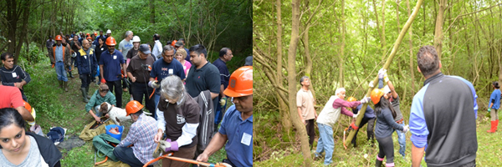
National Enviro-Care Project Hazelborough Wood
85 devotees in the Spirit of Service helping to clear the forestry grounds to improve habitat for Butterflies

Slide 8
Serve the Planet Project ‘Children: Our Future’
Worked in partnership with ‘Refuge UK’ – charity that provides specialist support for women and children experiencing domestic violence
Driven by youth, supported by Service Wing, and other devotees
Around 300 packs containing essential stationery for children were donated
Centres around UK involved
Offering as part of Avatar Declaration Day

Slide 9
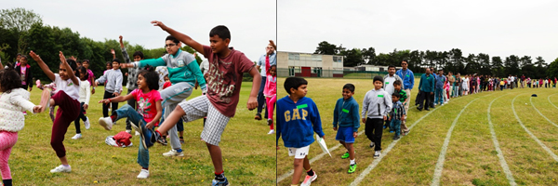
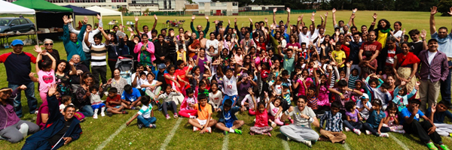
SSE Sports Day in Region 2

Slide 10
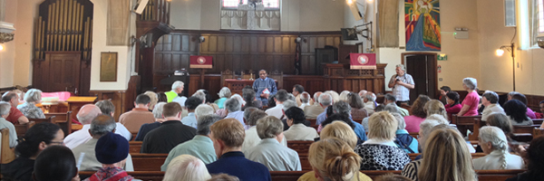
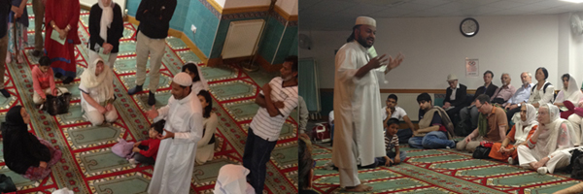
Region 3 participation at the Annual Multifaith Pilgrimage for Peace

Slide 11
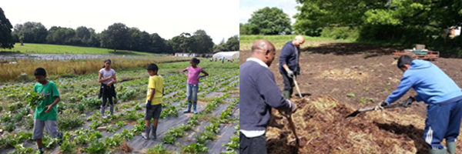
Harrow West Centre Service at Organic Farm

Slide 12
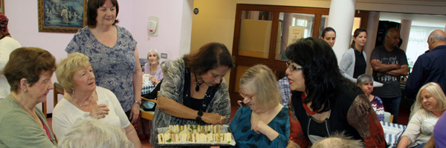
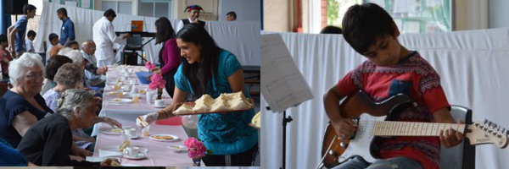
Lending a helping hand to the elderly
Brixton Sai Centre sharing Sai’s Love
Age link party at Tooting

