Slide 1
Sathya Sai International Organisation of Ireland May 2014 – November 2014
2014 has been another busy year of Sai activity in Ireland.
Sai Organisation in Ireland has small number of devotees spread over a wide area.
So, focus has been on holding regular “national” satsangs
one-day satsangs or weekend retreats
opportunity for devotees to come together.

Slide 2
In addition to Sai retreats, the SSIO of Ireland also holds public or semi-public satsangs and retreats for devotees and non-devotees.
SSEHV another key area of focus.
In the last year, a seven-module course of personal development for SSEHV teachers and parents was offered.
The course was very successful and a second course is being planned for Spring/Summer 2015.

Slide 3
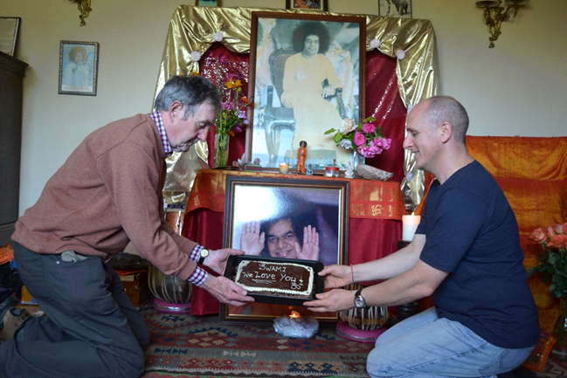
Cake for Swami

Slide 4
National Sai Retreats 2014 Sligo Retreat 2014
The second national retreat of 2014 was held in Co. Sligo in August. It was called the Unity retreat.
The program consisted of bhajan singing, Vedic chanting, mantra chanting, group meditation, workshop on Swami’s teachings on inner silence, and even a spiritual treasure hunt!
Here are some photos from the 2014 Sligo retreat.

Slide 5
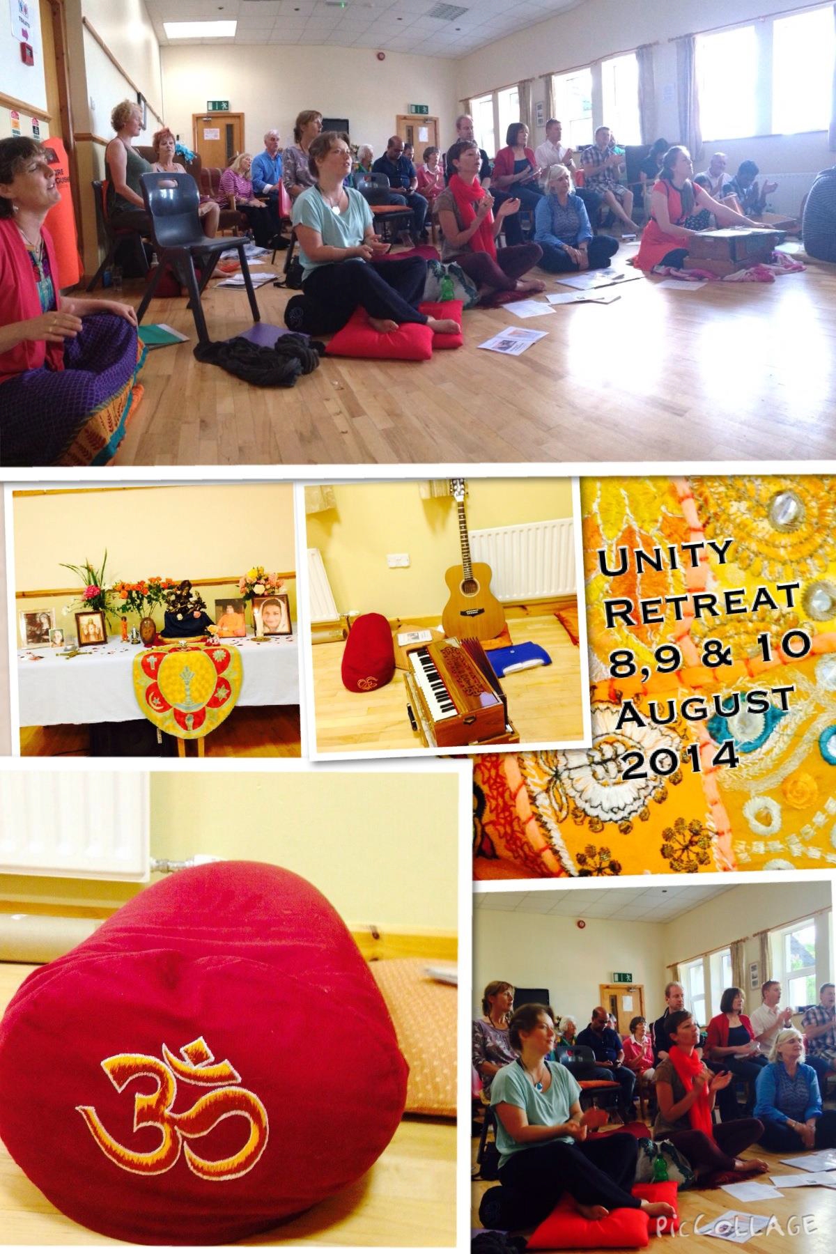
Sligo Retreat 2014

Slide 6
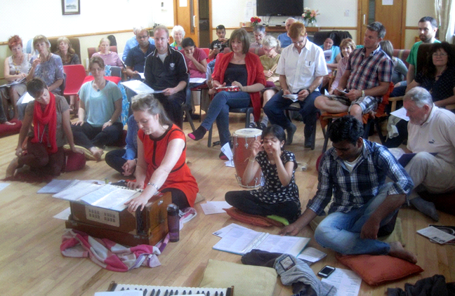
Sligo Retreat 2014 - Bhajan Singing

Slide 7

SSEHV Personal Development for Teachers and Parents October 2013 – August 2014
In 2013-14, the Sai Organisation ran a personal development course for SSEHV teachers and parents. The seven-module course was facilitated by SSEHV trainers John and Fionnuala O’Dowd in the Botanu Holistic Centre in Louisburgh, Co. Mayo.

Slide 8
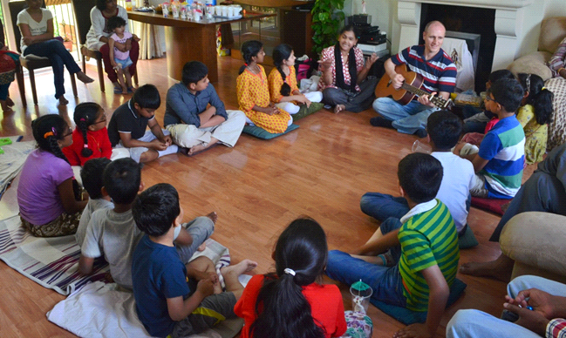
Sathya Sai Bal Vikas Class in Dublin, Ireland

