Slide 1

Zone 7
Report
August-November 2014

Slide 2

Zone 7
Northern Europe
Pilgrimage „Gratitude“ August 2014
Notes:
2
2

Slide 3

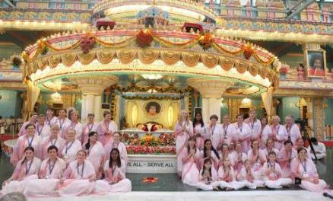
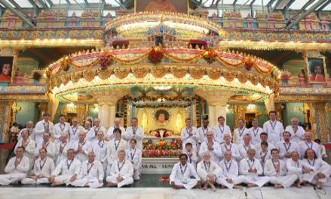
Pilgrimage ‚Gratitude‘ August 2014
120 Participants – Cultural Program
in Sai Kulwant Hall
Notes:
3
3

Slide 4





Region 71
Germany – Austria – Hungary – Czech Republic – Slovakia
Notes:
4
4

Slide 5
Basic info Region 71
Number of groups: 42
Number of centers: 14
Number of devotees: 562
National Council Presidents: Germany: Benno Wesener
Austria: Dr. Walter Zugal
Czech Republic: Eliska Horodyská
Hungary: Vincent Váczi
Slovakia: Anna Milosovicova
Notes:
5
5

Slide 6
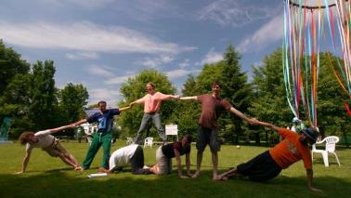
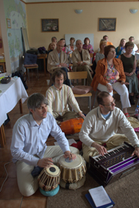
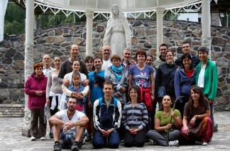
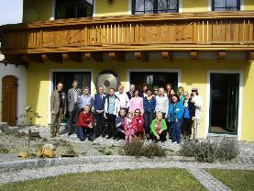
2014 National Meetings
In the countries of Region 71
Devotional Retreat in Germany, 124 Participants
Devotional Retreat in Czech Republic
40 Participants
Devotional Retreat in Hungary, 45 Participants
Devotional Retreat in Austria
34 Participants
Notes:
6
6

Slide 7
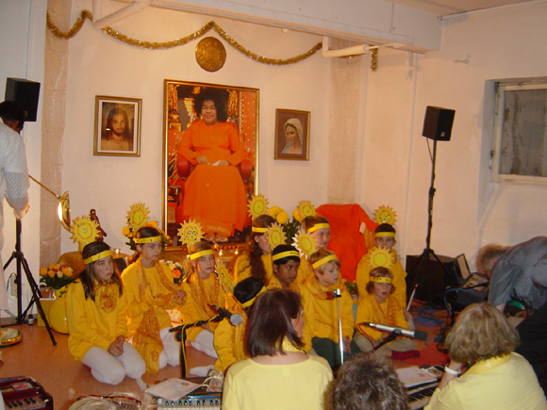
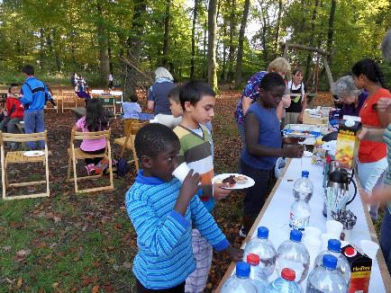
Avatar’s Declaration Day
on 20th October 2014
Germany, Karlsruhe
A day full of joy for children of an asylum‘s home
Germany, Munich
Gayathri-Initiation for 13 children of the center
Notes:
7
7

Slide 8
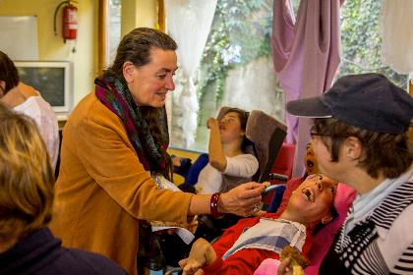

Avatar’s Declaration Day
on 20th October 2014
Hungary
A day with disabled children
Czech Republic
Olympic Games for children
Notes:
8
8

Slide 9






Region 72
Belgium – Denmark – Netherlands – Norway – Sweden
Notes:
9

Slide 10
Basic info Region 72
Number of groups: 23
Number of centers: 18
Number of devotees: 536
National Council Presidents
The Netherlands: Katinka van Lamsweerde
Sweden: Anita Persson
Denmark: Stig Meincke
Belgium: Marie-Paule Froidthier
Norway: Björn Hússtad
Notes:
10
10

Slide 11
The Netherlands
New projects:
Documentary about the change Sathya Sai brought into the life of devotees.
Requested by a Hindu broadcasting company
Booklet about selfless love will be published
Notes:
At this moment a devotee is making a short documentary about the change Swami has brought in the lives of devotees. His focus is also on the seva they are doing. This documentary will be broadcasted on Swami’s birthday on the Dutch TV. The request for this documentary came from the official Hindu broadcasting Organisation in The Netherlands. Care is taken that it is clear that That the Sai Organisation is not a Hindu Organisation.
The first book about Selfless Love for the studycircles preparing for the birthday in 2015, is translated and will be distributed to Centres and Groups. The second book follows soon.

Slide 12






Region 73
Estonia – Finland – Latvia – Lithuania – Poland
Notes:
12

Slide 13
Basic info Region 73
Number of groups: 15
Number of centers: 13
Number of devotees: 354
National Council Presidents: Poland: Anna Dobosz
Lithuania: Vilija Vitkuniene
    Estonia: Külli Kelu
    Latvia: Maija Tolberg
Finland: Gaiyer Altay
Notes:
13
13

Slide 14
„Sarva Dharma Choir“
An outstanding event in Region 73 was the tour of the “Sarva Dharma Choir” with participants of all countries of Region 73.
The target is to bring Swami’s massage of
the unity of all the religion to the society.
The concerts took place in Helsinki, Tallinn, Riga
and Palanga in Lithuania.

Slide 15
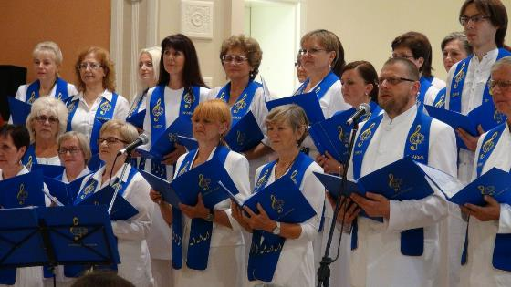
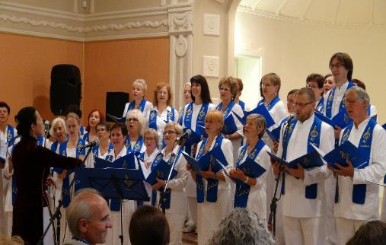
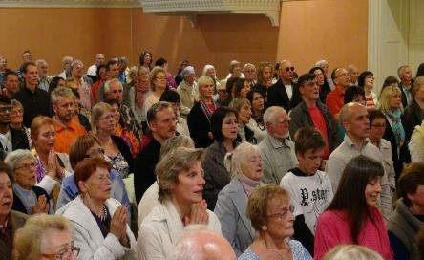

Slide 16
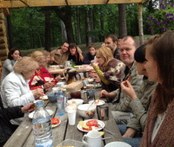
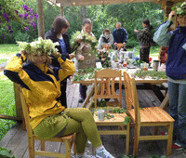
GRATITUTE towards
NATURE
Summer-camp in Latvia

Slide 17
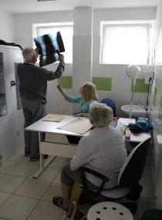
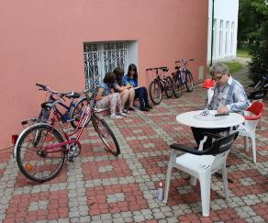
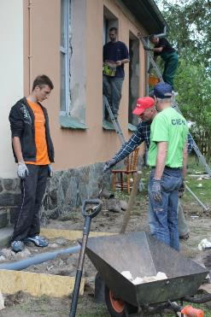
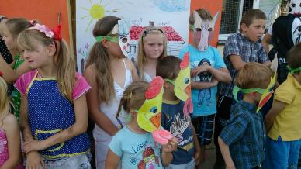
The 10th “Sai Boundless S ervice” in Poland
Kwiejce – 29th of June up to 06th of July, 2014
Sociocare
Medicare
Renovation
of houses
Educare

Slide 18
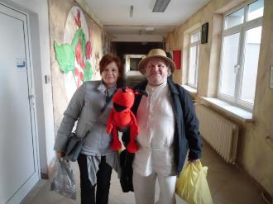
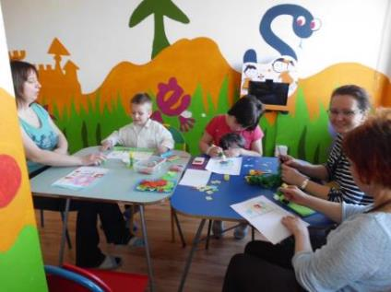
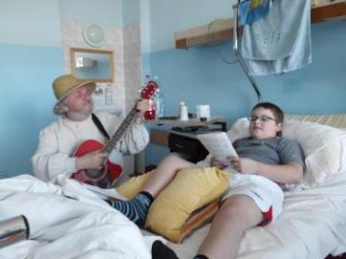
POLAND – New project
August 2014 Suwalki
„BRING HAPPINES TO THE CHILDREN IN THE HOSPITAL”

Slide 19
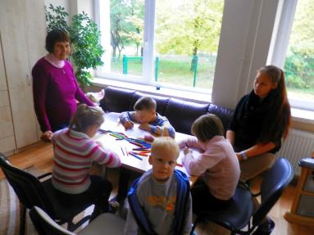
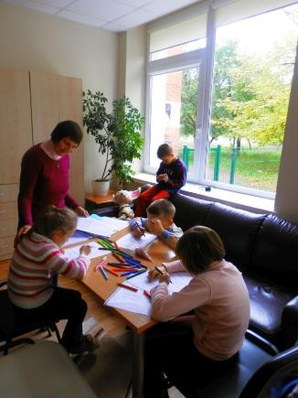
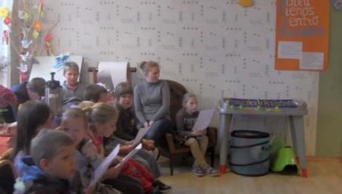
„HELP THE KIDS!” – a new project in Lithuania
Service in the orphanage - September 2014

Slide 20
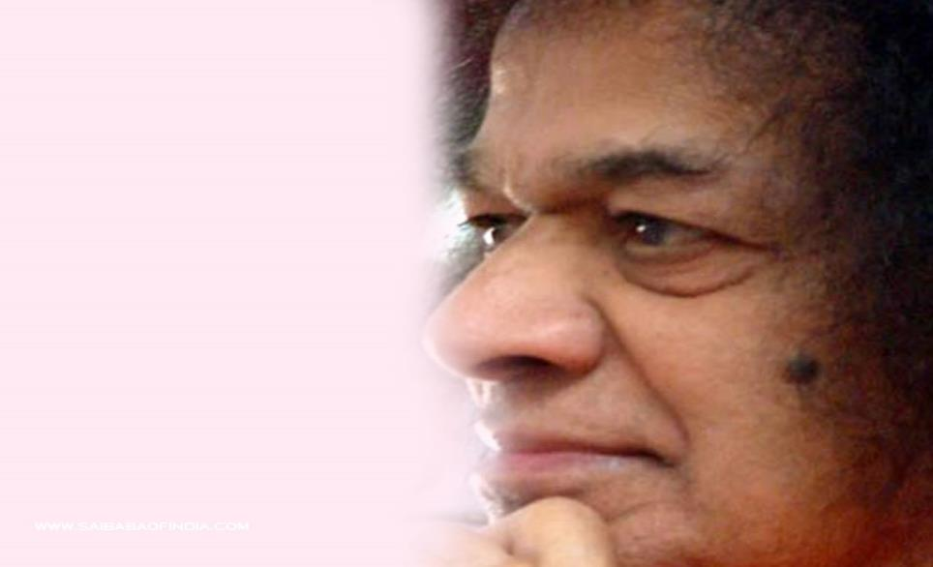
Sathya Sai International Youth Council
Zone 7
Zone 7
Outstanding activities 2014:
- YOUnity band Project
Inner Vision – European Youth Meeting in Czech Republic
Sai Boundless Service Camp
in Poland
Marta Panjeta
Zone 7 Youth Coordinator

Slide 21
Sathya Sai International Youth Council
Zone 7
(Project of Zones 6&7)
EUROPEAN YOUTH MEETING IN CZECH REPUBLIC
“Inner Vision – The Joy of Revealing what Resides Within”
The meeting took place in Prague from October 31st until November 2nd 2014. The purpose of the meeting was to experience joy and realize the power that lies within us; to reveal our inner talents, to grow together and to spend a great time in the spirit of service and unity. The program consisted of workshops, inspiring lectures, singing, an evening artistic program etc.
The organizing committee was established and worked together to prepare the whole event in which 76 participants from 19 different countries of Zones 6,7 and 8 attended.

Slide 22

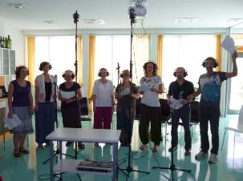
Sathya Sai International Youth Council
Zonal/International Level - Zone 7
Project of Zones 6&7
First music album of YOUnity band
The musicians and singers come from many different countries: Austria, Bosnia and Herzegovina, Croatia, France, Germany, Greece, Hungary, Poland, Slovakia. They were working on recording and editing through the whole 2013. CD came in two versions, one is called INNER VISION and second - SAI VISION as a special edition for Sai devotees, with 3 additional songs mentioning Sathya Sai Baba. Lyrics are based on spirituality and human values and should give positive vibration to the listener. All are conceived, written and recorded by YOUnity members.
After distributing already 1000 copies of CDs the band decided to continue with the project and started collecting material for recording another album.

Slide 23
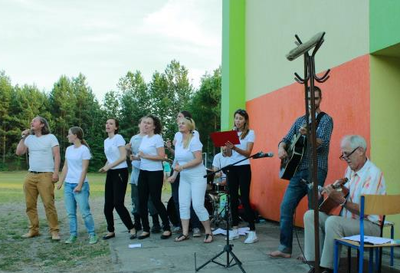
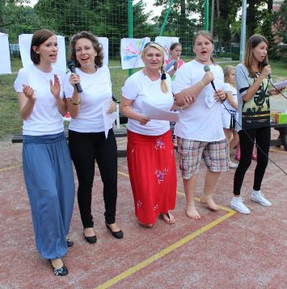
Sathya Sai International Youth Council
Zonal/International Level - Zone 7
2 public concerts took place in July 2014 in Poland, during Sai Boundless Service Camp. Around 100 people enjoyed the 35 min. Music Programme.
The band met again in Horn (Austria) on 20-21 September 2014 in order to work on new material for a second CD.
Another concert took place during the European Youth Meeting in the Czech Republic on November 1st.

Slide 24
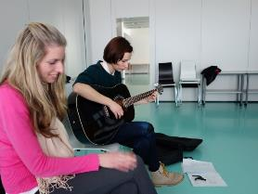
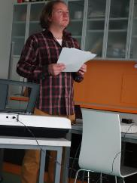
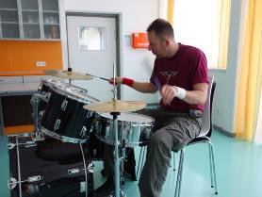
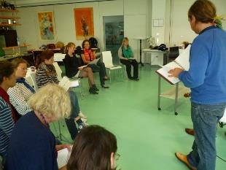
Sathya Sai International Youth Council
Zone 7

Slide 25
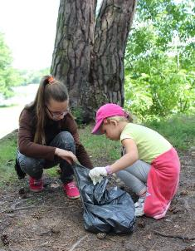
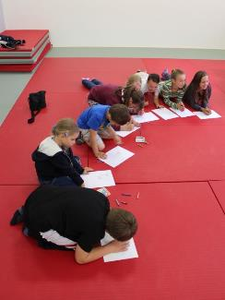
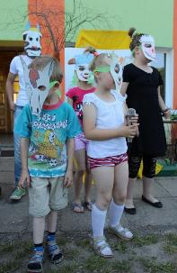
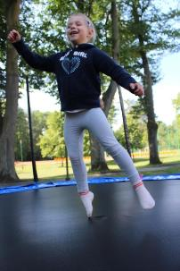
Sathya Sai International Youth Council
Zone 7
Sai Boundless Service Camp in Poland
July 2014 - Youth was involved in organization & leading SSEHV children activities during the camp with around 100 children. This time there were 14 young people participating – 10 from Poland and 4 guests from Bosnia & Herzegovina, Sweden and Austria.

Slide 26
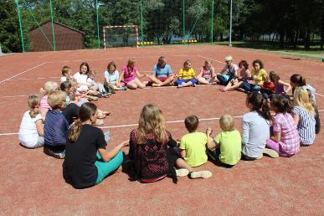
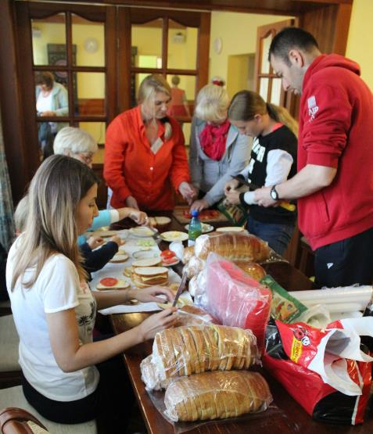
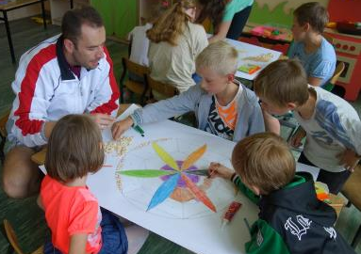
Sathya Sai International Youth Council
Zone 7

