Slide 1
Summary of Activities
Zone 3 – Australia, New Zealand, Fiji, Philippines
November 2014

Slide 2
AUSTRALIA

Slide 3
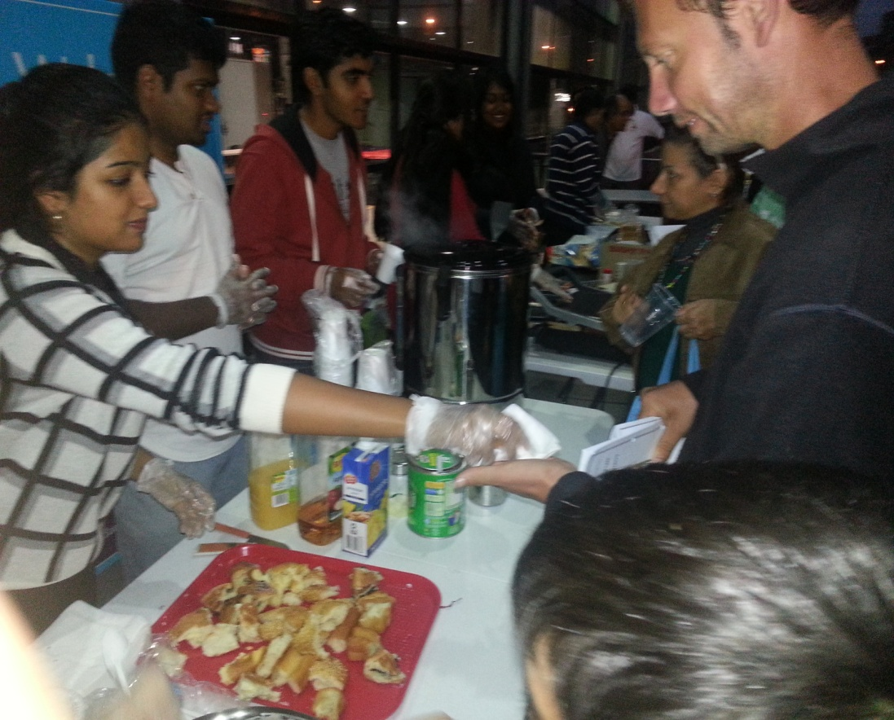
Focused Service Group
A dedicated service team has been established in one region
Made up of devotees who want to be fully focused on service as their spiritual practice

Slide 4

National Blood Donation Service Project : Oct – Nov 2014
The Australian Red Cross is keen to build a closer relationship with the SSIO of Australia following the website promotion work on Liquid Love

Slide 5
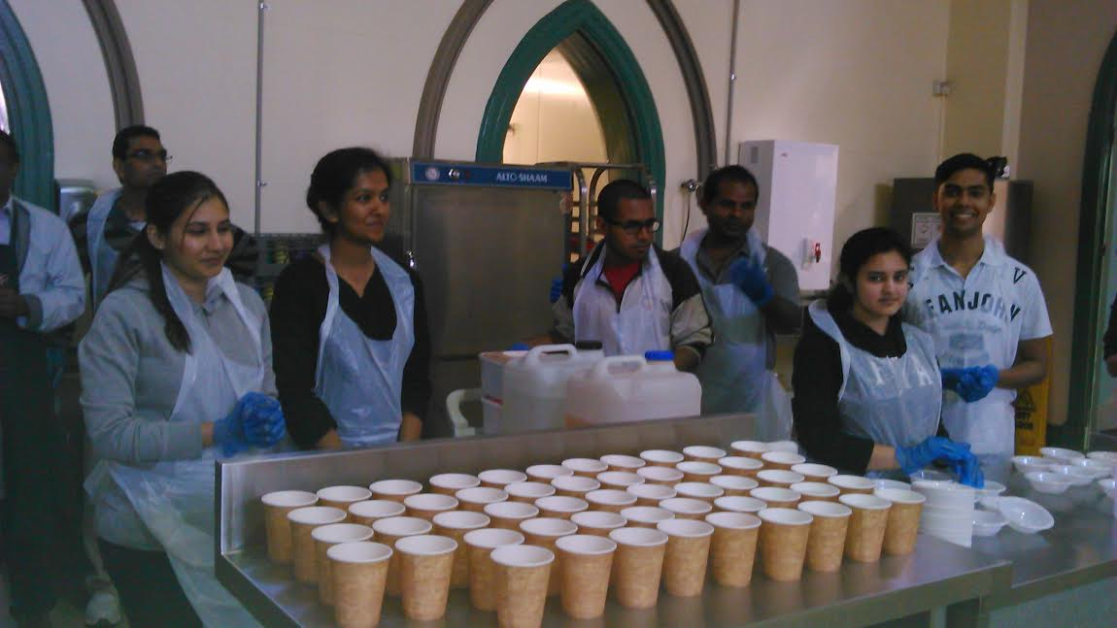
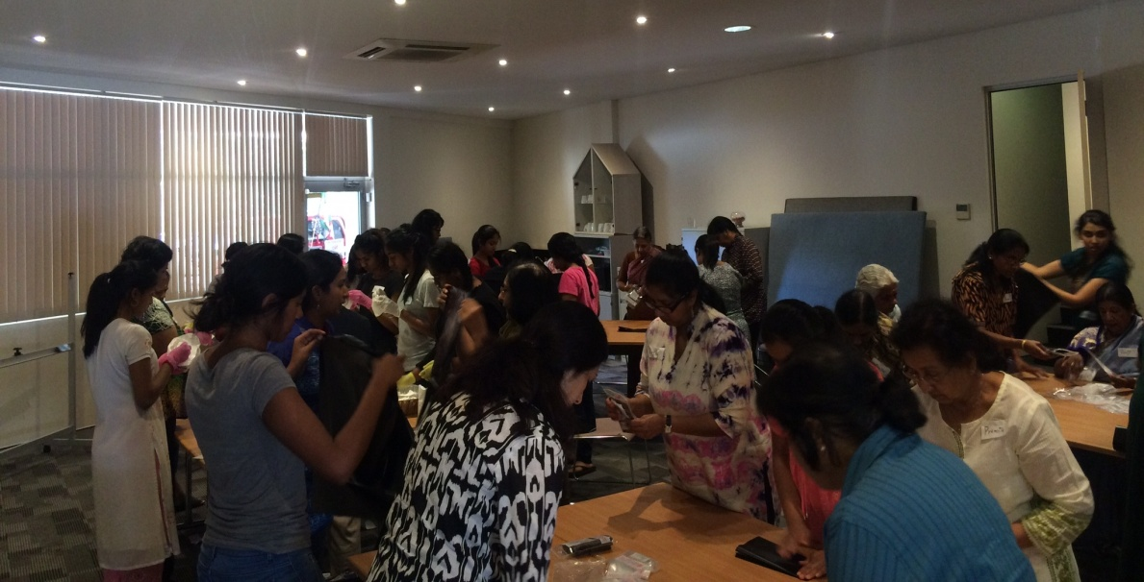
Serve the Planet 2014
Assembly of Birthing kits
Serving meals at Exodus Foundation

Slide 6
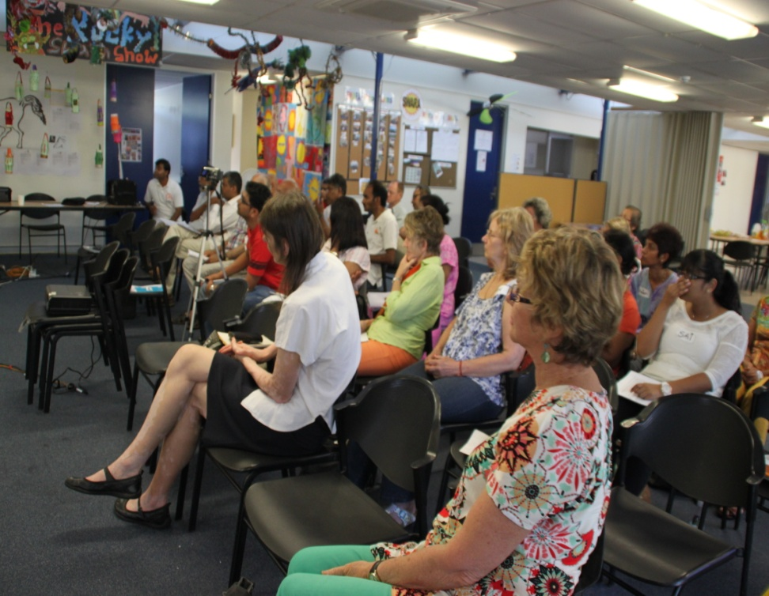
Self Transformation Programme
This continues to gradually expand, and launches have now been held in most regions. Focus now will be on more remote members and groups (Our great challenge in Australia!)
The National Core Team recently held its annual meeting to plan activity for 2015.

Slide 7
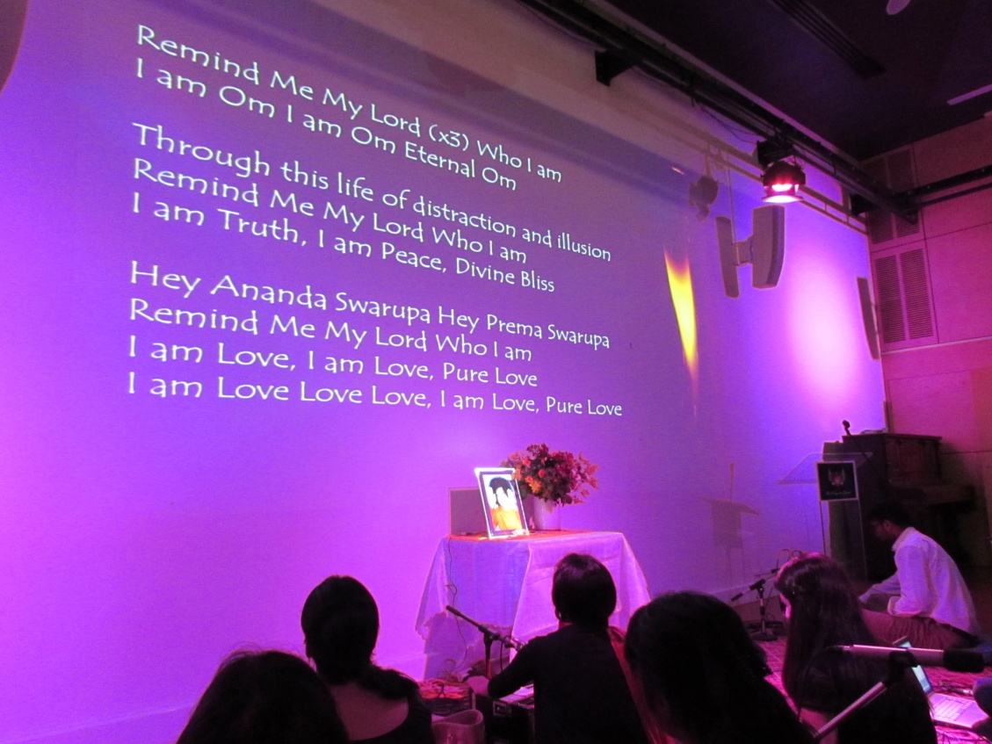
Unity of Faiths
Recent Interfaith service attended by Sai devotees and members of the Wayside Chapel.
Talk on Unity of faiths by minister from the Wayside Chapel and member of the Sathya Sai organisation.

Slide 8

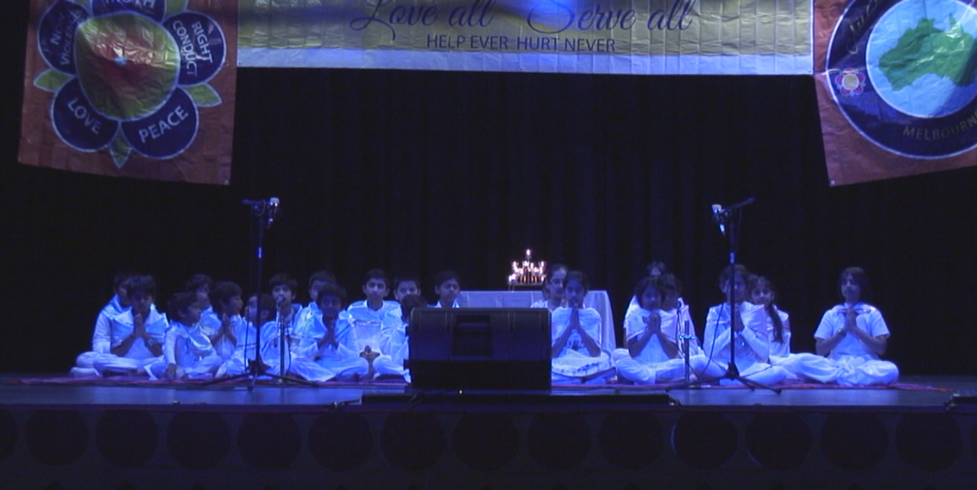
Unity of Faiths
– Connecting through the Language of Music

Slide 9
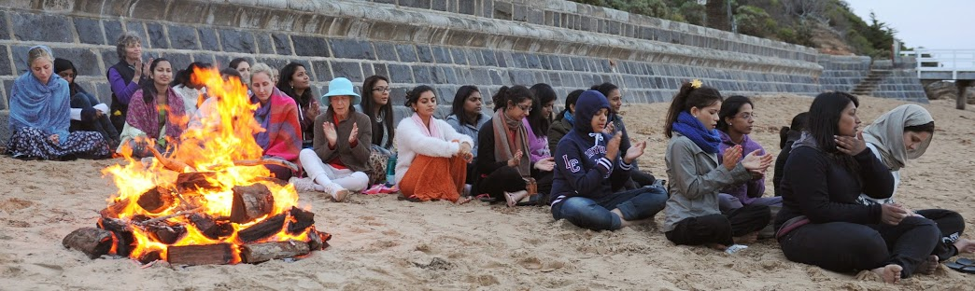
Envirocare – a devotion wing activity
This involves all regions and has been attracting the interest of the young adults.
Activities include reducing our environmental footprint, ceiling on desires, quarterly newsletter.
Understanding and avoiding violence to Mother Earth
Future programme is “Planting for Peace” – incorporating Unity of Faiths and Service.

Slide 10
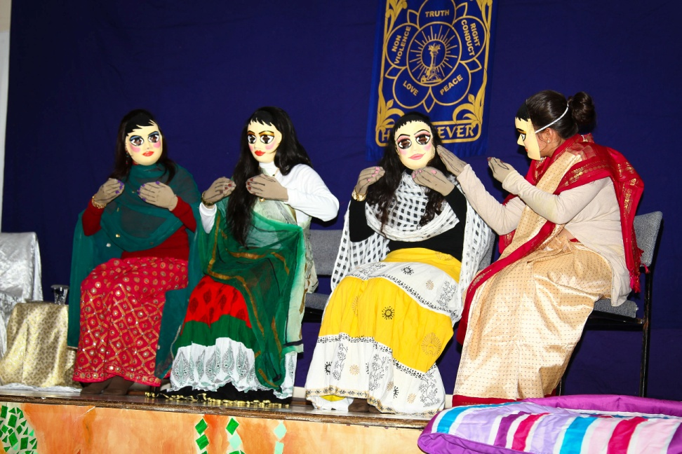
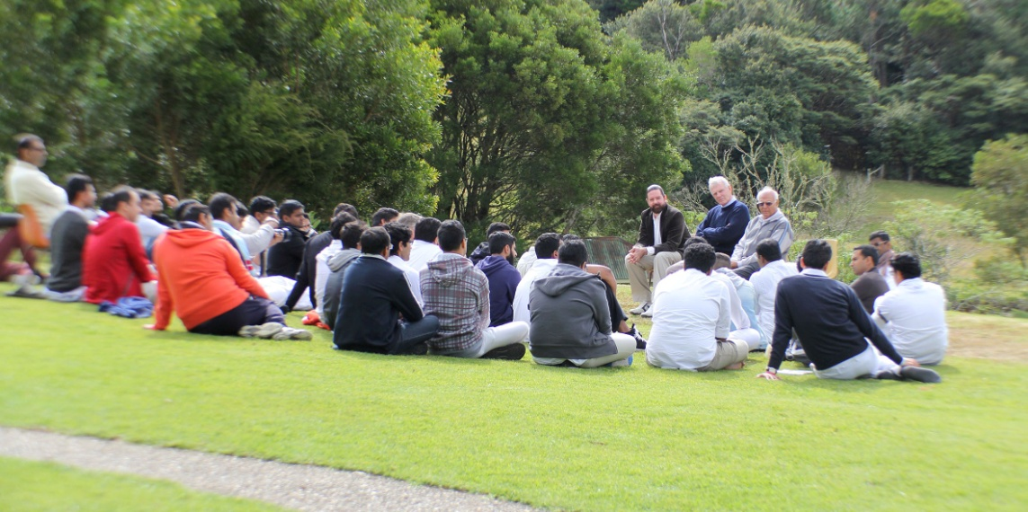
National Youth Retreat
“Sai in the Forest, Sai in Society – Two worlds – One Sai”. 125 participants

Slide 11
Engaging with the Community -Community Television
One of the regions has completed a series for a Community TV station.
The focus was on Sai’s teachings on happiness, involving interviews with different devotees.
Positive feedback was received from the TV station and viewers.

Slide 12

Sathya Sai School

Slide 13
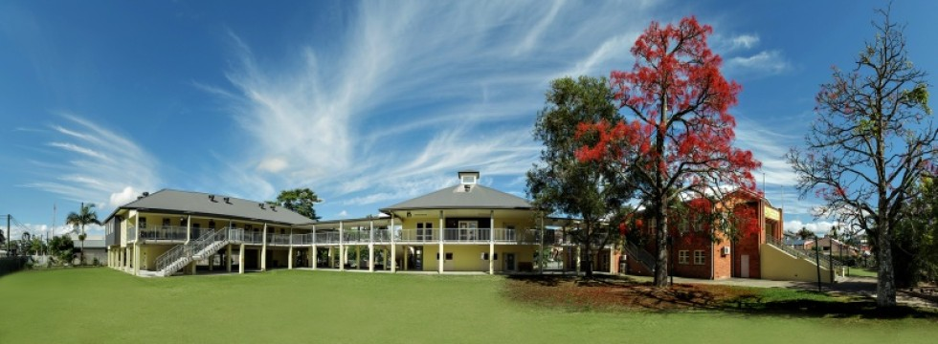
Sathya Sai School Australia
Our Primary campus at Murwillumbah

Slide 14
Highlights
- With Blessings of Swami, the School commenced in 1997
- Classes from Kindy to Year 6
Centrally located in Murwillumbah, Northern NSW, which is a low socio-economic area
New building, play grounds and state of the art classrooms
- Will be called Primary campus of Sathya Sai School

Slide 15
Highlights
-
- Over 95 % of the students are from
‘Non-Sai’ families
- Cost per student(2014) is $10,000(approx), $7,500 from government, balance from devotees
- Follows NSW curriculum with values integrated
- Maximum capacity is 170 students
currently 126

Slide 16
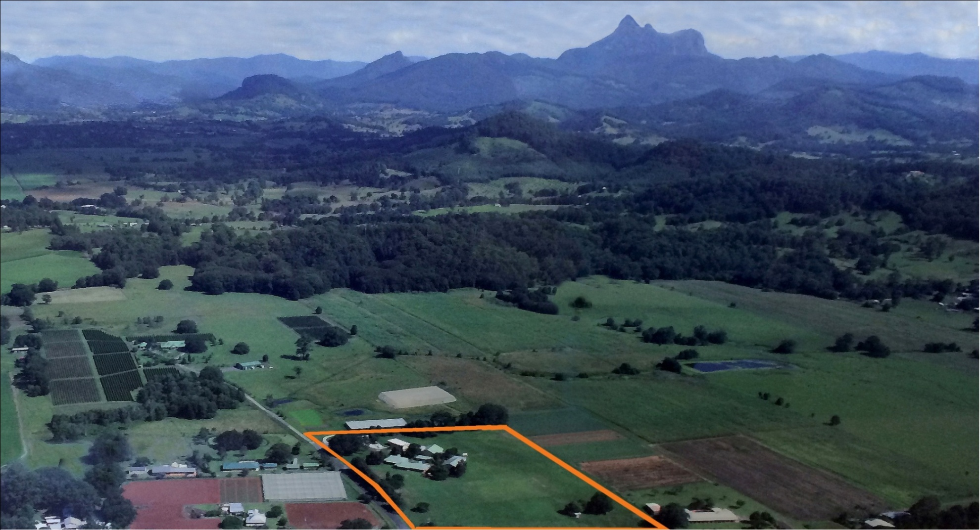
The new secondary school campus for Years 7-12

Slide 17
          Highlights
          - By Swami’s grace, and with the support of SSIO members, a Secondary School campus was acquired in Sept 2014
          - The 10.5 acre property was originally developed as a School for about 100 students from K – Year 8
          - Aim is to commence in 2016 with two streams of years 7 & 8 – project management team is working towards this target date.
          - To achieve this we need a new hall, specialised classrooms, and other capital works, extra funding required for this purpose

Slide 18
          Highlights
          - Will include Teacher Training facility to take EHV to schools around Australia, with involvement from ISSEA
          - Cost per student is $14,700(approx), $11,000 per student is expected from the government
          - By Swami’s grace, hopeful of having a full capacity primary and secondary schools by year 2020

Slide 19
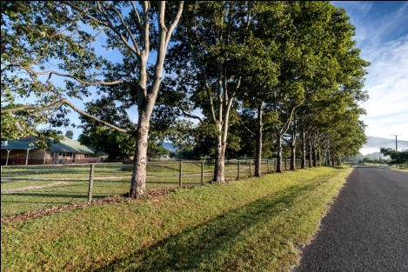
On the left, the new secondary campus from the approach road

Slide 20
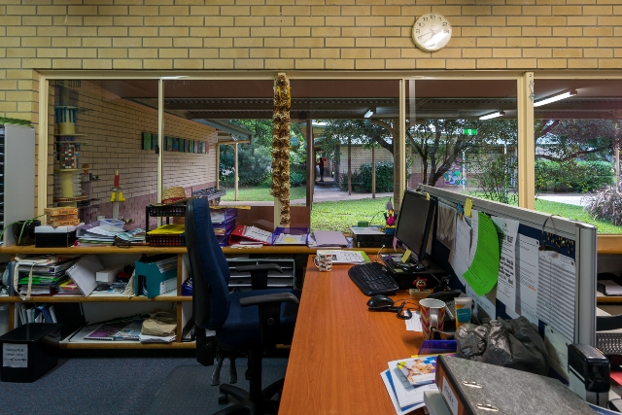
The Main Office

Slide 21
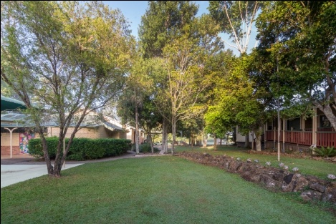
The Central Courtyard

Slide 22
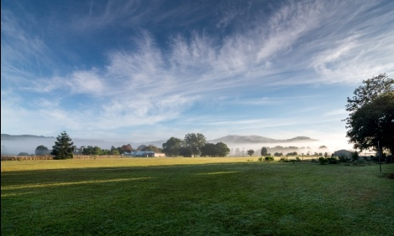
Playing fields and expansion area

Slide 23
NEW ZEALAND

Slide 24

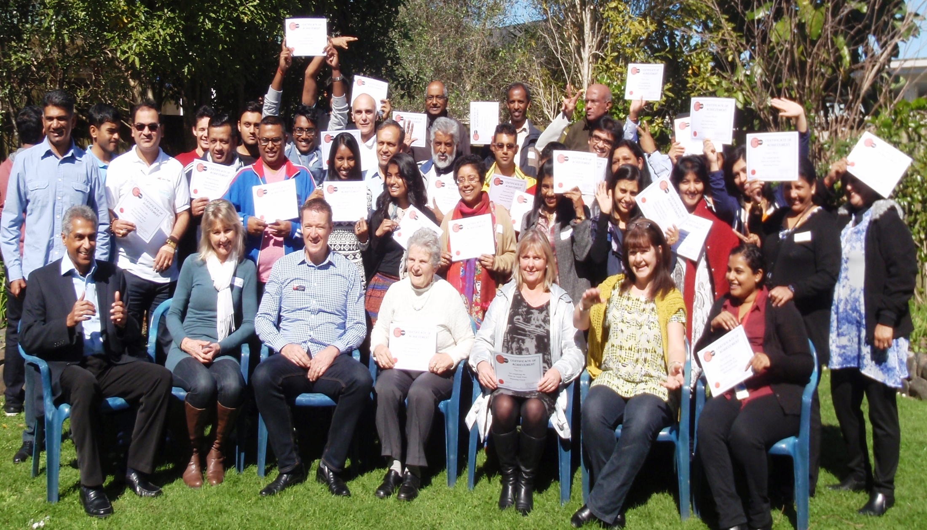
Youth Mentoring – Graduation
40 Sai Members trained to mentor vulnerable youth. In the year to June 2014 in New Zealand, 547 people committed suicide.
In the 15 to 19-year-old age group, there were 80 suicides

Slide 25
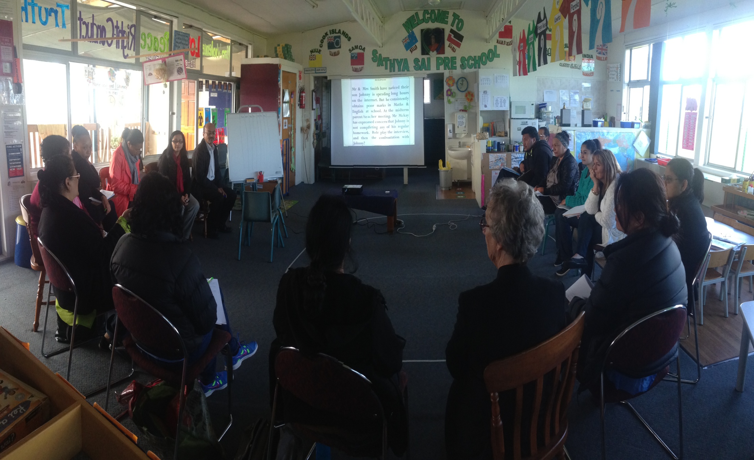
Human Values in Parenting - 35 people (including 9 staff from the
Sathya Sai Preschool) completed course.

Slide 26
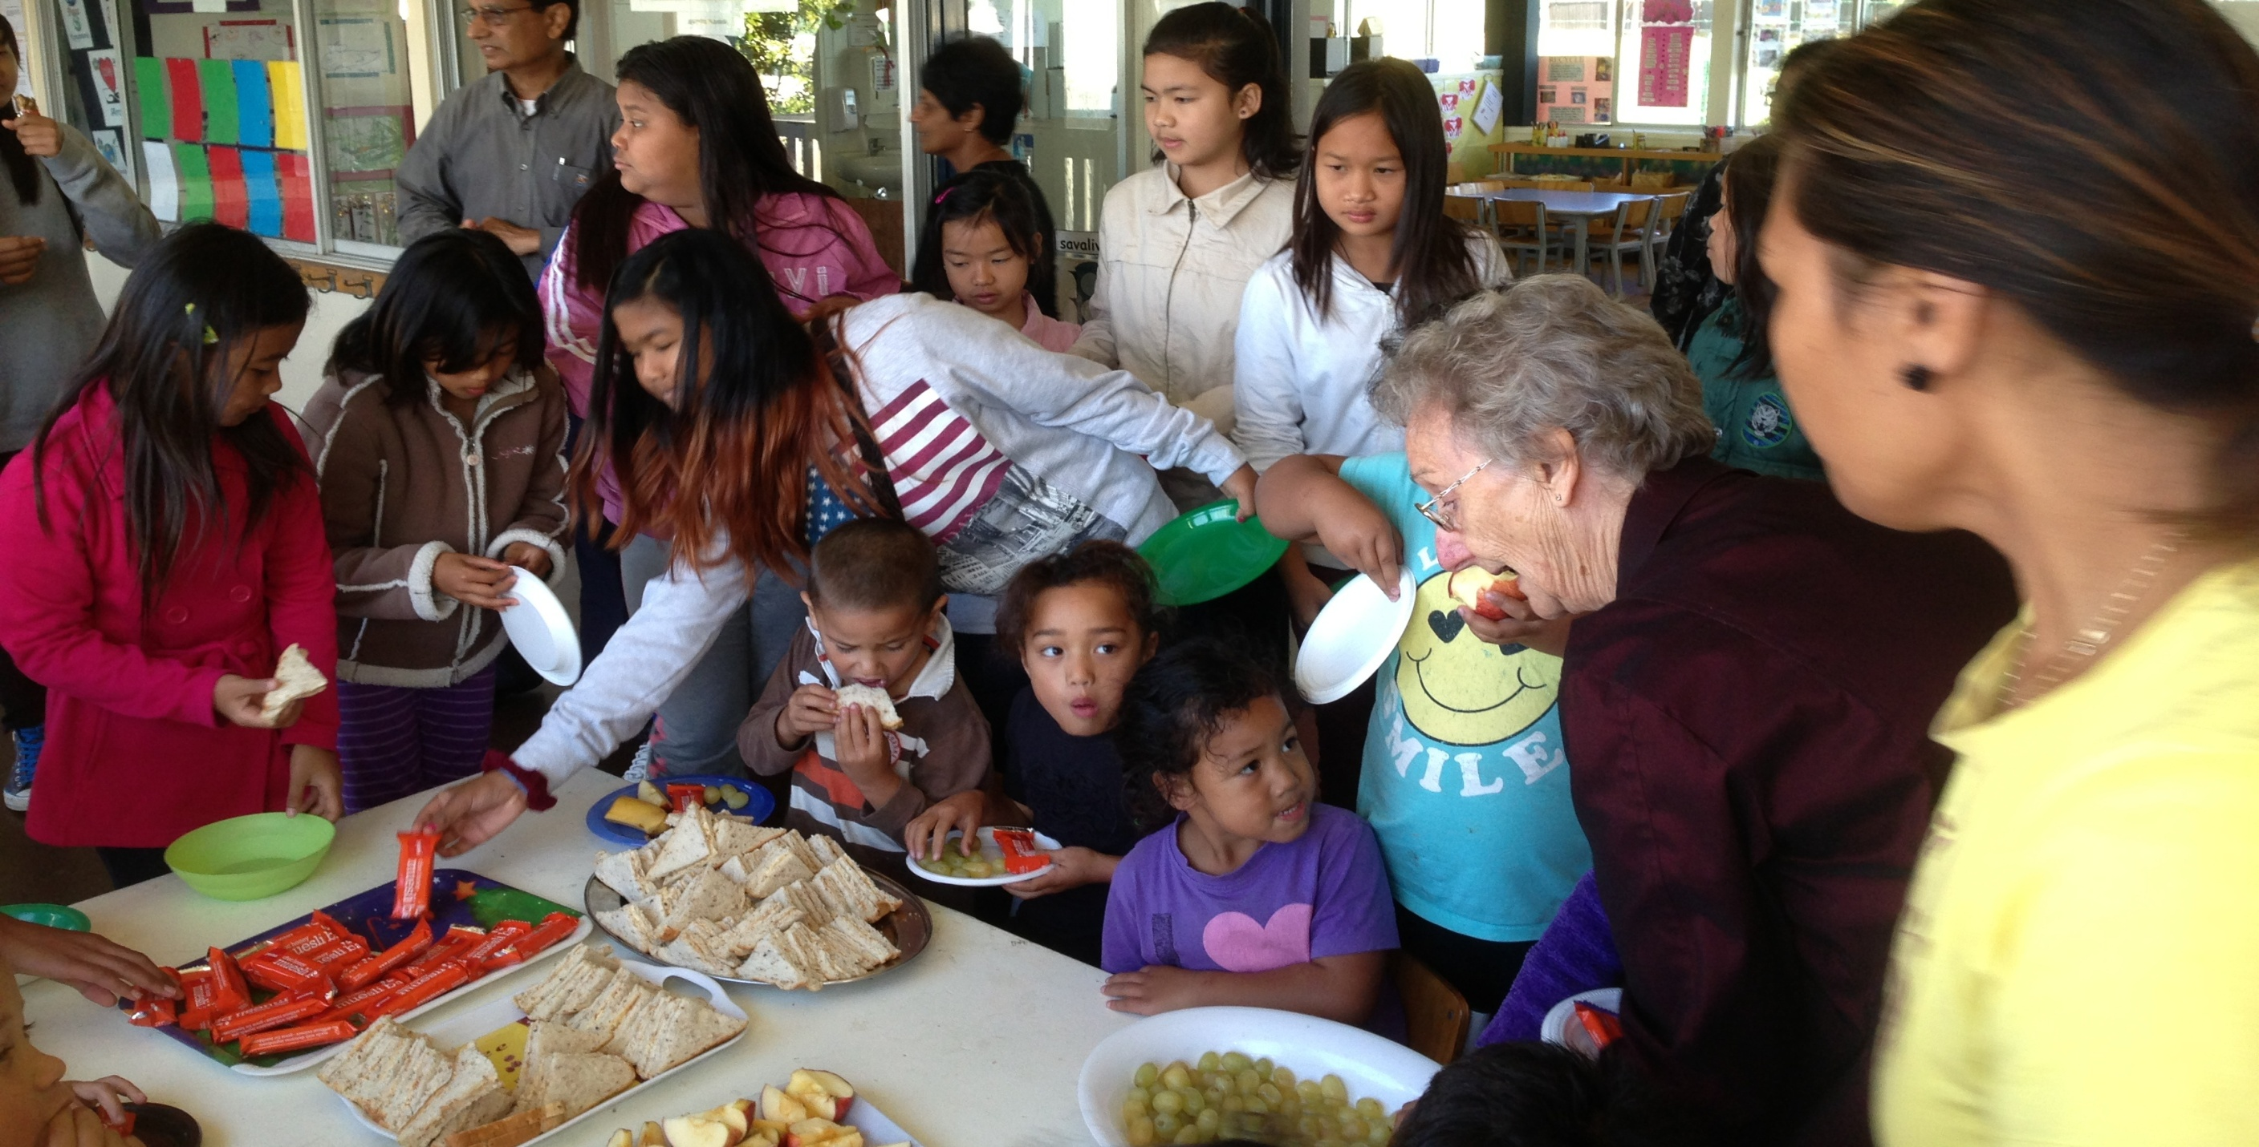
COMMUNITY ADOPTION PROGRAM (CAP)
HELPING CHLIDREN WITH THEIR SCHOOL FOUNDATION

Slide 27
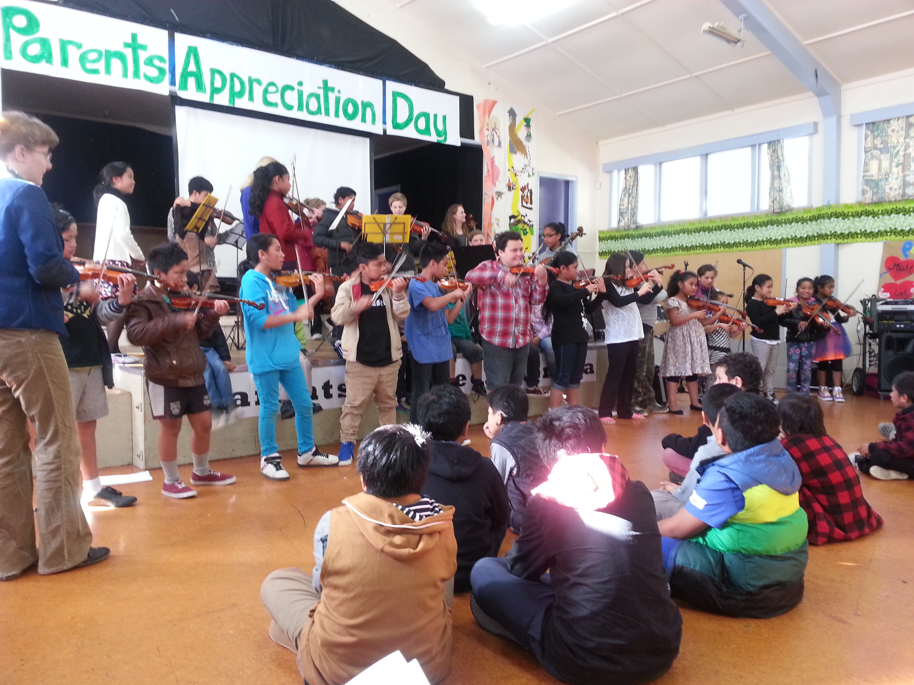

Slide 28
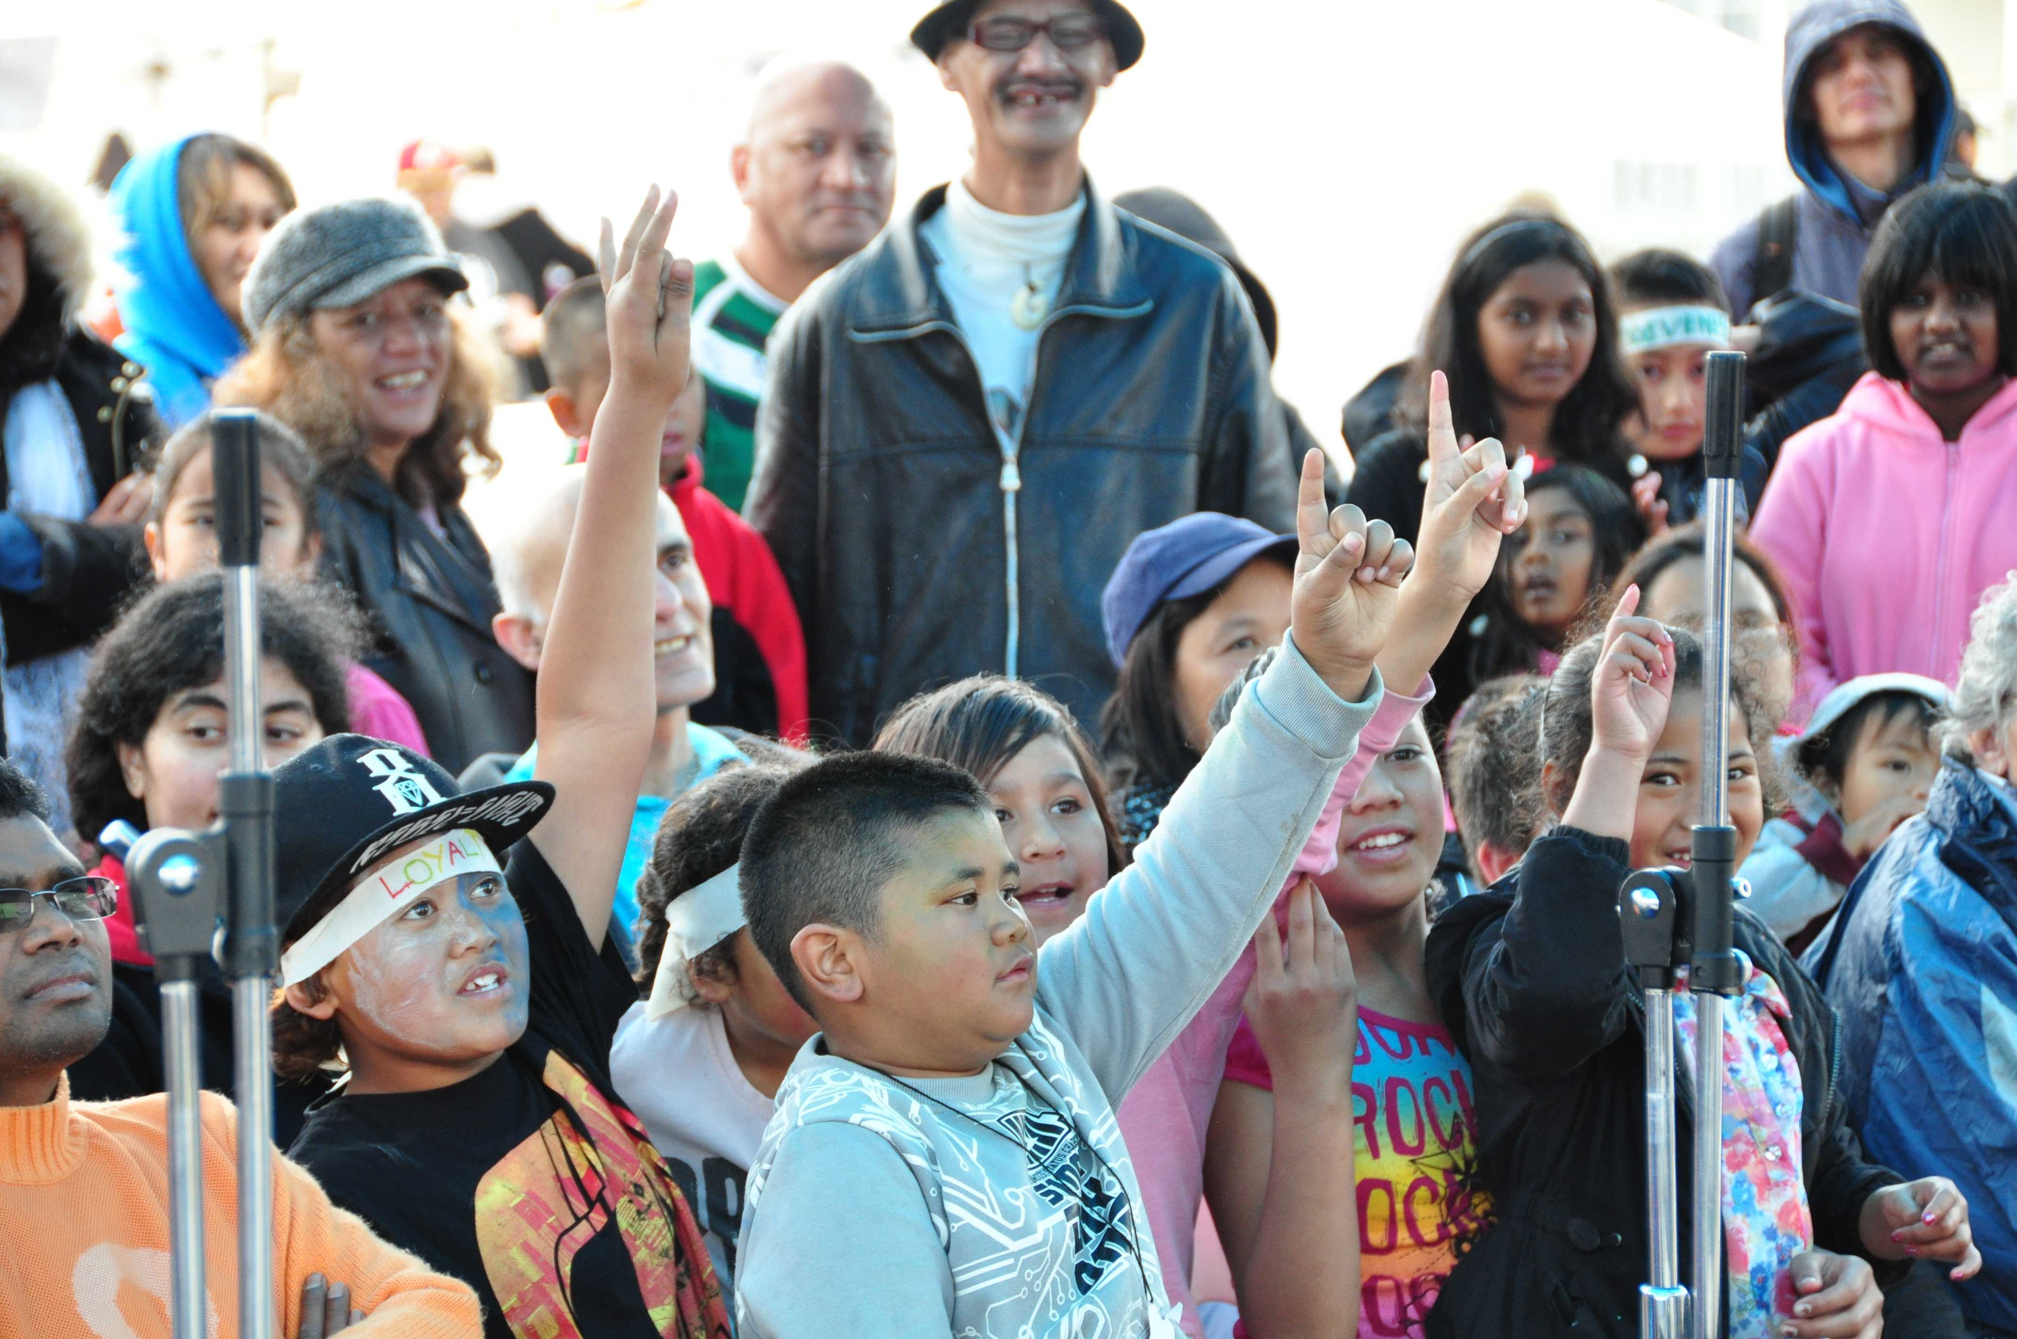
Avatar Declaration Day – attended by 300 people
Free Food & Medical, HV Stalls & Posters, Entertainment, Maori & Pacific Island Cultural Items, Fire Safety , Fun Activities & Games

Slide 29
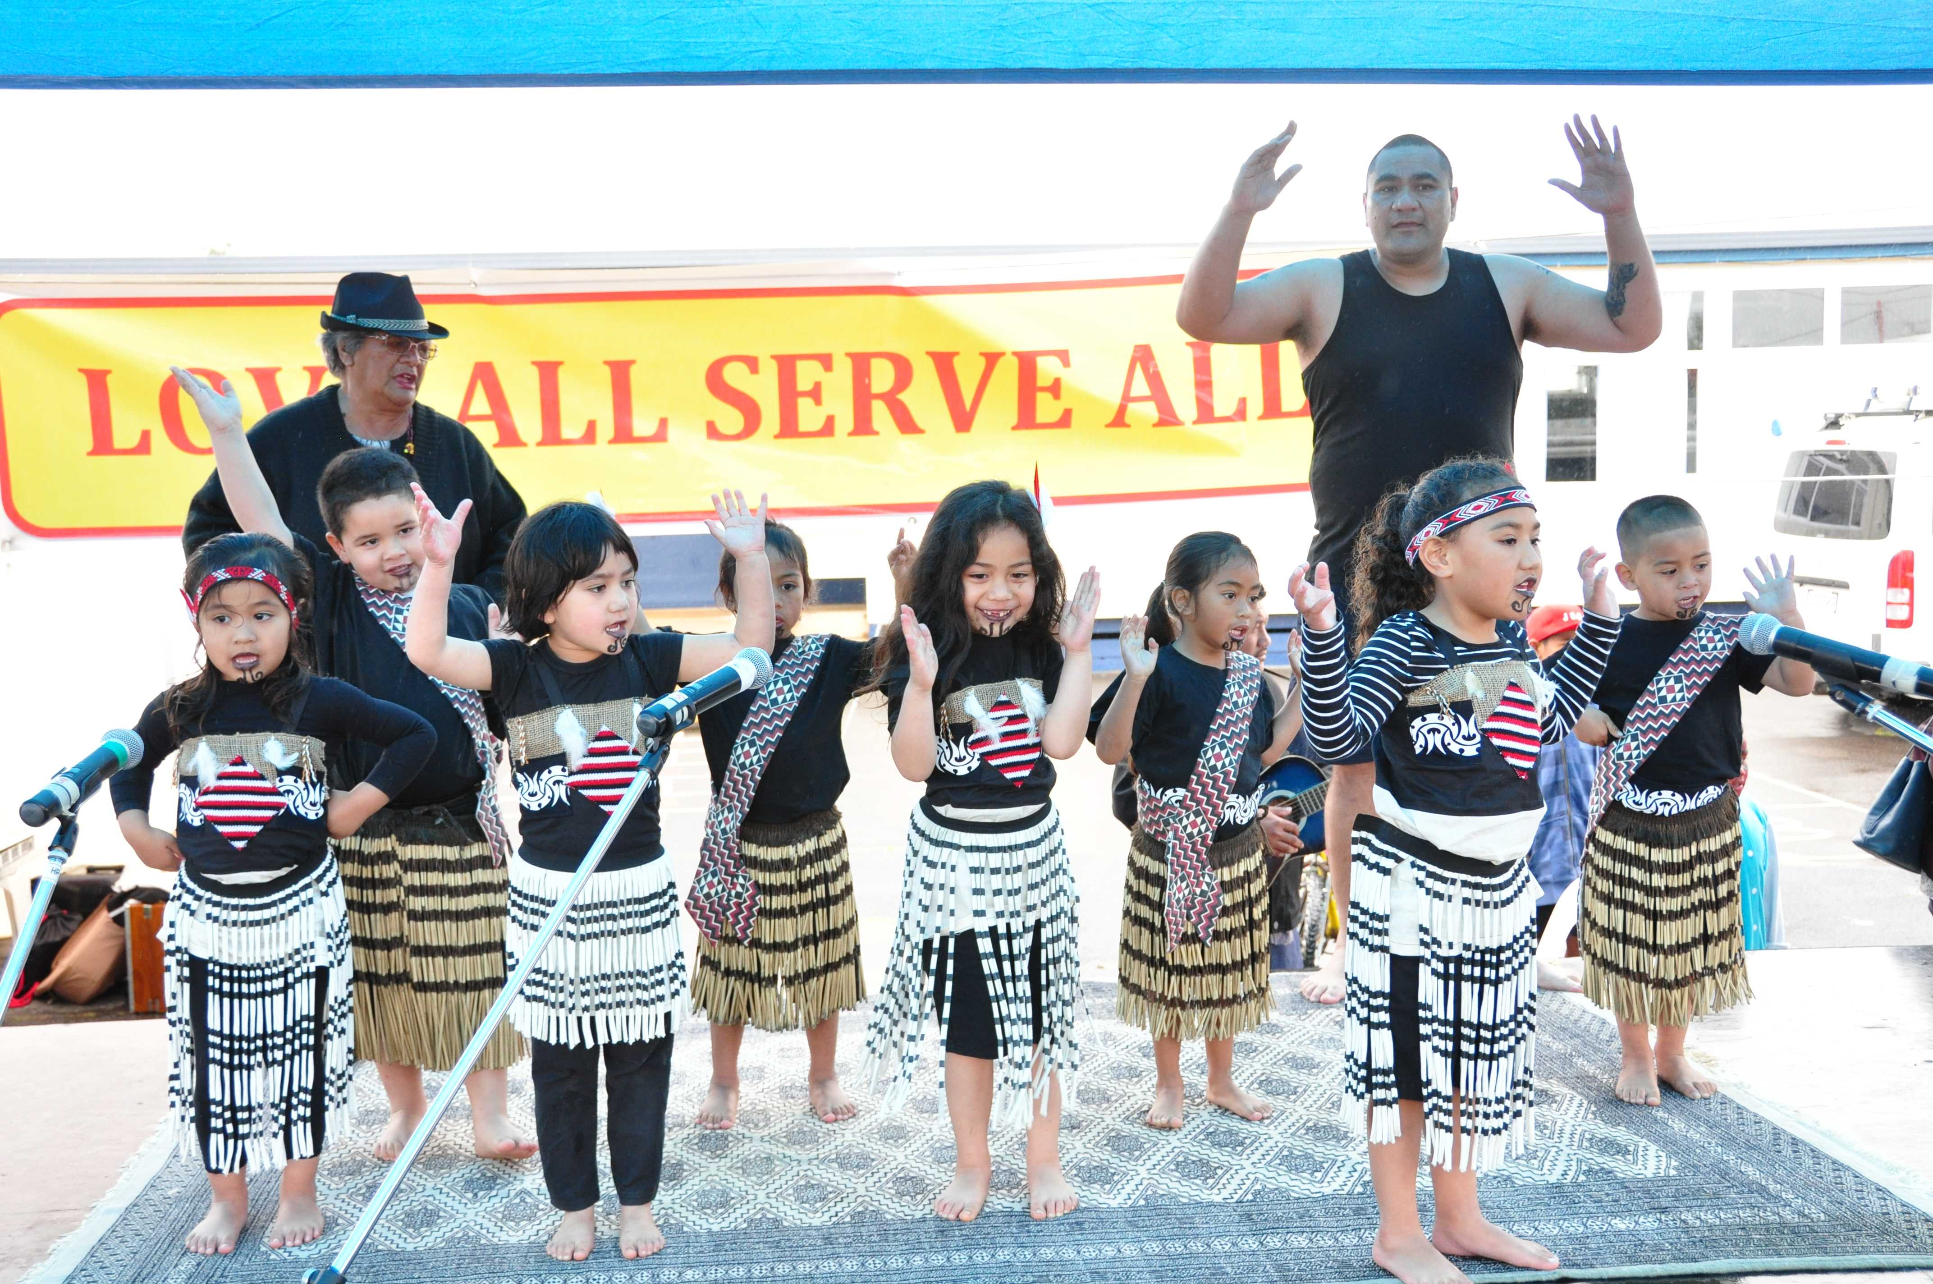
Avatar Declaration Day – attended by 300 people – Free Food & Medical, HV Stalls & Posters, Entertainment, Maori & Pacific Island Cultural Items, Fire Safety , Fun Activities & Games

Slide 30
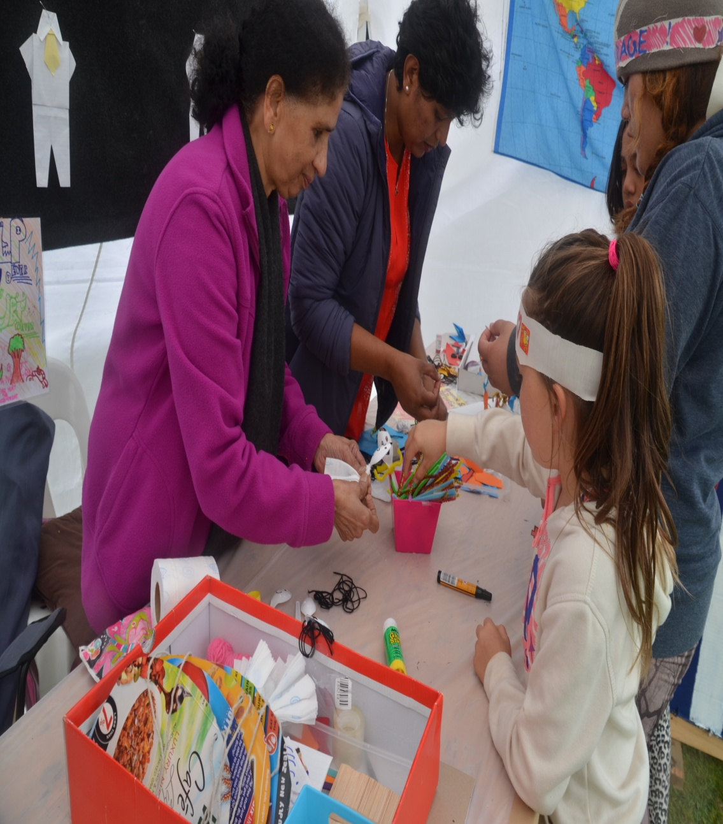
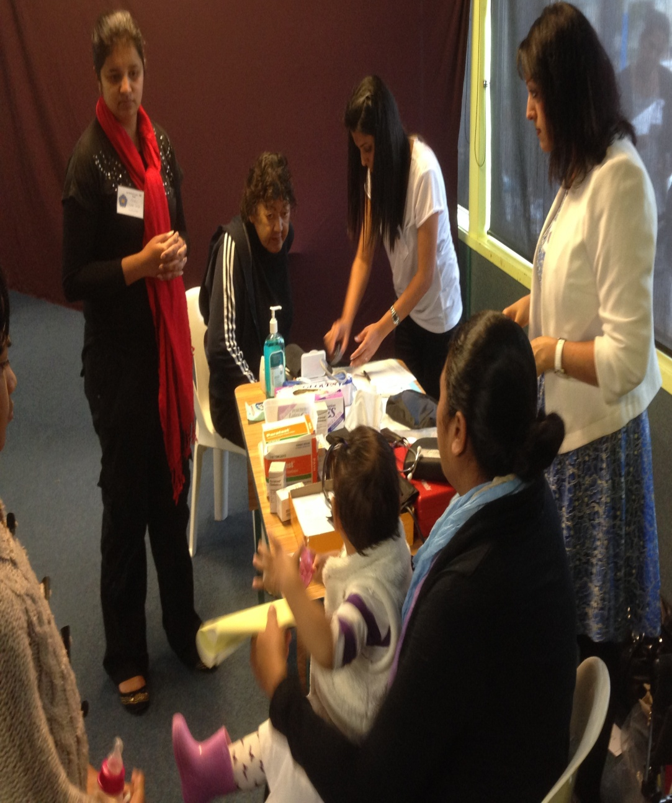
Avatar Declaration Day – Human Values Stalls and Free Medical

Slide 31
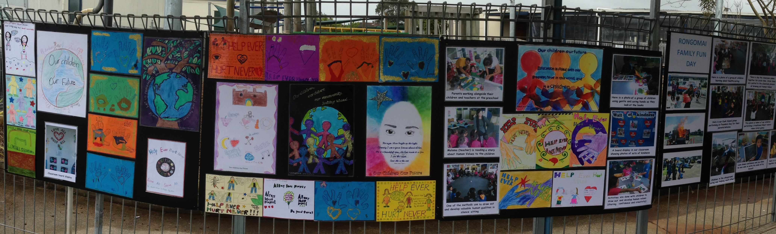
Avatar Declaration Day-
Human Values Posters

Slide 32
Planned Initiatives
A final session to develop the National Vision and Strategy Plan will be held in December.
Certificate in Adult Education Course for Trainers & Facilitators – Dec 2014 to March 2015
Plan to deliver own ISSE Intermediate & Parenting Programs in late 2015 / early 2016
Ongoing “Community Adoption Program” and “Mentoring Young People”.
Planning underway for next years 10th Fiji Medical Camp and the National SSE retreat at Easter 2015 themed “Be the Love that You Are”.
Increased focus on Study Circles based on the World Conference Theme on “Love and Selfless Service” – Big Challenge!

Slide 33

FIJI
Sathya Sai International Fiji
Incorporated under the Charitable Trust Act Cap 67

Slide 34
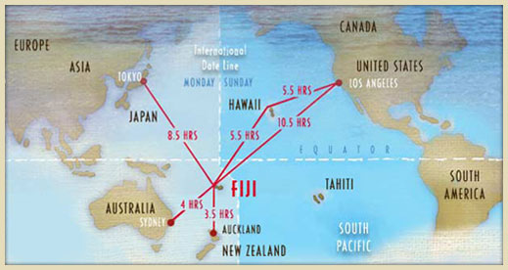
Fiji’s location in the South Pacific
Isolated.
Some 16 continuous hours of flying from Bangalore, 4 & ½ hours from Sydney , and 4 hours from Auckland, NZ.

Slide 35
Membership
Members 18 years and older 173
Youth numbers 55
Issues
Aging membership
Youths migrating

Slide 36
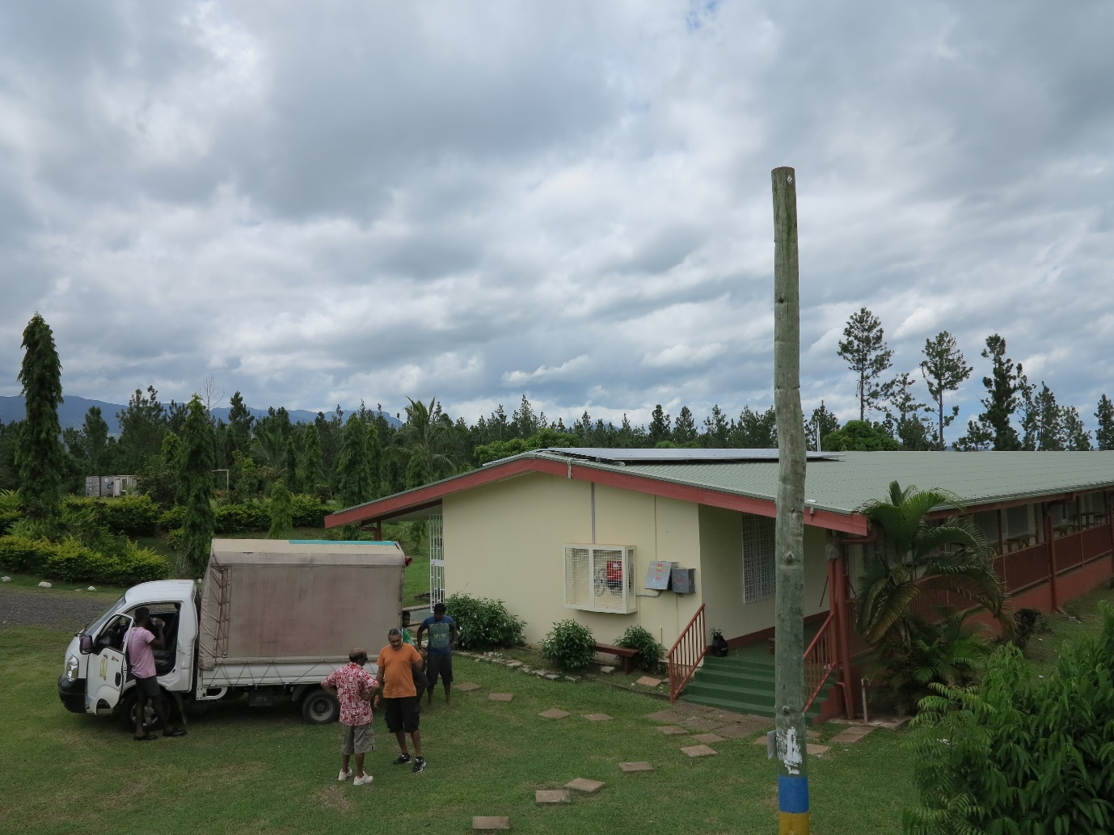
Solar Power Received for School 2014

Slide 37
Initiatives: EHV
Principals’ Conferences on EHV - Directed by Ministry of Education
Teacher In Charge at the Schools EHV also invited for workshop

Slide 38
Initiatives: Service
60 Street dwellers provided with lunch, blankets & clothes
Two medical camps organised with local doctor input
Medical Camp by NZ held 5 to 10 May
Medical Camp by Australian devotees held August 18 to 21
Joint medical conference Fiji/Australia on Men’s Health held on 17/8/14
Blood drives were held in various parts of Fiji & collected 437 pints.

Slide 39
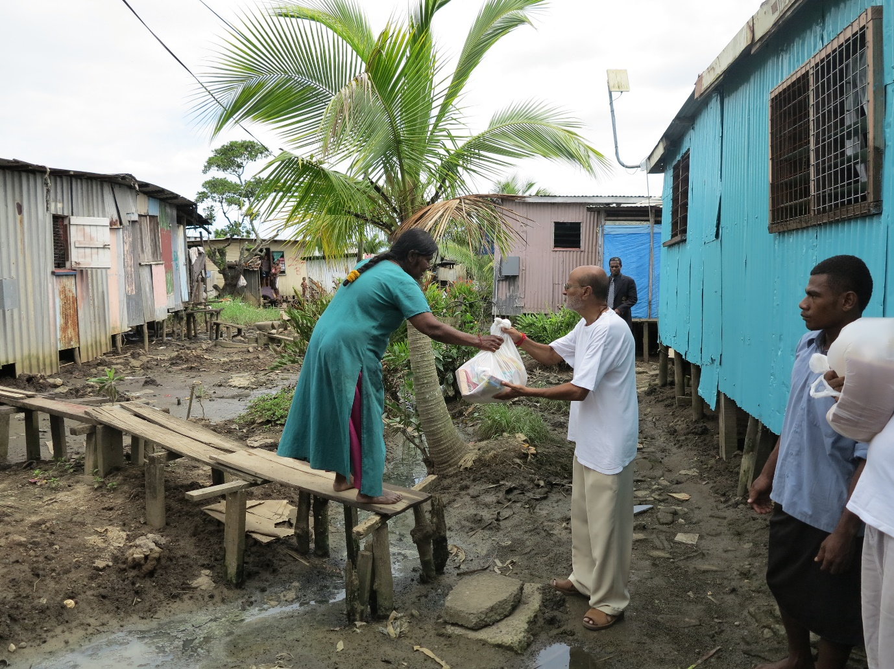
Relief for Flood Victims 2014

Slide 40
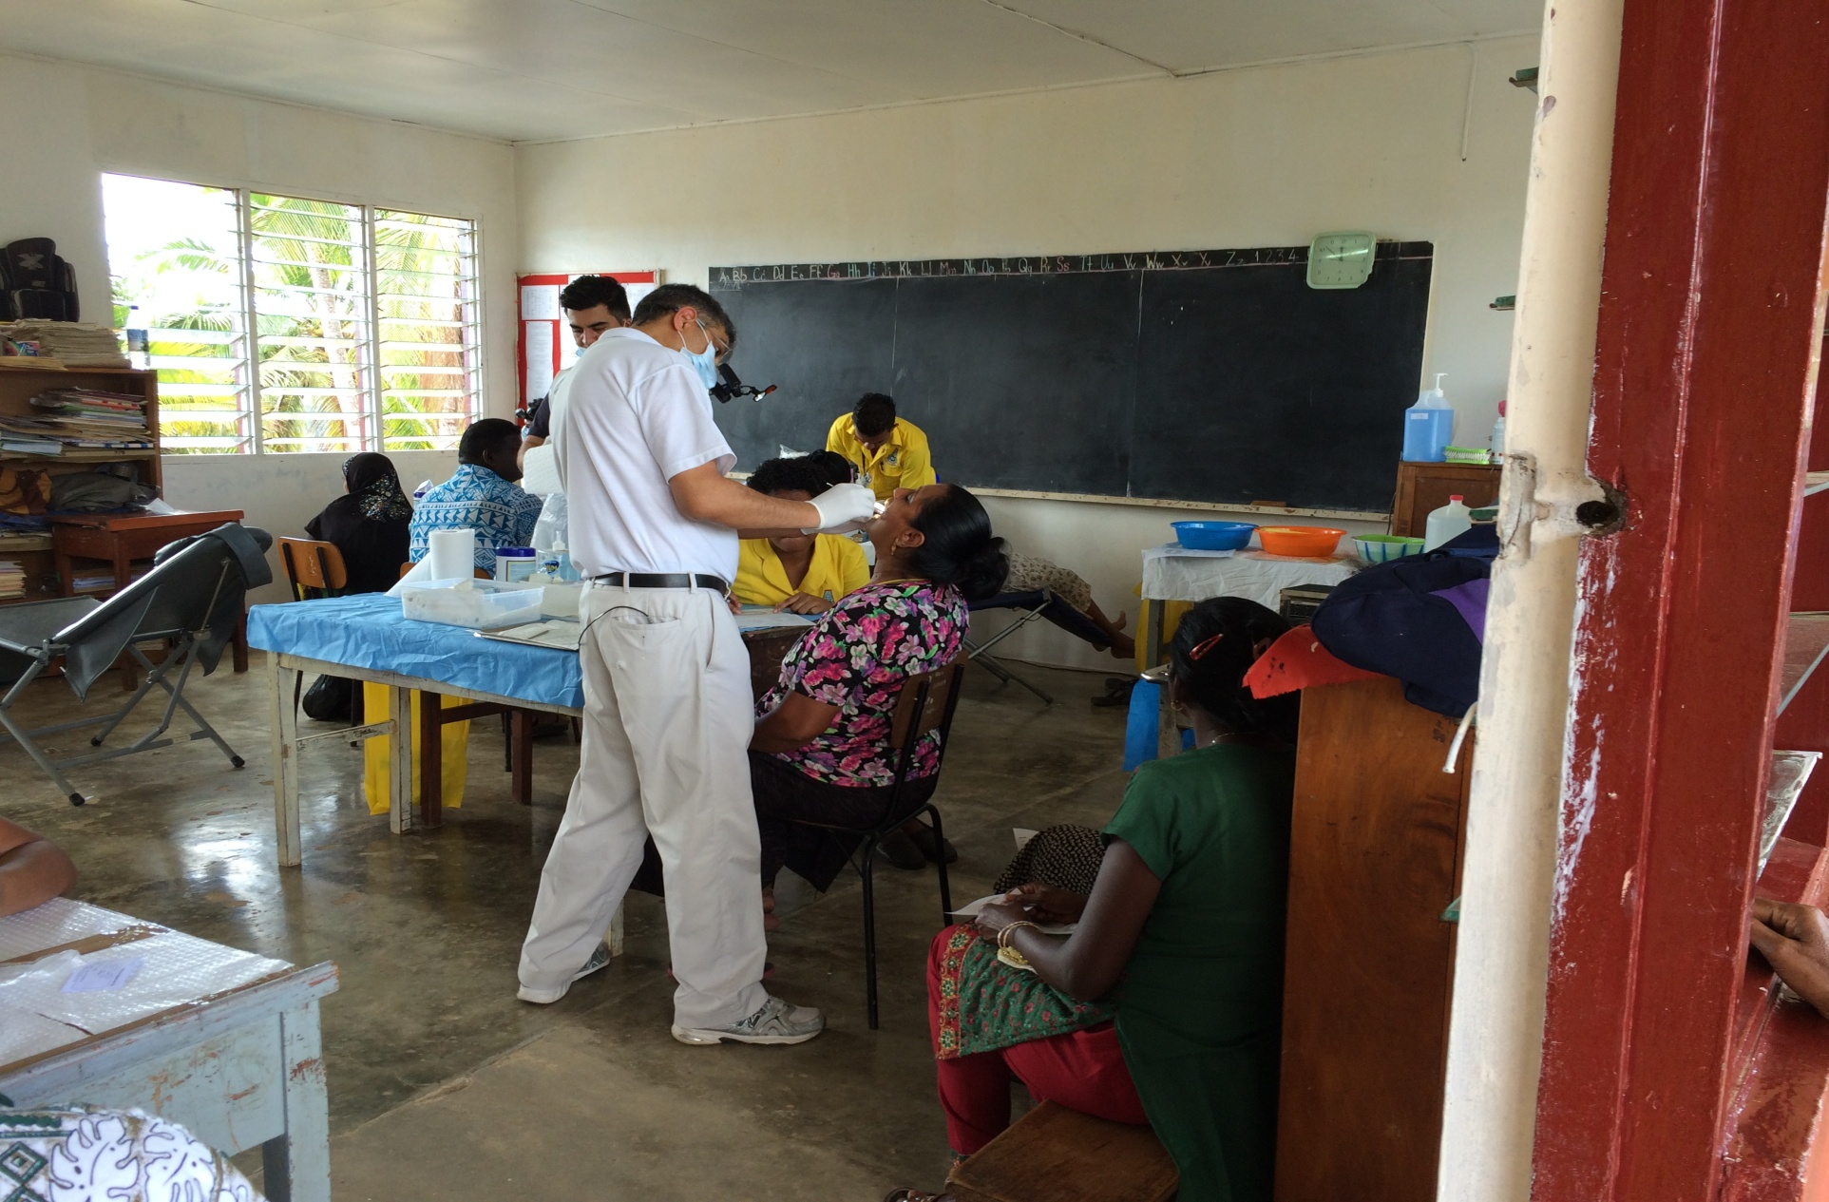
Australian/Fiji Medical Camp 2014

Slide 41
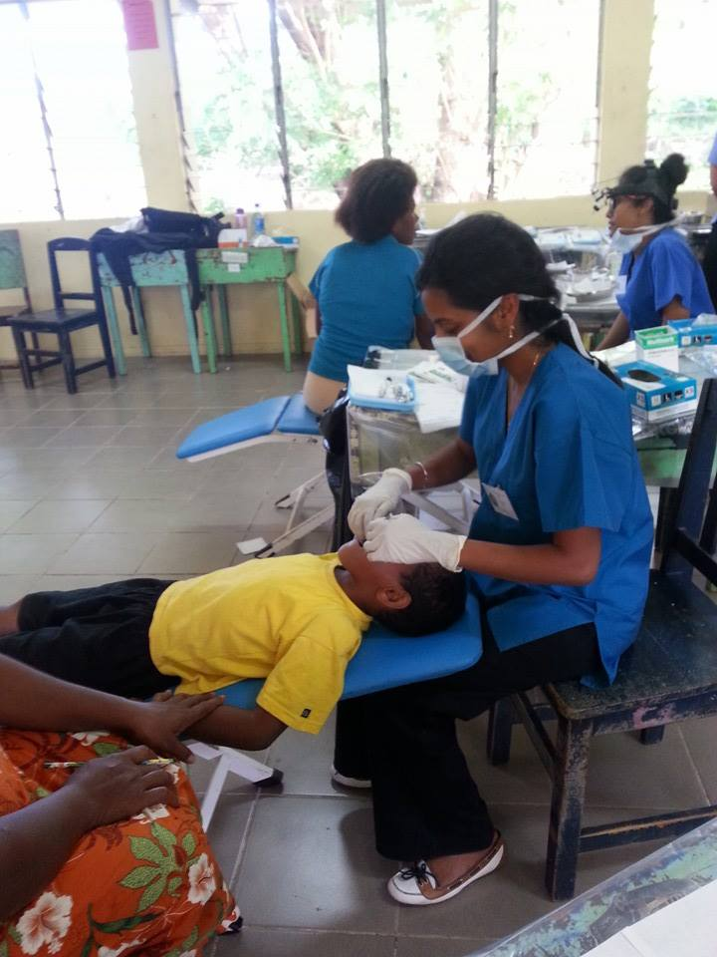
NZ Medical Team 2014

Slide 42
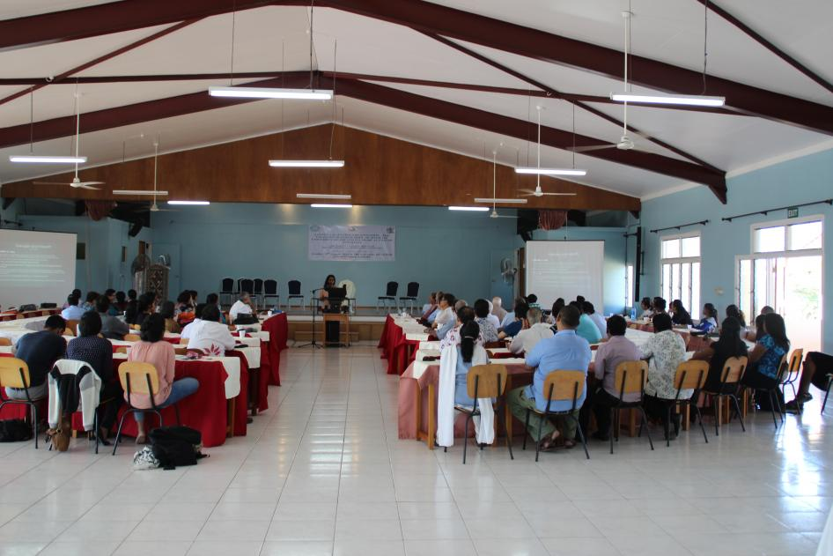
Medical Conference 2014: Aust/Fiji

Slide 43
Devotion Wing
Special prayers were conducted for 2 sick Sai devotees & release of 45 Fiji solders in Middle East.
Two Conferences held.
Participation in Interfaith meetings/prayers.
Participation in Study Circle improving
Regular Bhajans

Slide 44
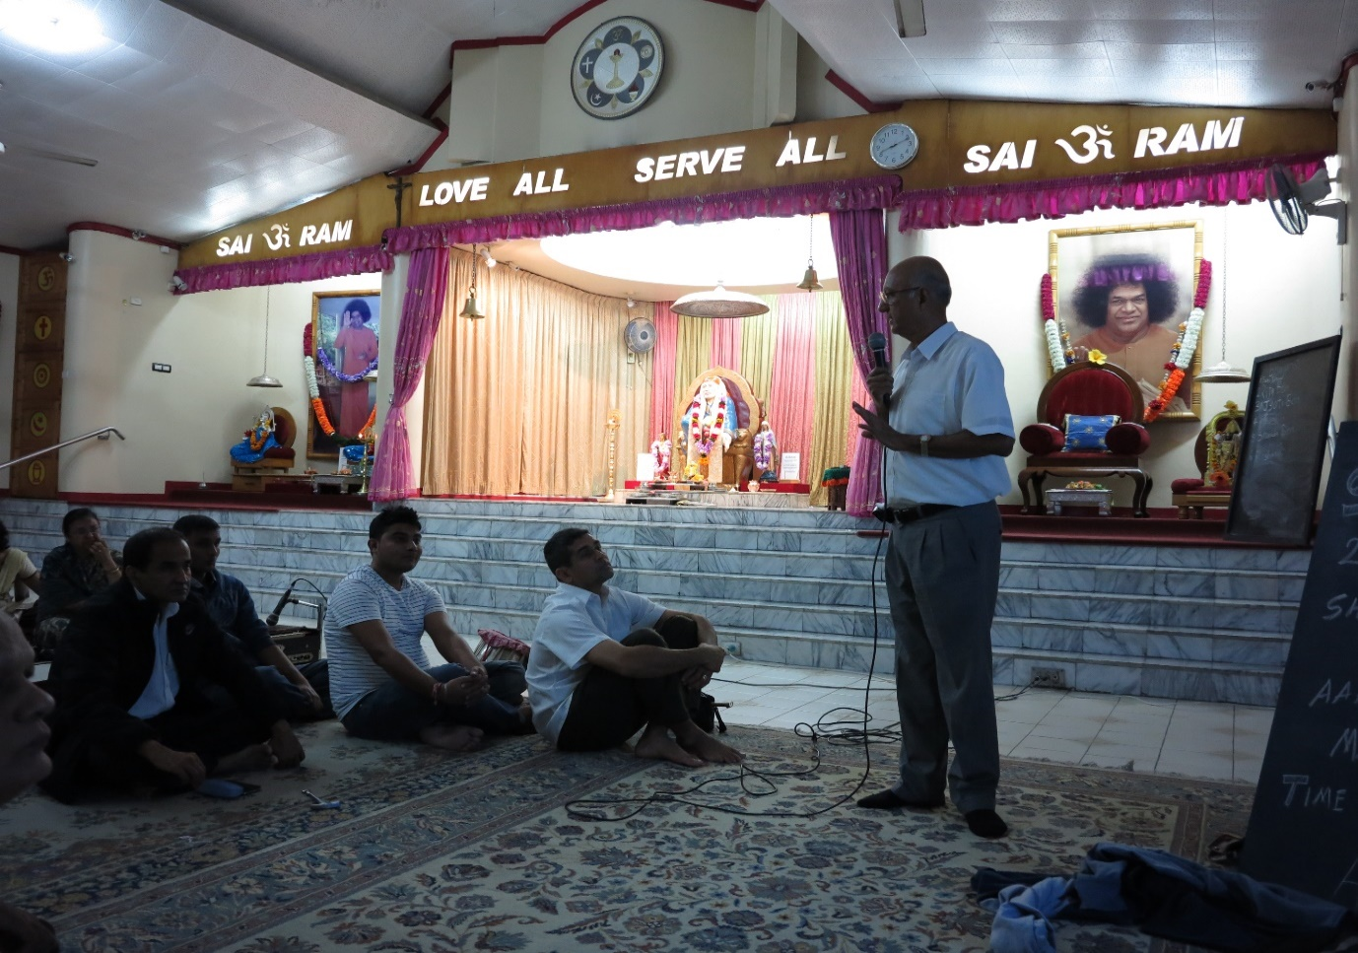
Two Devotional Conferences 2014

Slide 45
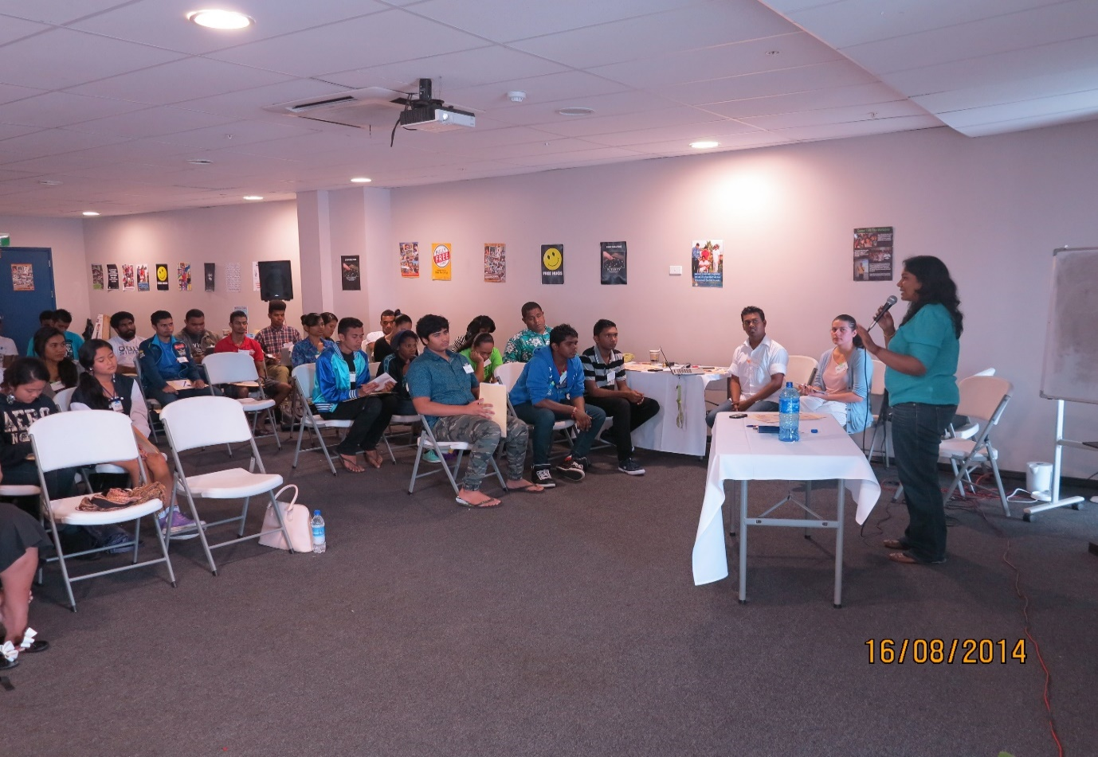
Youth Programme: Mental Health Conference 16/8/2014

Slide 46
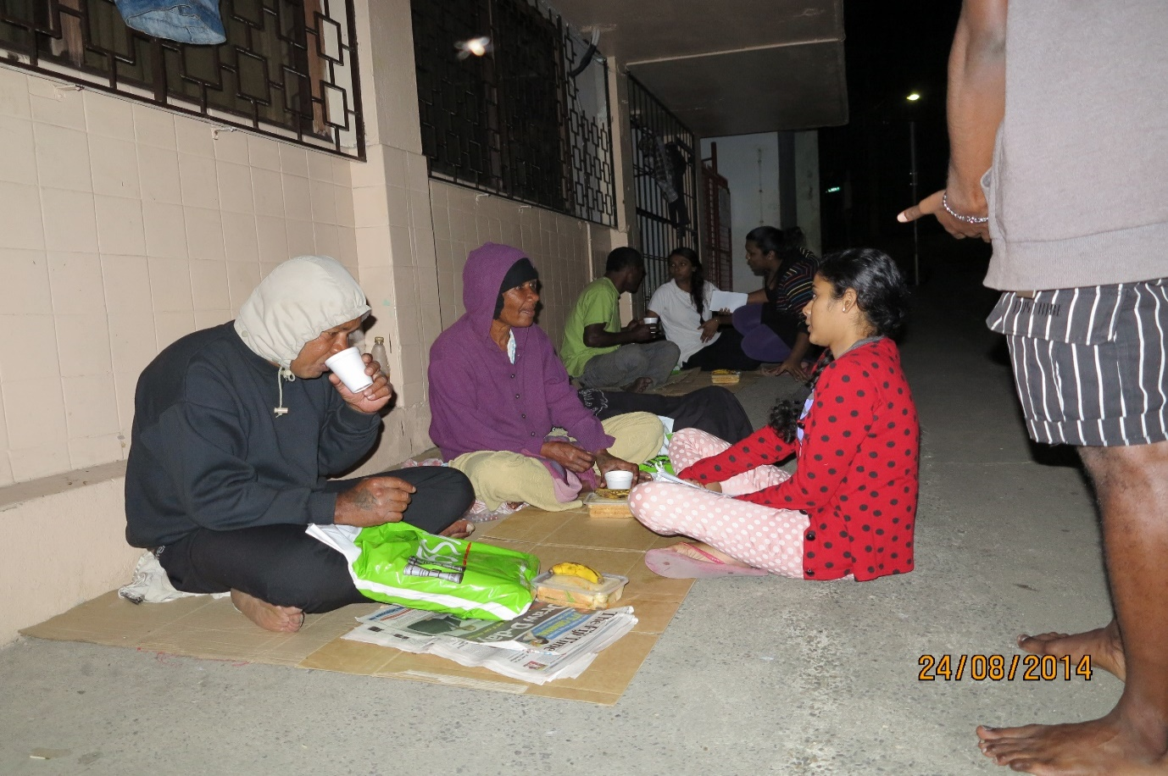
Street Kids: Cared

Slide 47
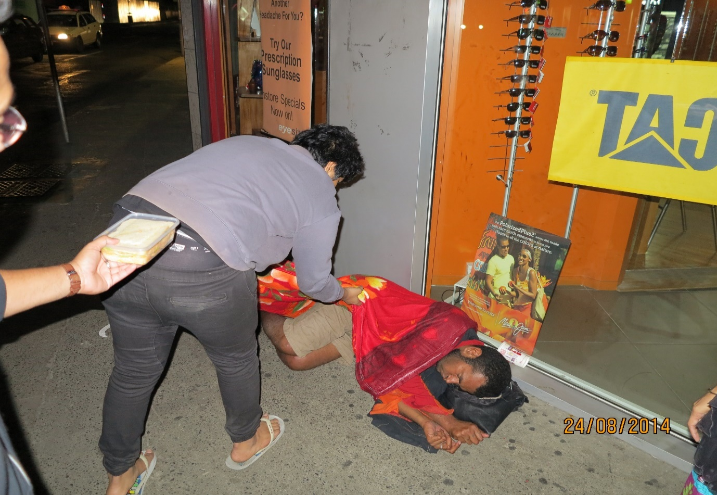
Street Dweller Fed

Slide 48
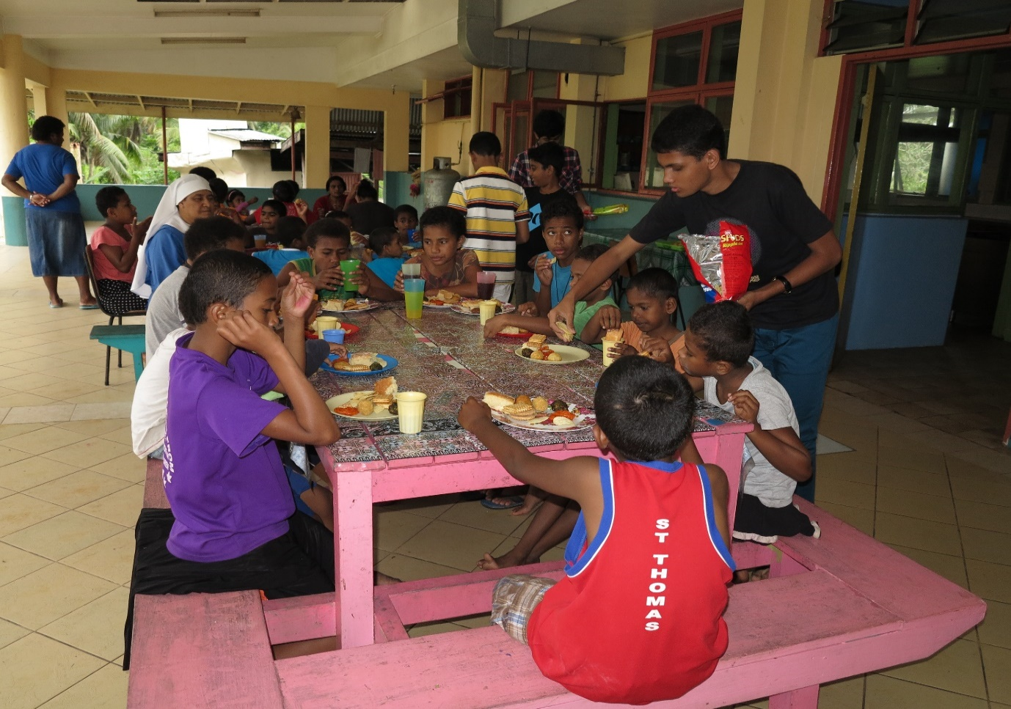
Visit to Orphanage by Youths

Slide 49
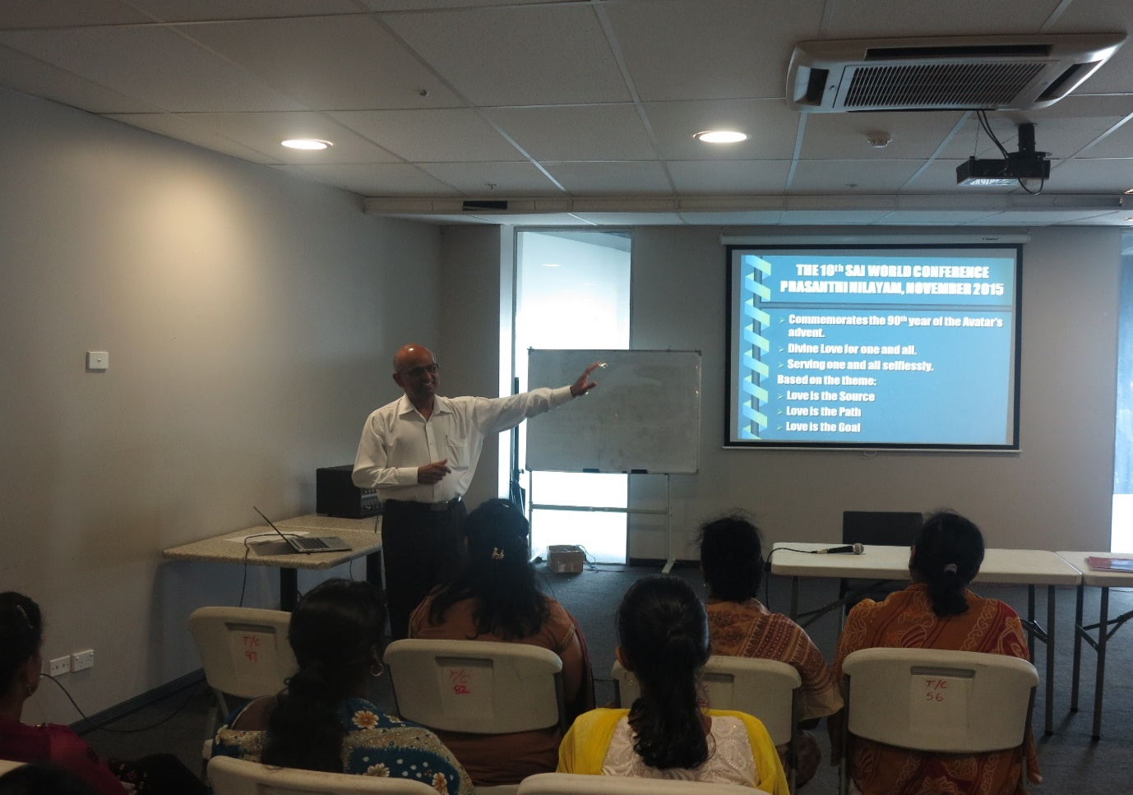
Workshop By Bro Nair from Sydney

Slide 50
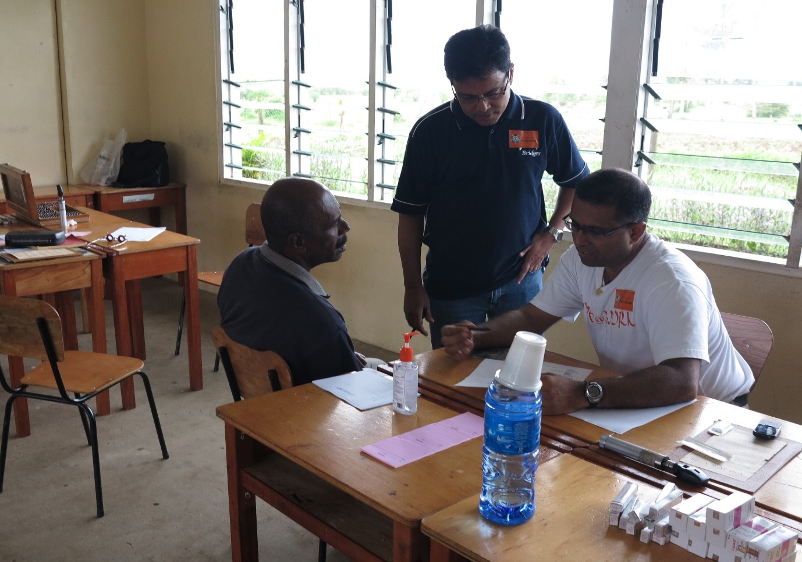
2 Medical Camps with local Doctors 2014

Slide 51
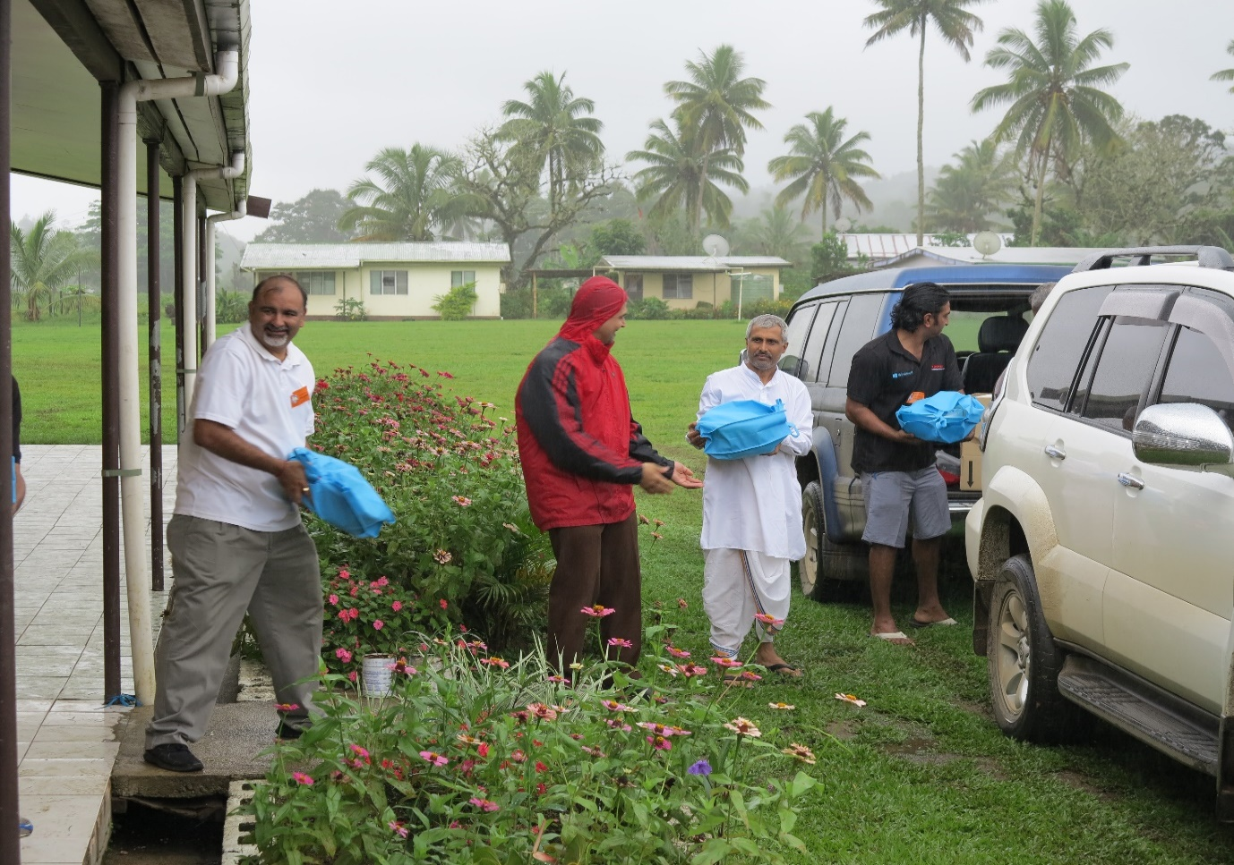
Avatar Day/Diwali Sweets

Slide 52
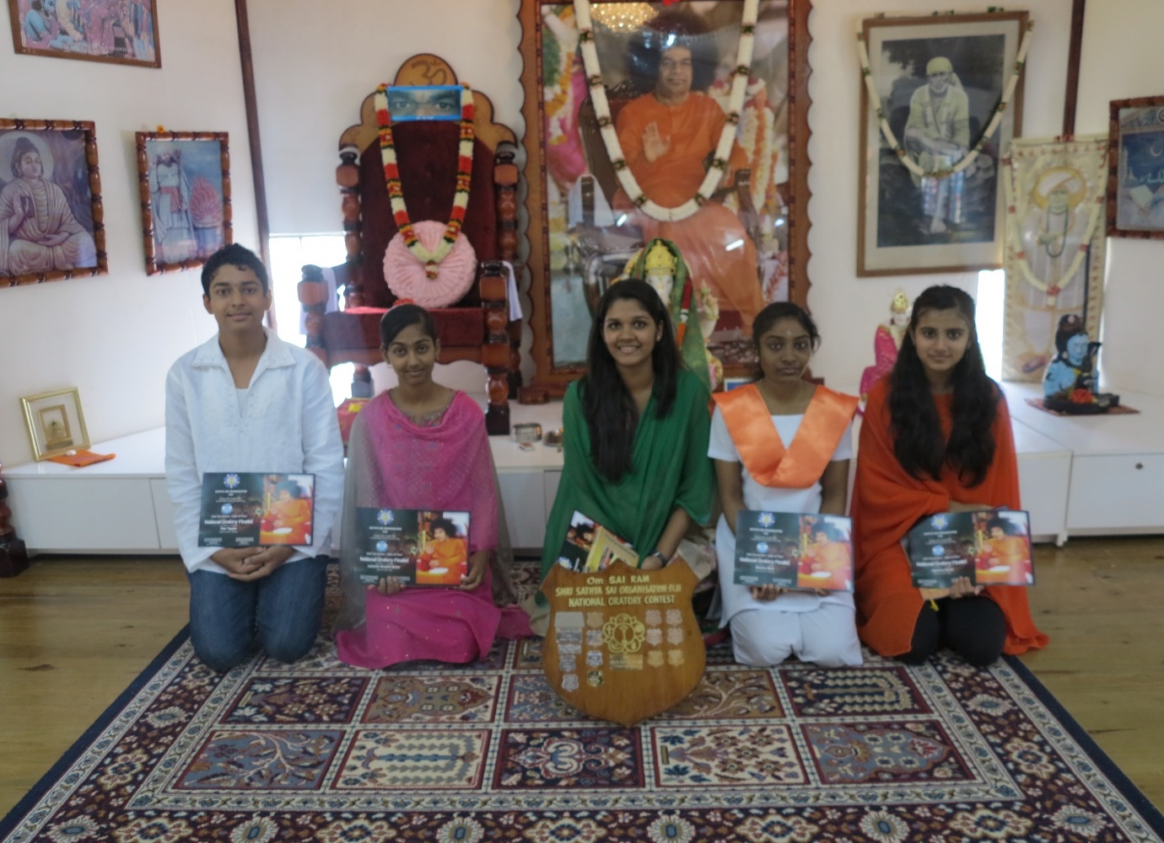
Avatar Day SSE Classes Oratory 2014

Slide 53

PHILIPPINES

Slide 54
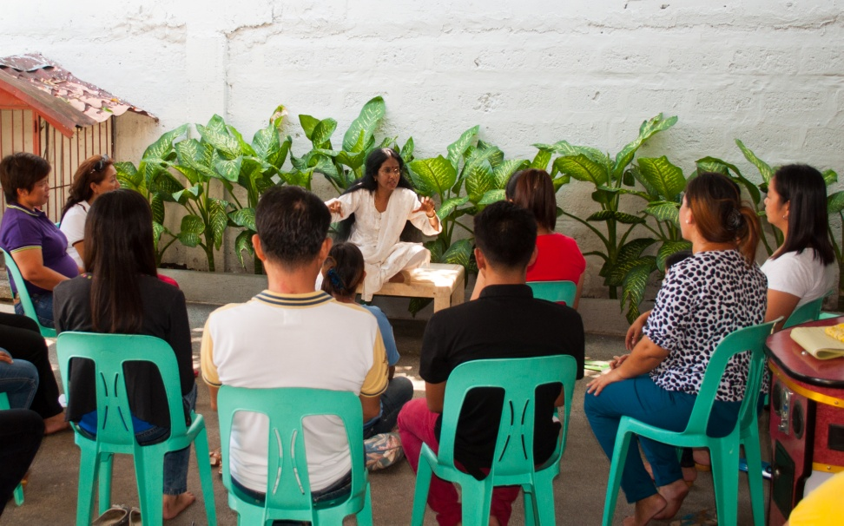
Education in Human Values
(EHV)
Strengthening teacher training in EHV.
Alumni to include values education in their classes.
Introduce human values to Master of Education program.
Notes:
# Strengthening teacher training in vicinity of the ISSE. Will be carried out on Saturday mornings (to ISSE guidelines) and will be recognized by the Commission of Higher Education. 20 to 40 teachers in each batch.
# Seek to gather the alumni of the ISSE to help the trainee teachers integrate the values into their classroom environments.
# Introduce human values into the core curriculum of the Master of Education program of the University of Muntinlupa.

Slide 55
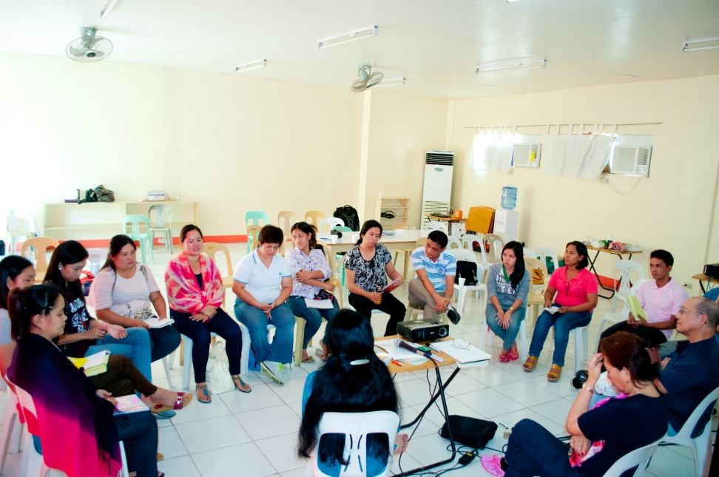
EHV (continued)
Introduce human values to Bachelors in Education Program.
Teachers Involve Parents in School (TIPS).
Partner with local groups for parenting workshops.
Notes:
# Introduce a similar program into the Casa del nino Training College for Bachelors in Education so that each licenced teacherwill be mandatorily trained in Human values.
# Initiate TIPS (Teachers Involve Parents in School) by strengthening the community around the school.
#Partner with a local hospitel to conduct parenting workshops for families with parenting problems and for “ soon to be parents”.

Slide 56
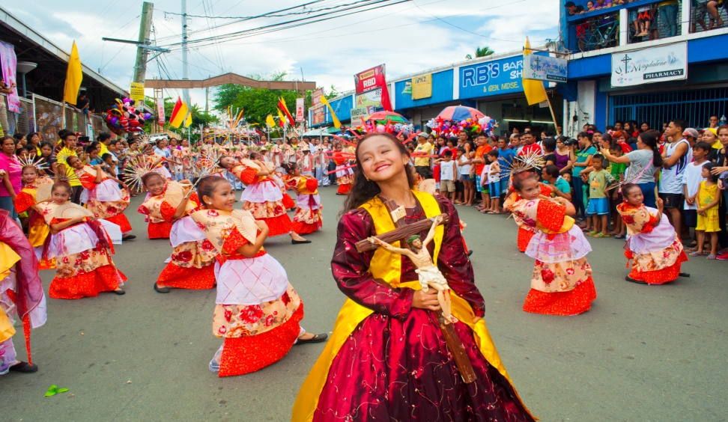
EHV (continued)
Conveying human values by way of street dance.

Slide 57
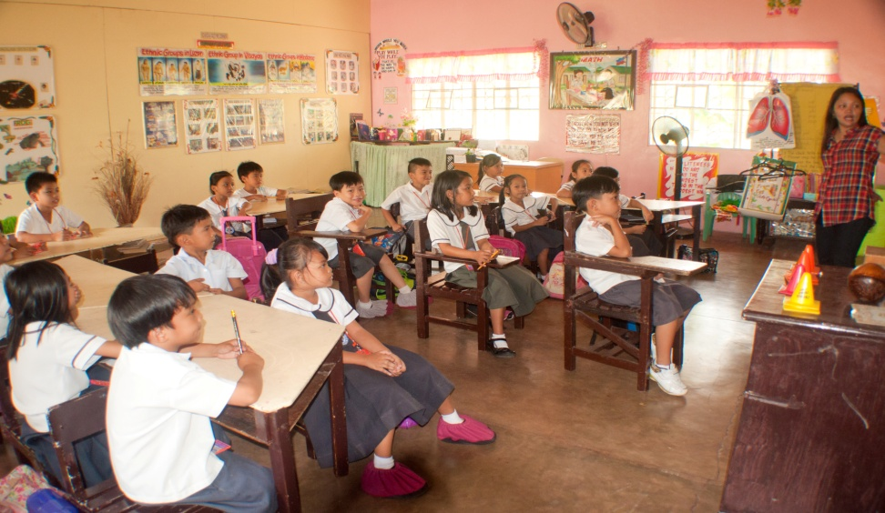
EHV (continued)
School-wide effort to translate sayings by Sathya Sai Baba into Tagalog, the Philippines’ National Language.

Slide 58
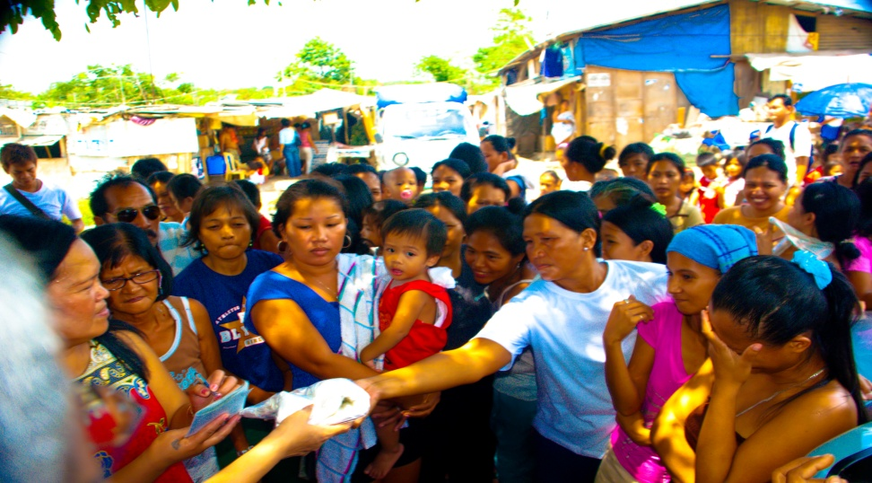
Devotion
Ladies Wing dedicate 19th of month to service.
Sathya Sai Narayana Katha translated in Tagalog.
Ladies wing conducts Narayana Seva, in Metro Manila.
Notes:
# Ladies Wing reactivated and have committed to commemorate the 19th of each month with a specific service or spiritual activity.
# Sathya Sai Narayana Katha has been translated into Tagalog (Philippino language) and performed to commemorate Declaration Day.
# Ladies wing conducted narayana seva, serving several hundred poor children and elderly in Taguig , near Metro Manilla.

Slide 59
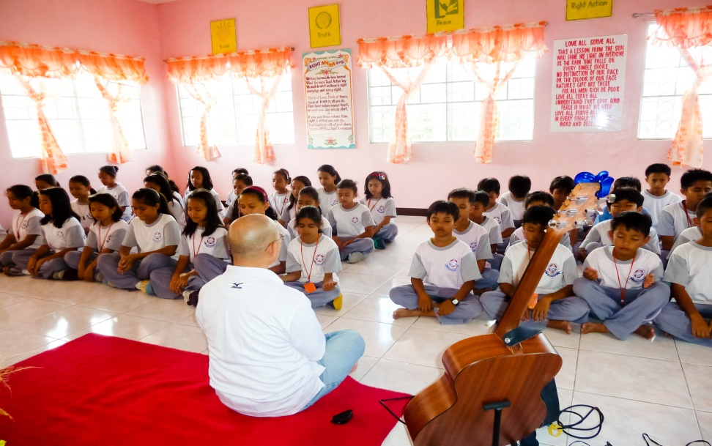
Devotion (continued)
Bhajan practice at Sathya Sai School

Slide 60
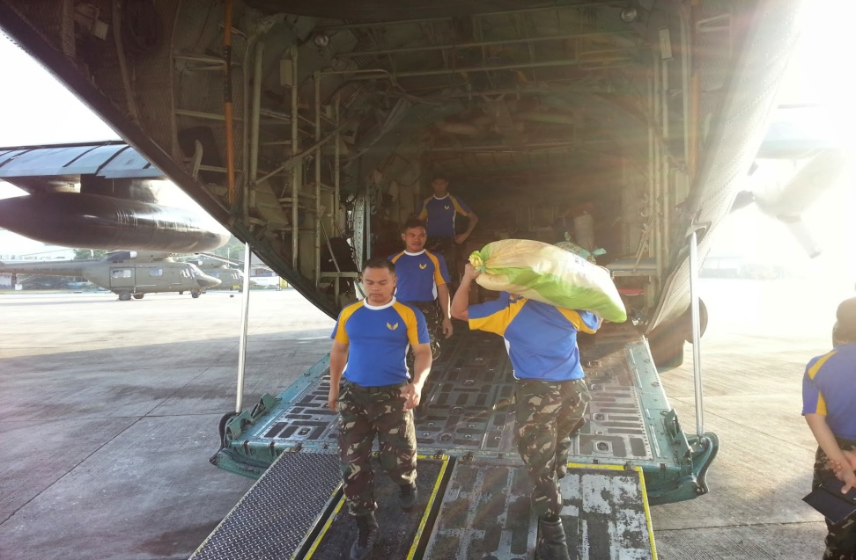
Service
Support and logistics of Sai Humanitarian Relief by the International Disaster Relief Team of SSIO.
15,000 served in daily Narayana Seva.
Launch medical and maternity clinic, with the support of Zone 4.
Zone 4 volunteers restoring of electrical wiring in schools and shelters for aged.
Notes:
# SSO Philippines provided overall support and logistics to deliver the various service activities of the Sai Humanitarian Relief of the International Disaster Relief Team of SSIO, assisted by international volunteers, coordinators and medical experts. More than 20,000 have been served in 8 medical camps.
# A total of 15,000 persons have been served through daily narayana seva programs.
# A full time medical and maternity clinic, with the support of Zone 4 volunteers, will be launched in the town of Dulag. It is expected to serve for 4 years.
# Zone 4 volunteers also embarking on restoration of electrical wiring in public schools and rebuilding shelters for aged people.

Slide 61
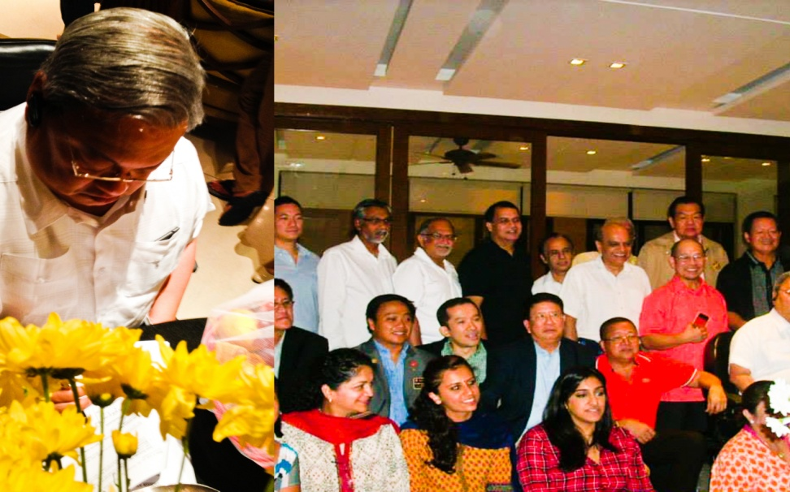
Service (continued)
Signed memorandum of agreement between Rotary Club, Frey-Phil Corp, ADB employees & SSO-Philippines, to rebuild classrooms in Tacloban.
Notes:
# Mid October - A contract signed to rebuild 3 classrooms.

Slide 62
Aum Sai Ram!
From Zone 3

