Slide 1
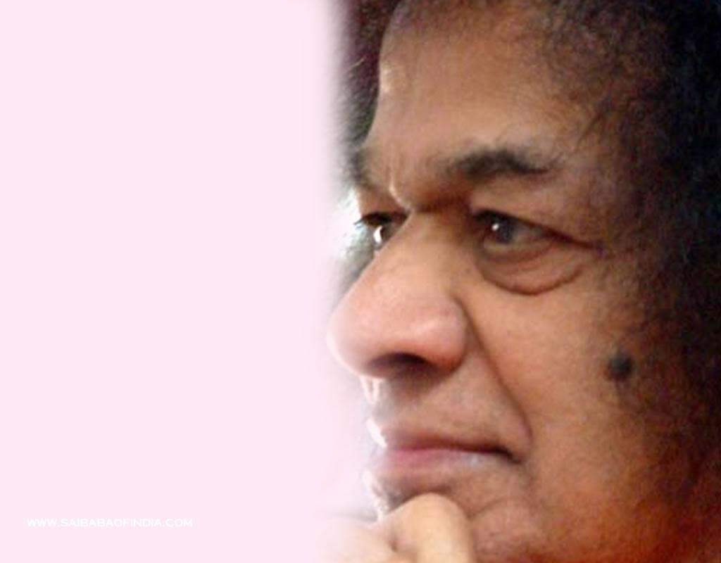
SSIO – West Indies
Aruba, Barbados, Curacao, Guyana, Jamaica, St Kitts, St Lucia, Suriname, Trinidad & Tobago

Slide 2
Book Launch
The Sai Institute of Education West Indies (SIEWI), whose headquarters is in Trinidad, launched a book, “Sathya Sai Education in Human Values: For the Foundation Years and Beyond”
Mr. Gopaul Boodhan - Mayor of the Borough of Chaguanas, Mr. Richie Sookhai - President of the Chaguanas Chamber of Commerce, Five Ministry of Education Officials including Mr John Roopchand - Director of Curriculum, Mr. Abhimanyu Kaul and Dr. Sundar Iyer - Special Advisers to Minister in EHV were among the Four School Supervisors, 36 School Teachers/Principals, 7 Religious Heads/ Representatives and 12 Business persons that participated in this event.

Slide 3
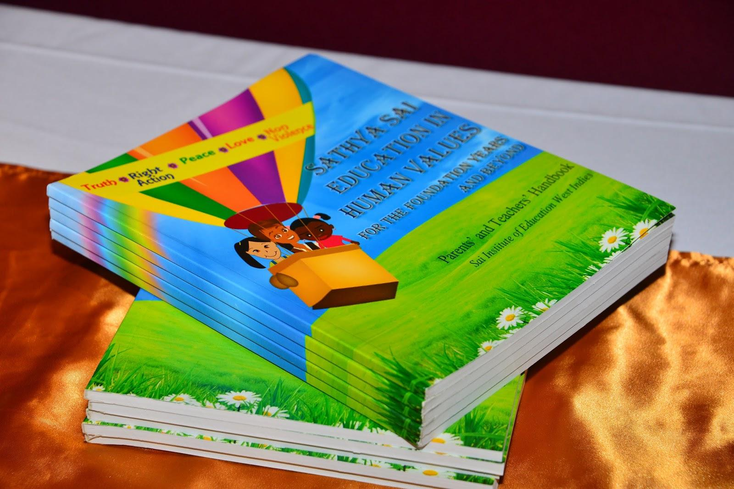

Slide 4
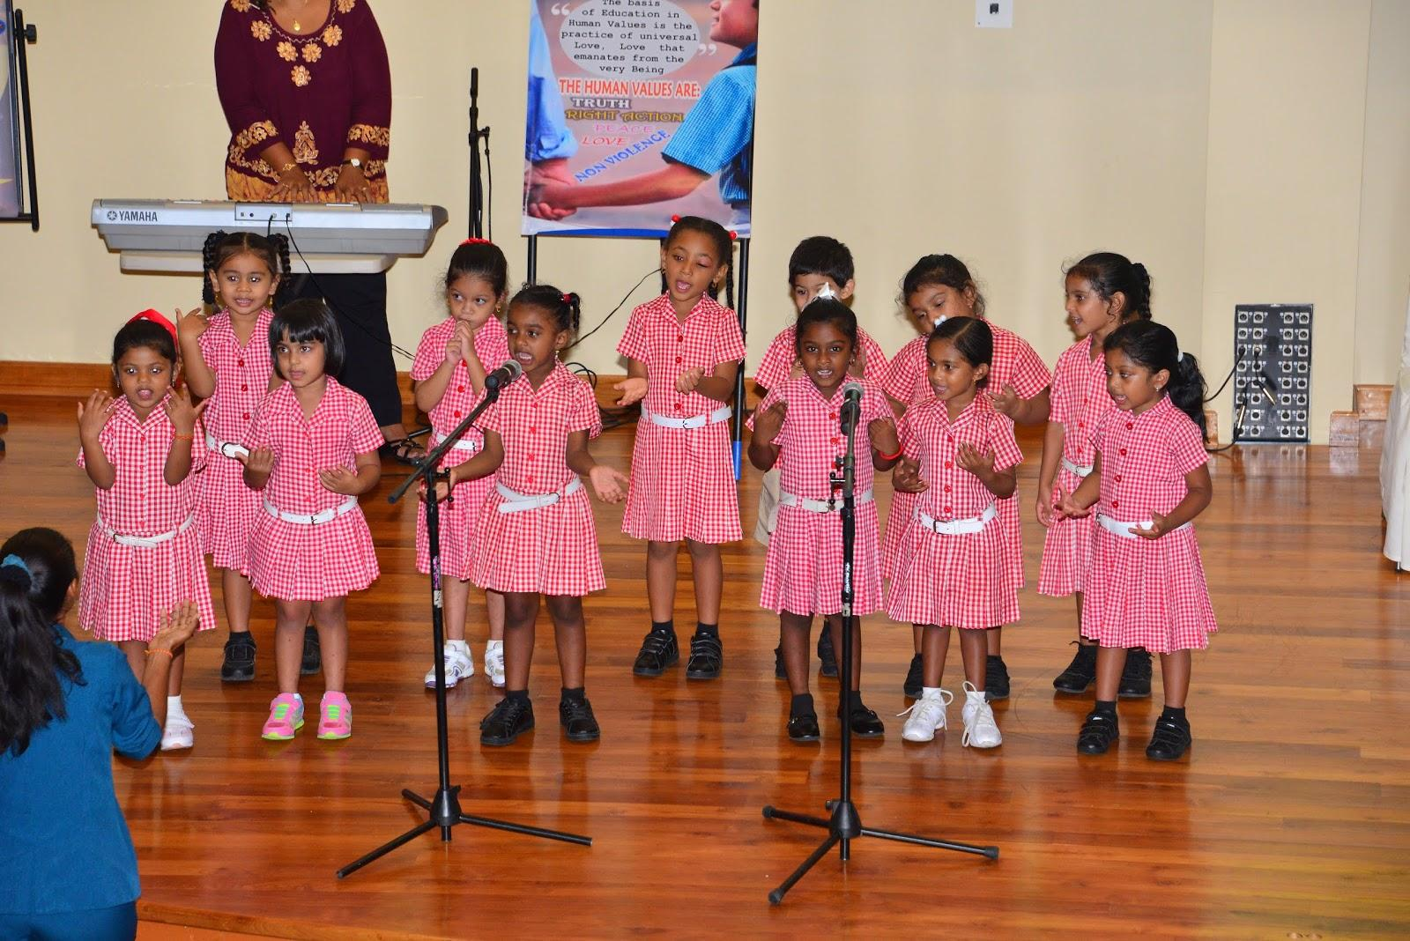

Slide 5
Mentoring Children
A mentoring program for children in the Central region (SSSBO of Trinidad & Tobago) - “Swami’s Camp”
Over 40 children were mentored in a premises that was converted into a school for academics, the arts, computer lab, yoga, outdoor games, agricultural science, balloon art, human values

Slide 6
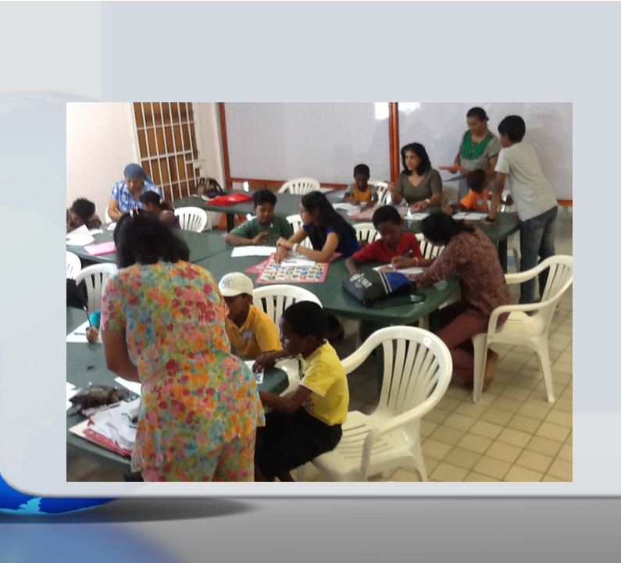
“Swami’s Camp” – Trinidad and Tobago (Central Region)

Slide 7
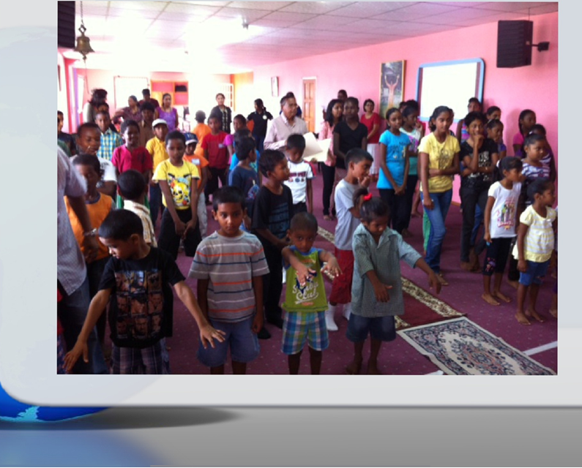
“Swami’s Camp” – Trinidad and Tobago (Central Region)

Slide 8
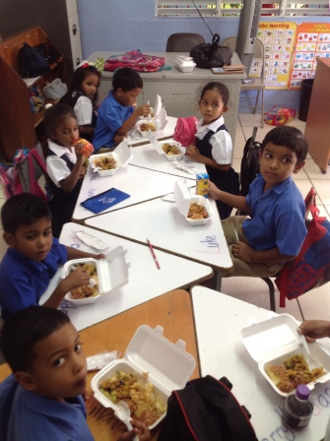
Serve The Planet – Serving School Children in Trinidad

Slide 9
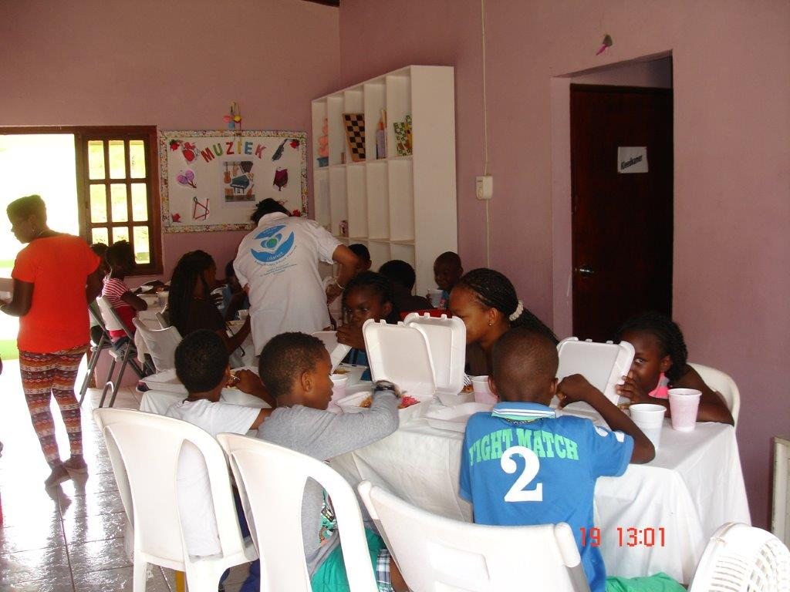
Serve The Planet – Curacao

Slide 10
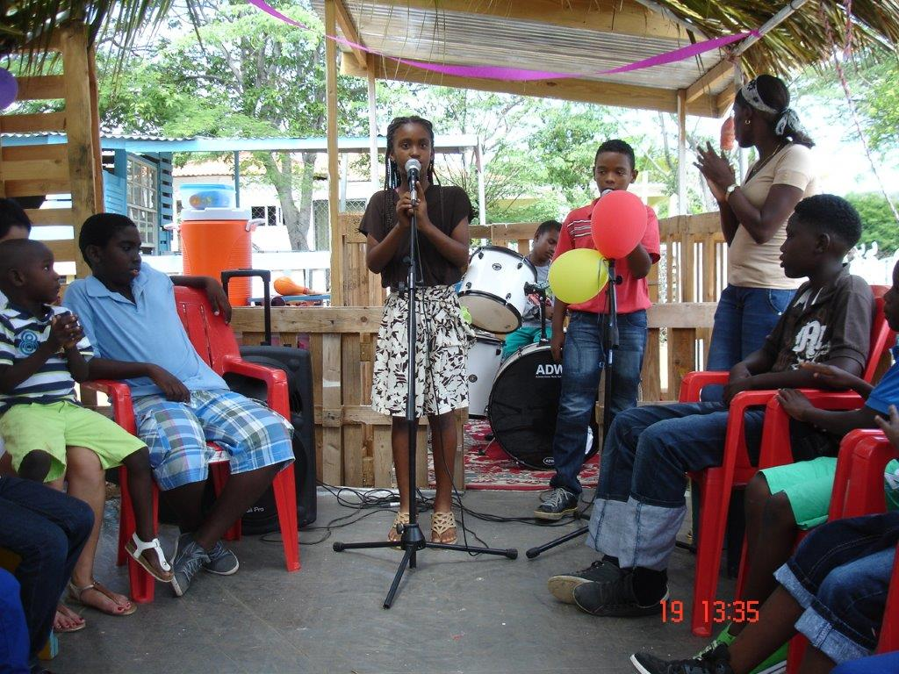
Serve The Planet – Curacao

Slide 11
Suriname
School supplies for children
Study Circle Workshops coinciding with pre-World Conference

Slide 12
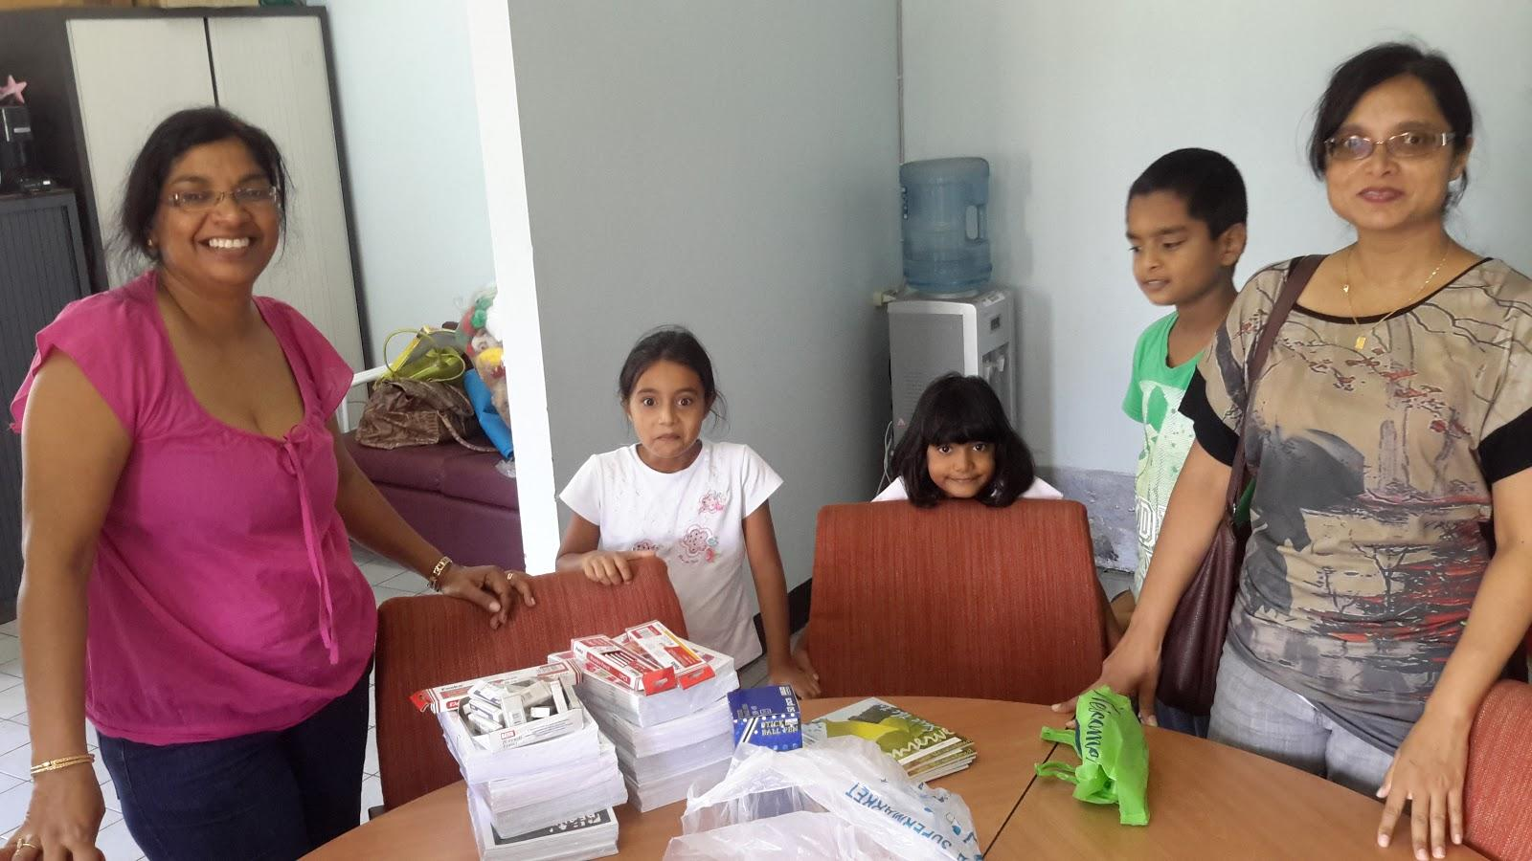

Slide 13
Guyana – Fibroids Project 2014
Following the successful completion of the earlier Fibroids Project at the West Demerara & Georgetown Public Hospital in November 2013, the Honorable Minister of Health, Dr. Bheri Ramsarran had presented a formal report to Members of Parliament.
The Ministry of Health was again approached for another Fibroids Project in 2014. New Amsterdam Hospital was identified as the location for executing the 2014 Fibroids Project.
The SSIO of Guyana ensured that all patients requiring Fibroids surgeries were pre-screened and pre-operation testing carried out. The New Amsterdam Hospital made arrangements for Fibroids operations.

Slide 14
Guyana – Fibroids Project 2014
Doctors saw and performed pre-surgical testing and screened 46 patients, of whom 18 patients required surgery.
On October 6th 2014, the Sai Int'l Medical Team started the surgeries and by the end of the week had successfully performed 23 Uterine Fibroids Surgeries with a 100% success rate and 100% completion rate.
Many of the women, who had been waiting for long periods of time for this kind of medical attention, had enlarged Uterine Fibroids with multiple adhesions and lesions; this led to complicated surgeries which lasted in some cases over 2 hours.

Slide 15
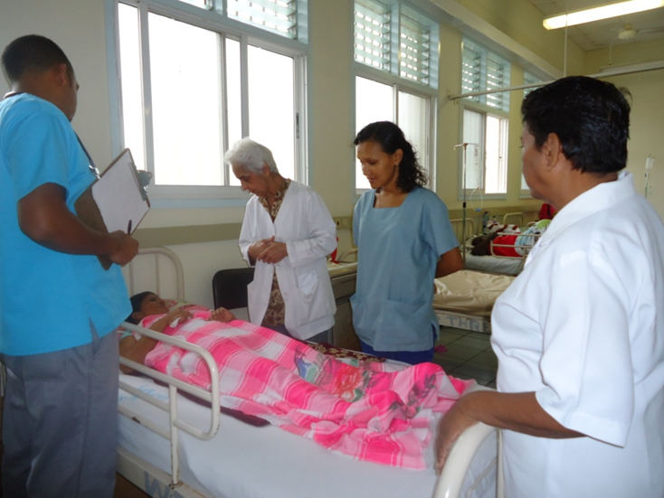
GUYANA – Visiting Fibroid Patient in Hospital

Slide 16
Israel
Educare Conference

Slide 17
Educare Conference
In August 2014, as the unrest was raging in the South, Sai volunteers came together for an Educare Conference in the North
Conference was attended by people from all walks of life and from all faiths - Jews, Muslims and Druzes

Slide 18
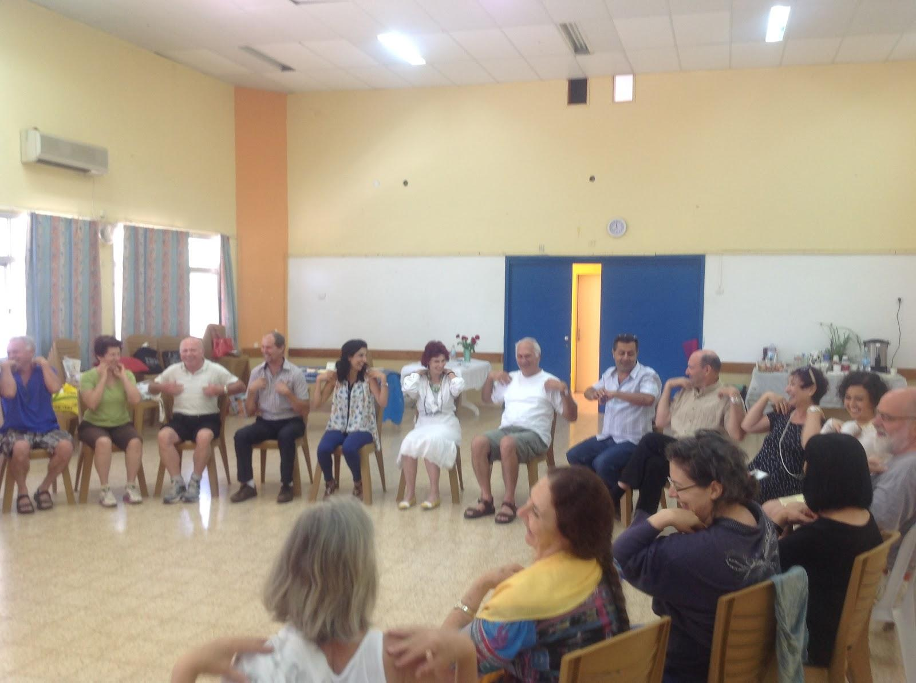

Slide 19
