Slide 1
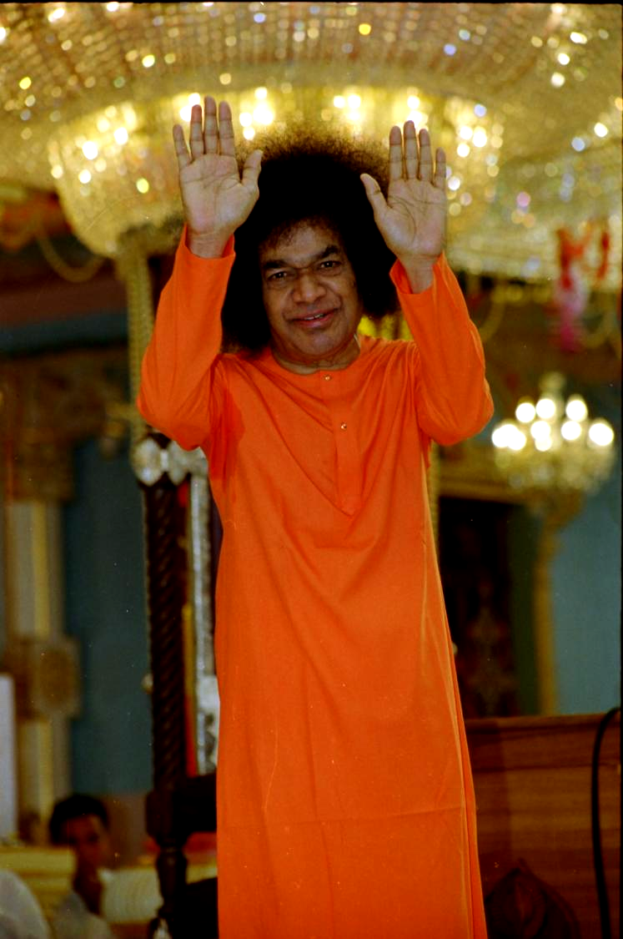

Zone 1 – USA

Slide 2
Region 1: One Voice - Musical “Summer Showers” Workshop - Aug 2, 2014
ABOUT THE PROGRAM
The musical workshop was organized by the Young Adults and other Sai volunteers of Region 1 at Northborough in Massachusetts on August 2, 2014.
Songs, hymns and chants from cultures spanning all the continents of the world.
Participants had an opportunity to listen and learn devotional singing from different languages, including, Dutch, Hebrew, and Arabic.

Slide 3
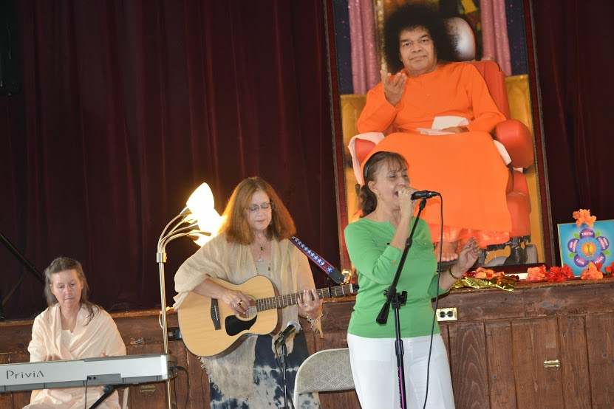

Slide 4
Region 2: CPR Training Workshops
ABOUT THE PROGRAM
Region 2 summer service program focused on preparing for health emergency. Most cardiac arrests in the USA occur outside the hospital and survival rates are extremely low.
Six CPR (Cardio Pulmonary Resuscitation) Training workshops were conducted for Sai volunteers across the states of NY, NJ, PA, MD and VA.
Over 200 Sai volunteers received hands on knowledge on performing CPR compressions and using an Automated External Defibrillator (AED)

Slide 5
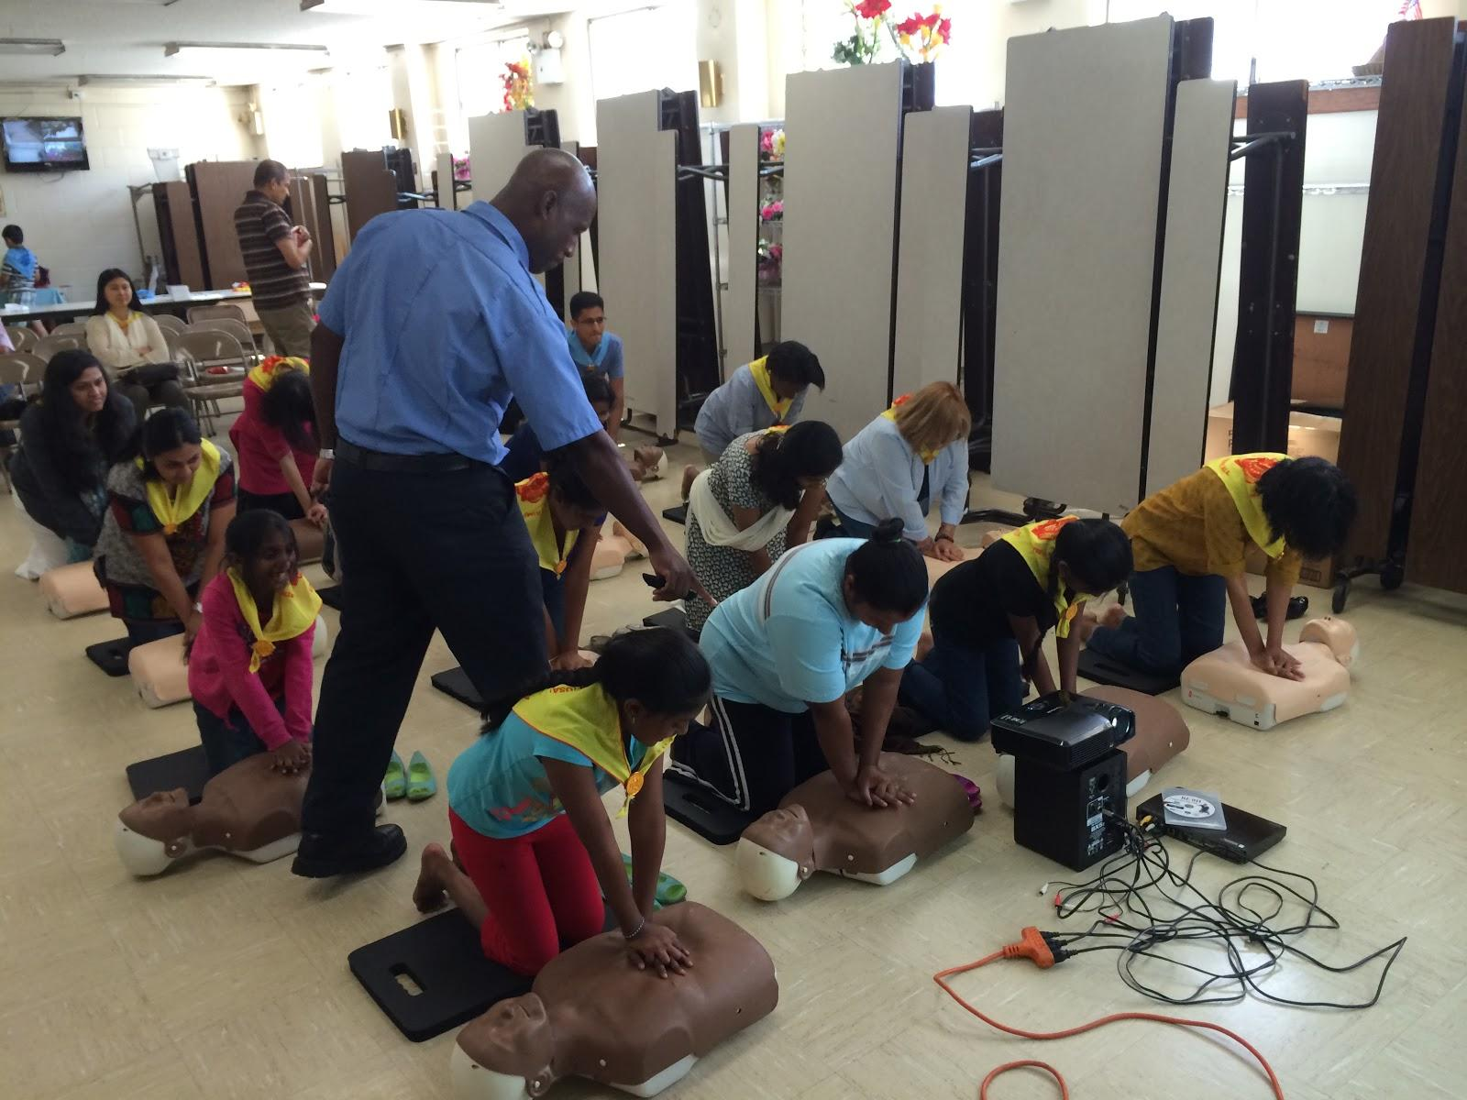

Slide 6
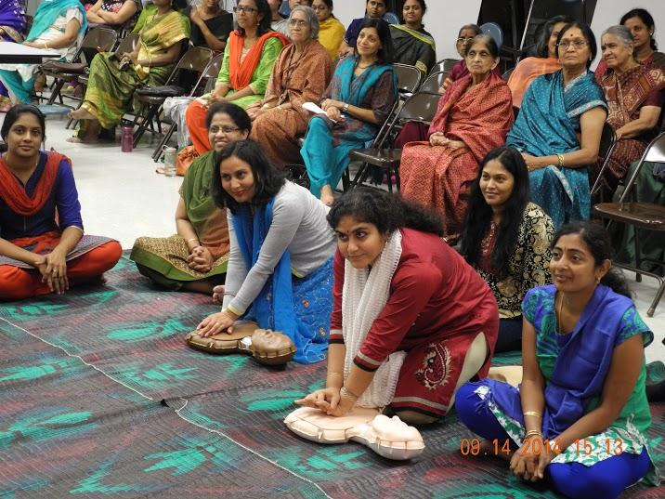
The Deputy Mayor of the City of Dallas, during her opening remarks, provided the SSIO with a Special Recognition prepared by Dallas Mayor Mike Rawlings for the Event
Notes:
Recognition

Slide 7
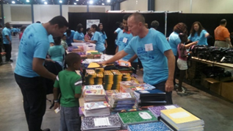
Region 3: Back to School Bash (BTSB) Service Project
August 9, 2014 – Palm Beach, Florida
School supplies distributed to 5,000 underprivileged kids at the Palm Beach Convention Center in Region 3
86 Sai volunteers assisted the students by escorting them, restocking and distributing supplies, multi-lingual translations, and event coordination.
Many Sai volunteers expressed a deep sense of gratitude for having the opportunity to assist these students.

Slide 8
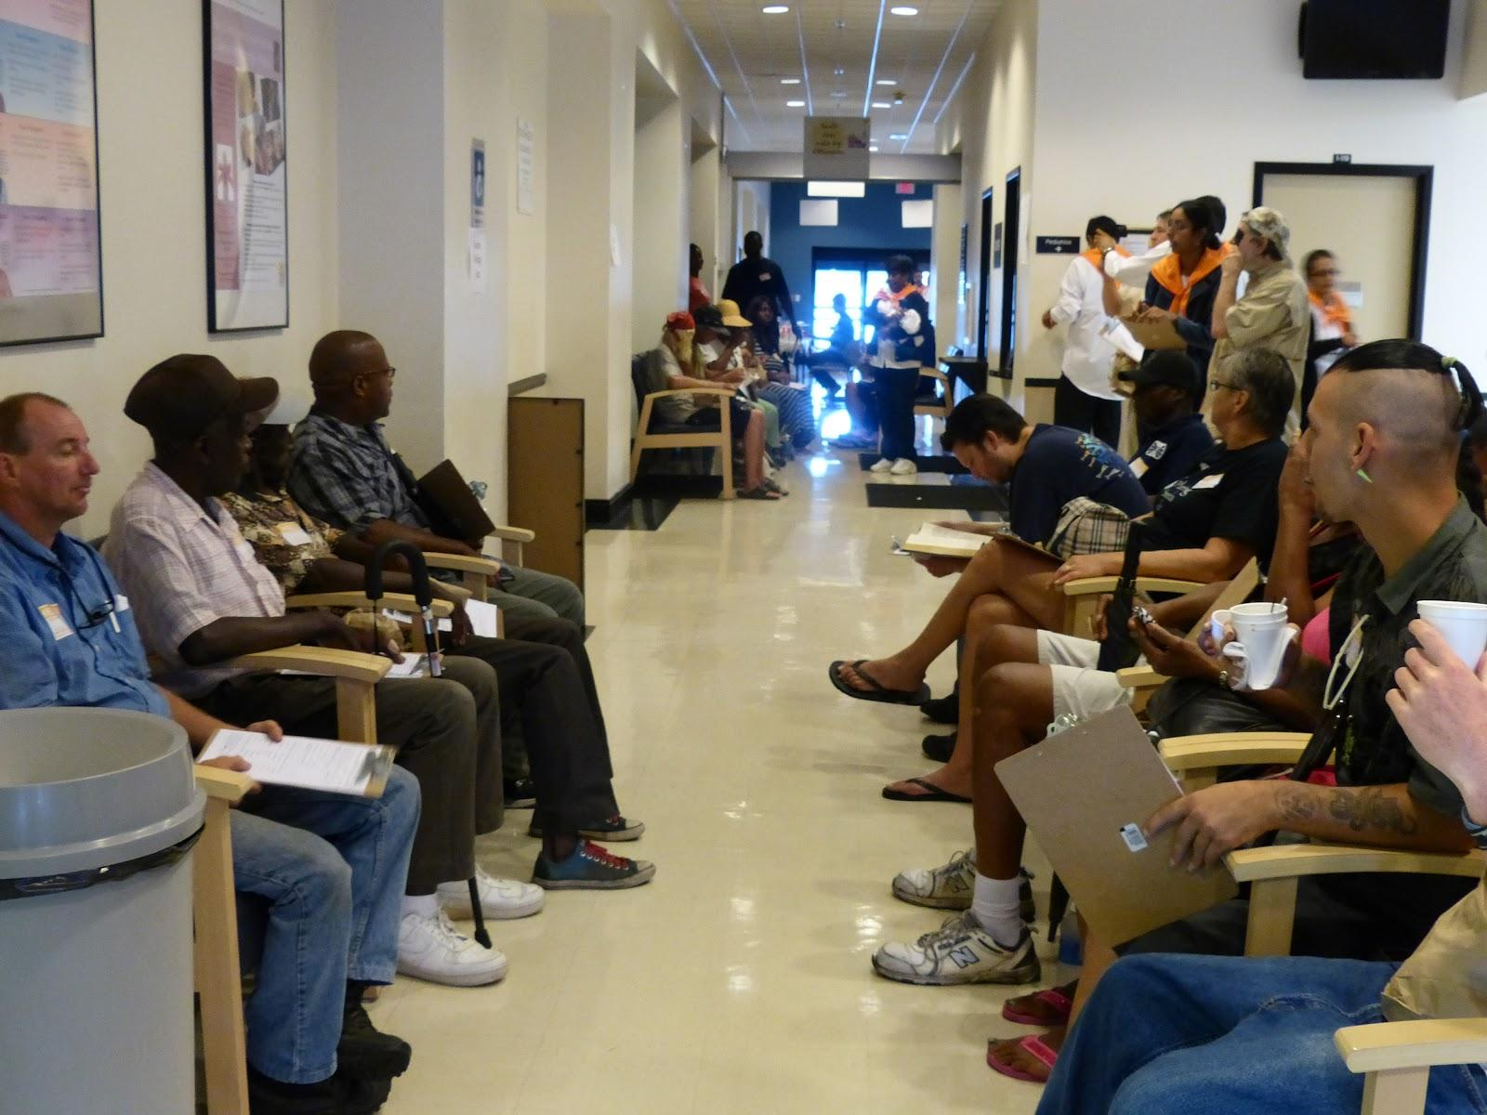
Region 3: Tampa Eye Camp
ABOUT THE PROGRAM
The Tampa Sai Center, along with the city of Clearwater, Florida organized an Eye camp on 20th September, 2014.
Over 100 visitors and Sai volunteers participated.

Slide 9
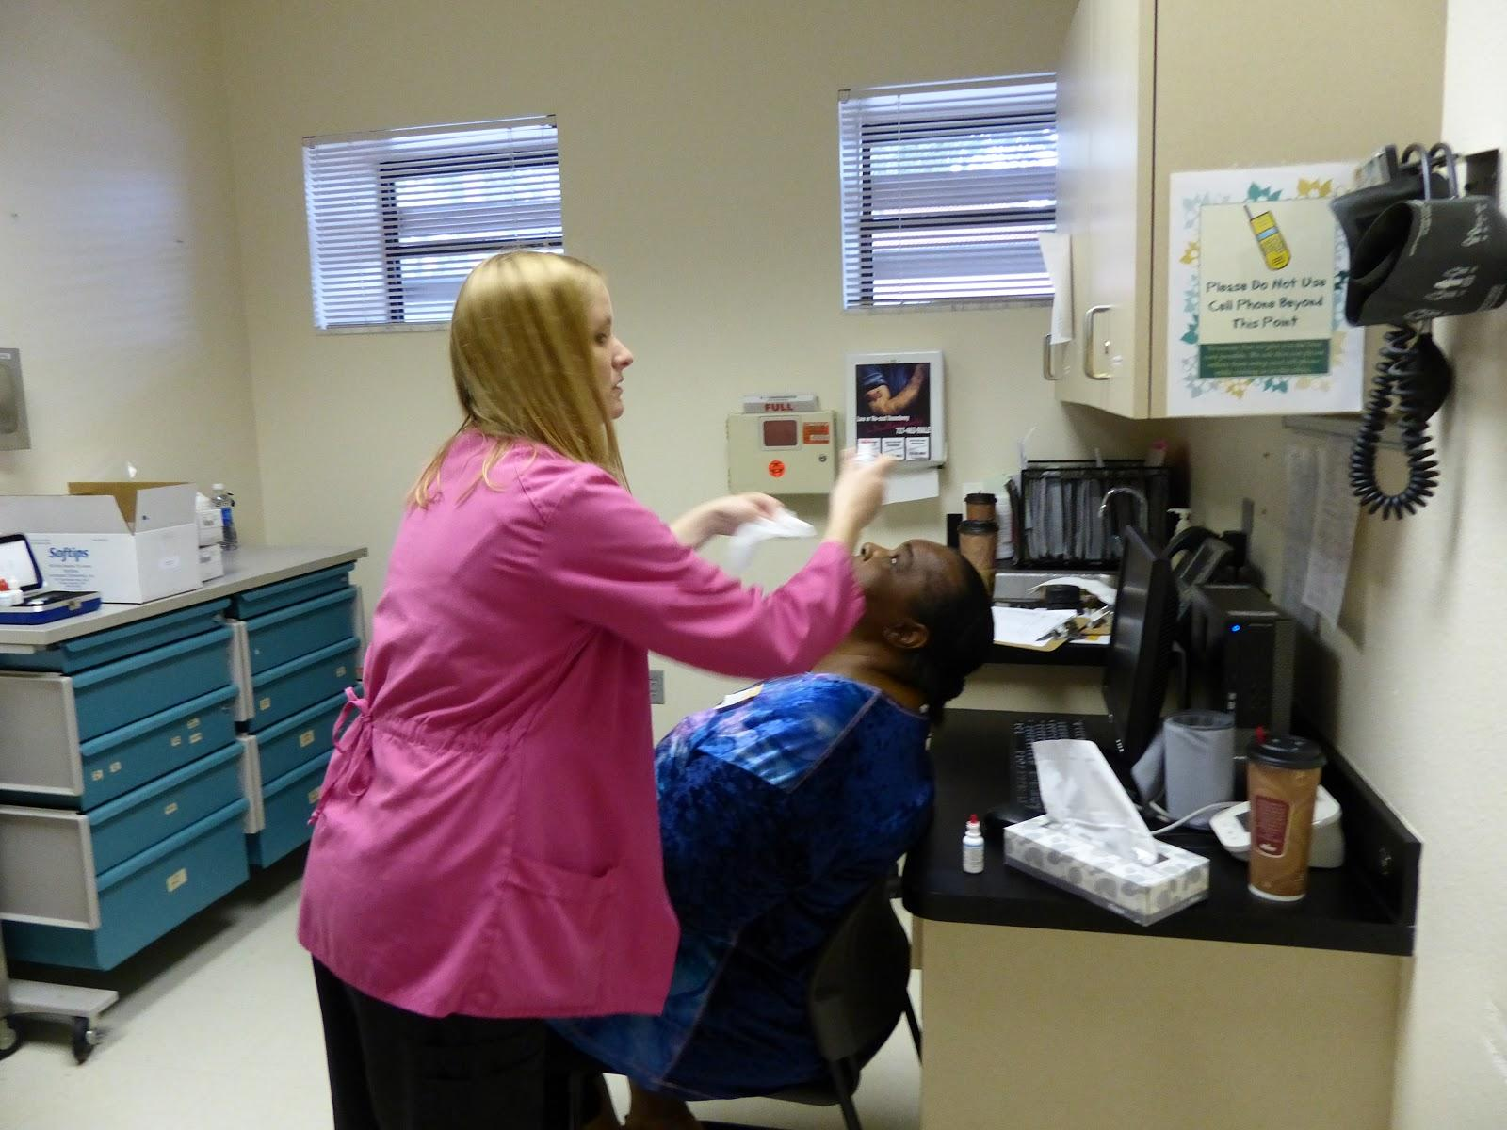

Slide 10
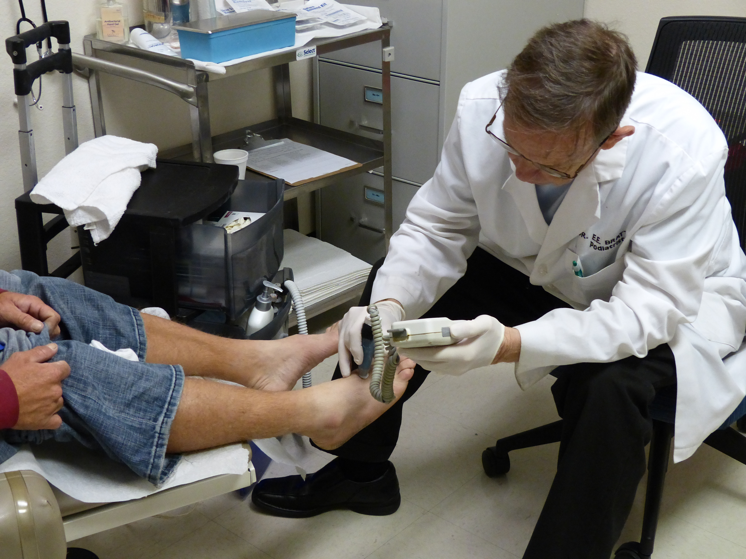
Region 3: Podiatry Camp – 1st November, 2014
St. Petersburg, Florida

Slide 11
Region 3: Raleigh Free Healthcare Day
ABOUT THE PROGRAM
The Raleigh Sai Center in collaboration with the Pullen Memorial Baptist Church hosted their third Free Healthcare Day on 6th September, 2014.
272 visitors were rendered medical, dental and vision services.
Over 100 volunteers from Raleigh/Durham area and medical staff assisted.
Specialized services included dental screening, detailed vision center, HIV/STD testing and screening services, immunizations and mammogram screenings.

Slide 12
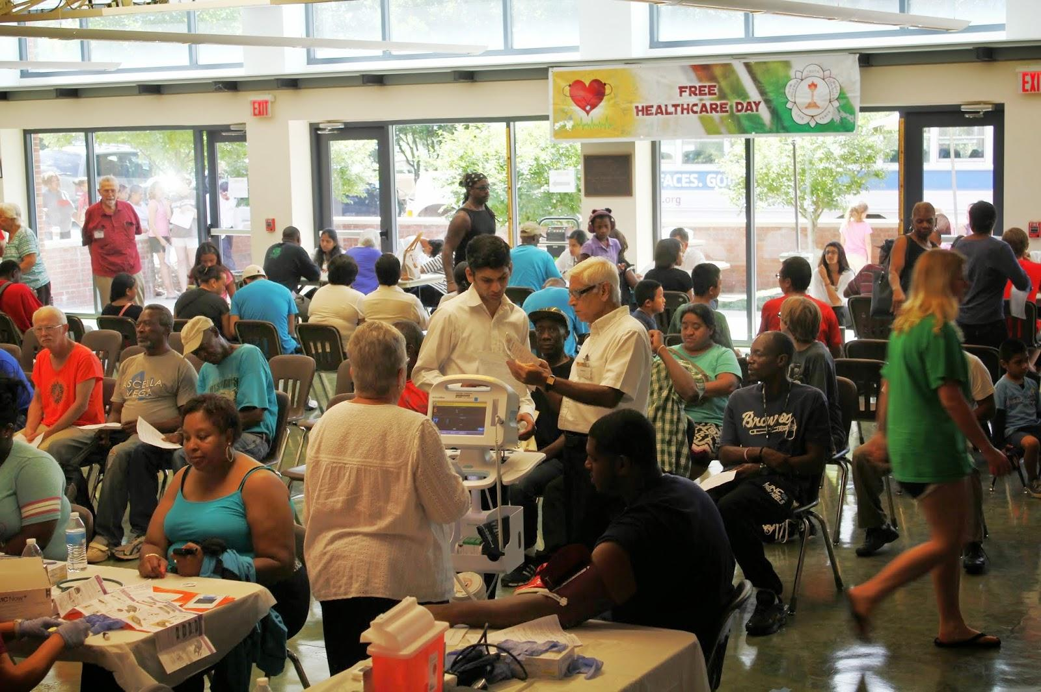

Slide 13
USA – Region 5
North Central Region Sai Conference and Retreat with Free Medical Camp,- JCYS Camp Henry Horner, Ingleside, Illinois
  August 29 - September 1, 2014.
  Free Medical Camp was conducted during the Sai Retreat. Health education and health screening was performed. Blood pressure and blood tests were also performed.
The LEAP Retreat –annual event organized by the Minneapolis Sai Center, Minnesota
  Focused on personal transformation.
  Fun filled, balanced and interactive event designed around the 5 Human Values and inspire personal growth.

Slide 14
USA – Region 6
Sai Elder Retreat - August 1-3, 2014
  Over 40 attendees: Designed for elders (age 60 yrs+) and pre‐elders (50‐59)
  Theme: Becoming Wisdom – Becoming Oneness.
Region-6 Annual Retreat - August 30 – September 1, 2014
  Silver Falls Conference Center, Sublimity, Oregon;
  Theme: The Power of Love
  Guest speakers: Dr. Sam Sandweiss, Sharon Sandweiss, and Michele Kaplowitz
Narayana Seva Project - October 12, 2014
  Men’s and Women’s Shelter, Seattle, Washington
  Served over 700 dinner to residents at Tent City and Union Gospel Church

Slide 15
USA – Region 7
Hayward City Sandwich project.
  Monthly project from Fremont center – 200 sandwiches are prepared at homes and distributed to homeless in Hayward City.
Sai Summer Course Coordinated by Region 7 Young Adults.
  Region 7 YAs conducted a literacy program to help the Hispanic farm workers and children in Morgan Hill, California.
  Assist adult farm workers with English, and kids with mathematics, reading and character building.
Day On the Beach Regional Service Project.
  Annual service project
  Sponsored by Shared Adventures, a group that provides individuals with disabilities the opportunity to experience adventure through ocean sports such as kayaking, outrigger canoeing, SCUBA diving, and taking beach wheelchair rides along the seaside and in the surf.
  At this year’s Day on the Beach, 200 volunteers helped over 120 children and adults with special needs.
  In total, approximately 800 individuals were served including people with disabilities, family members, friends, and caregivers.

Slide 16
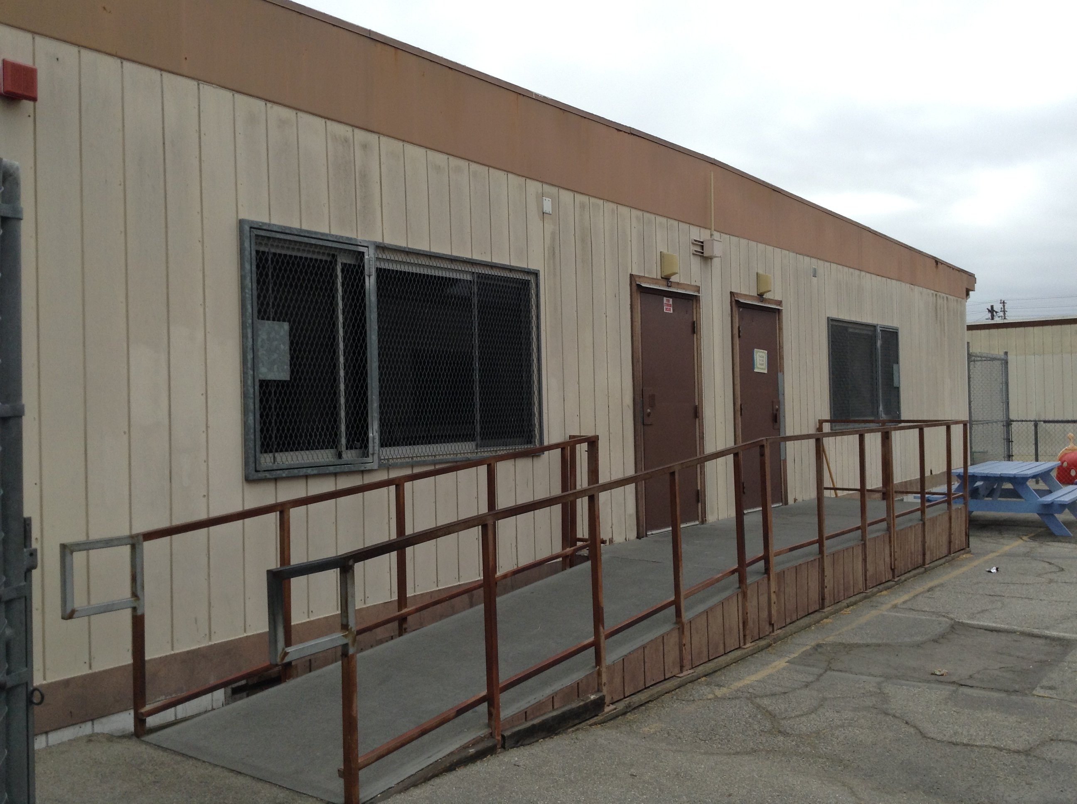
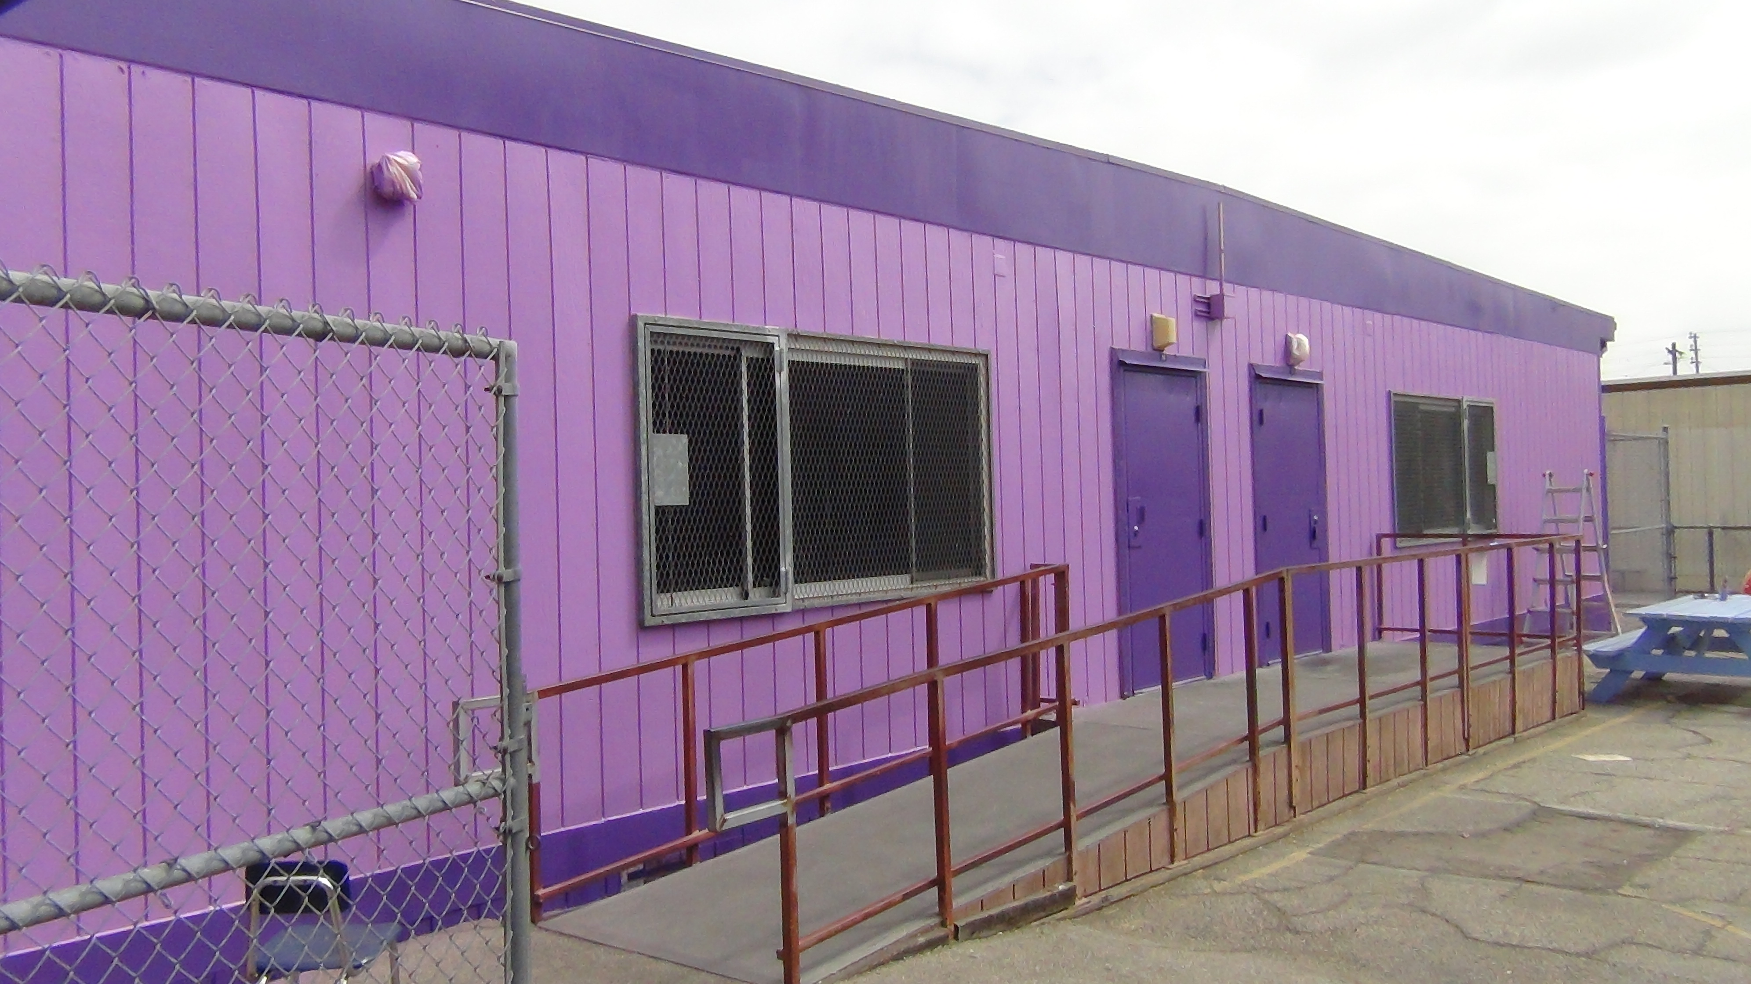
Region 8: 93rd Elementary School, Los Angeles
School Renovation Project
ABOUT THE PROGRAM
USA, Region 8 has adopted three schools in Southern California.
As part of “Serve The Planet”, 20 Sai volunteers painted the interior and exterior of two buildings on September 20, 2014.
BEFORE PAINTING AFTER PAINTING

Slide 17
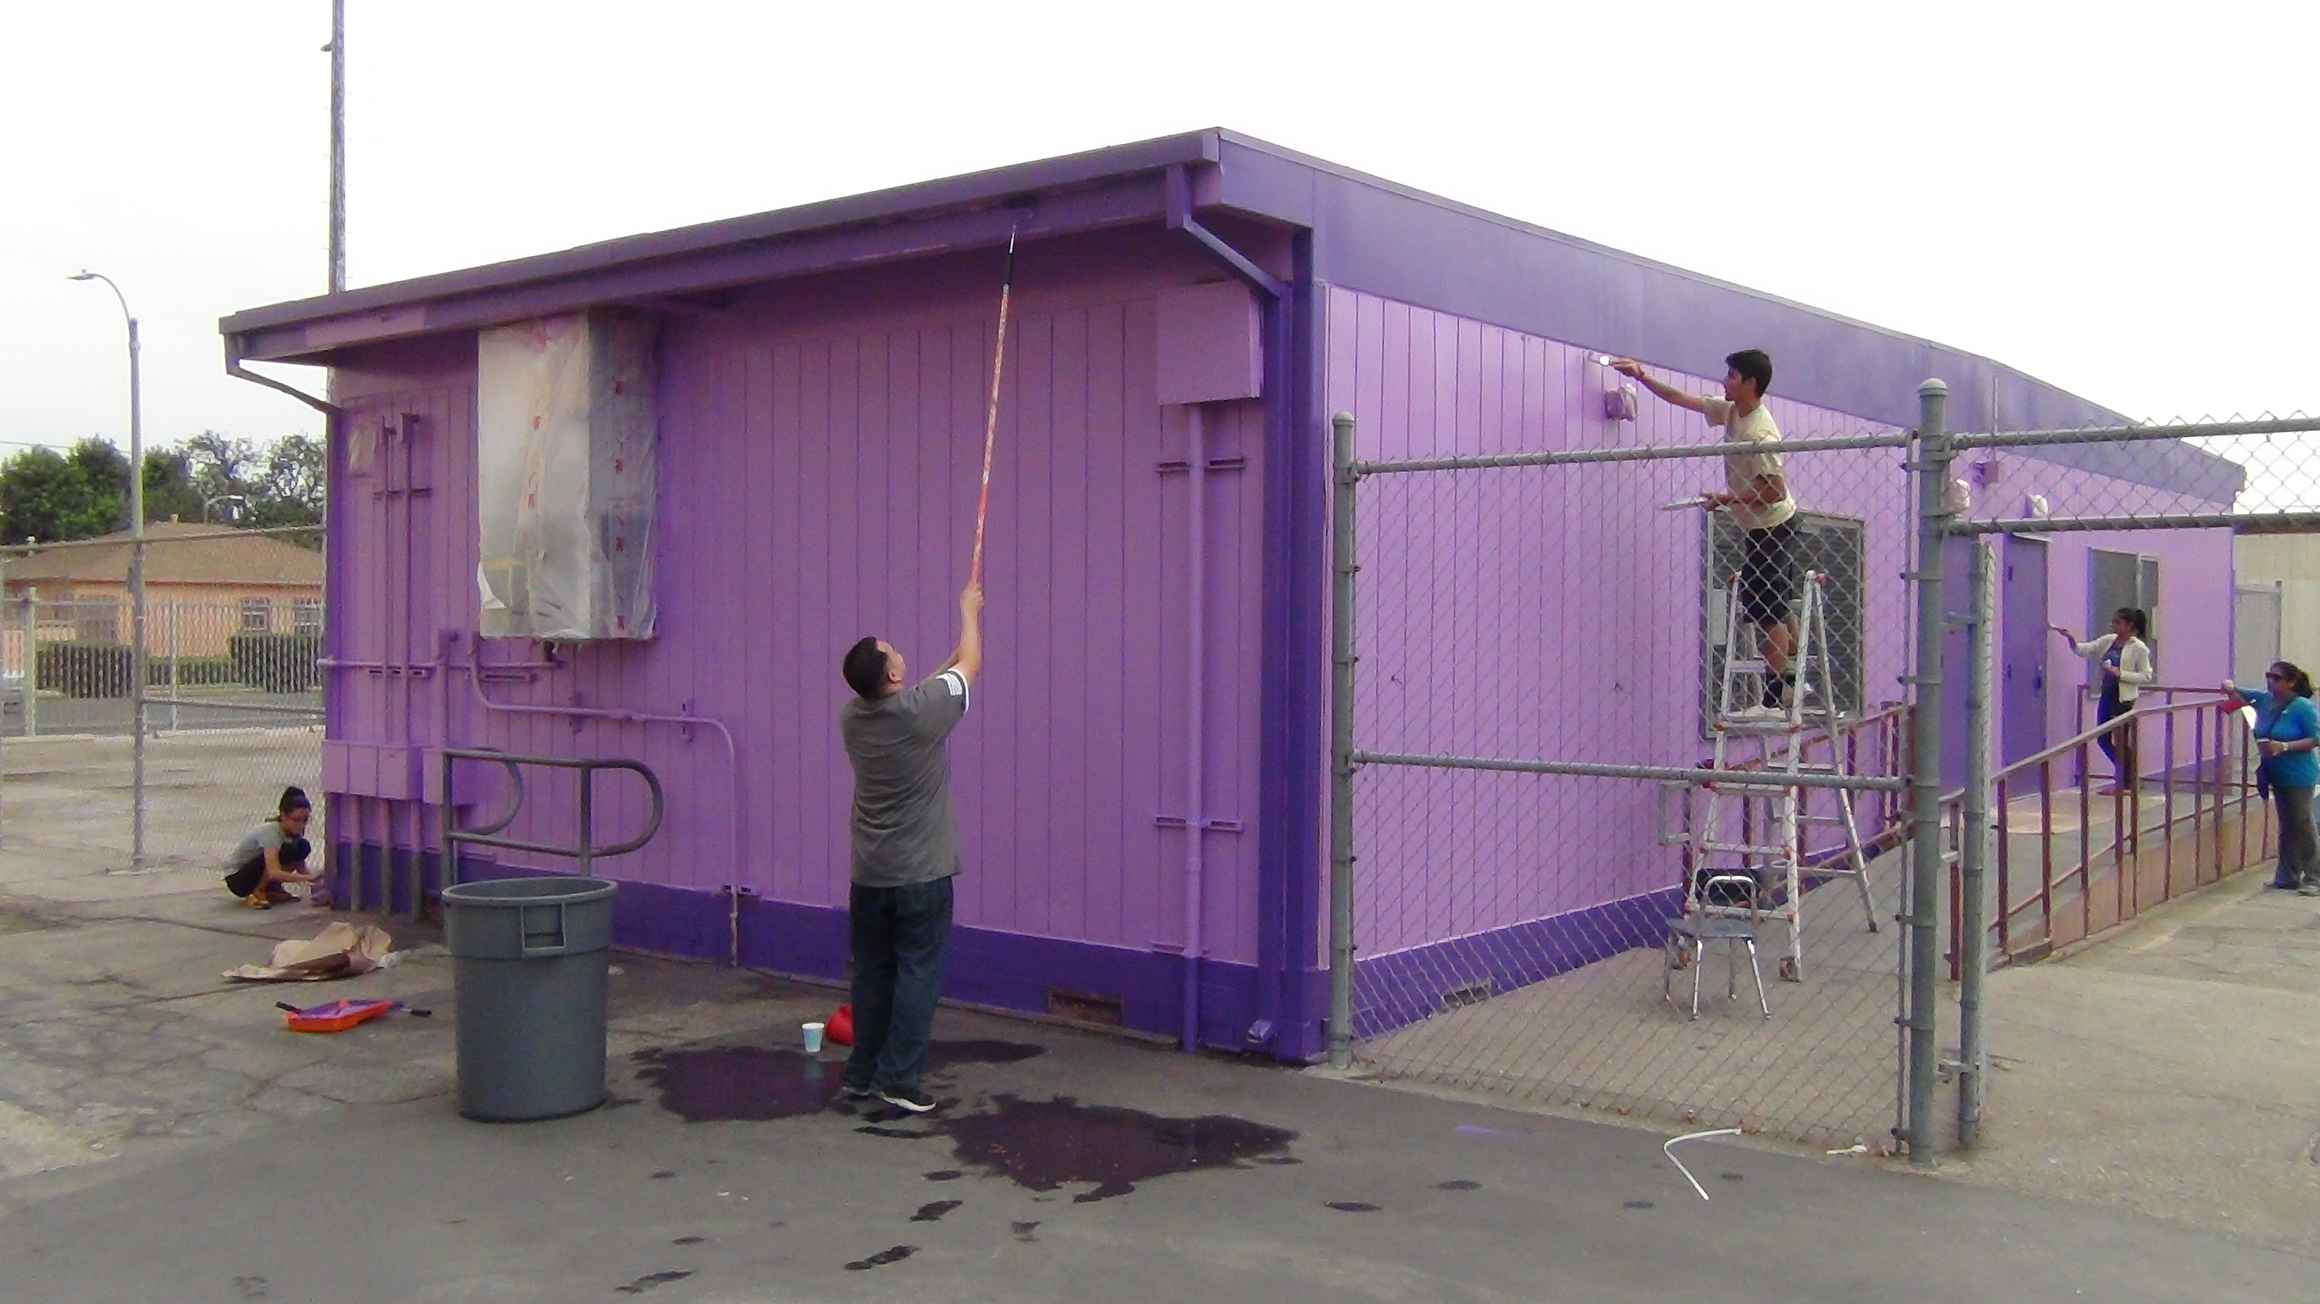

Slide 18
Region 10: SAI (Service-Awareness-Integration) Event – Dallas, Texas
ABOUT THE PROGRAM
Region 10 organized the inaugural SAI (Service-Awareness-Integration) event, “Loving All and Serving All: The Role of Human Values in Society,” in Dallas, Texas, on 3rd May 2014.
300 community leaders and more than 70 organizations came together to raise awareness about societal needs and service initiatives, and to develop commitments to take action.
The Honorable Ms. Monica Alonzo, Deputy Mayor Pro Tempore, Dallas, conveyed a special “City of Dallas Recognition” to the SSIO from the Mayor of Dallas, the Honorable Mike Rawlings.

Slide 19
