Slide 1
International Youth Program Update
General Assembly Meeting
20 November 2014
Offered at the divine lotus feet of Sri Sathya Sai Baba

Slide 2
AGENDA
OM SAI RAM
Service to Man is Service to God – Presentation 20th November
Serve the Planet 2014 Interim Report
Sathya Sai International Youth Leadership Program
Sathya Sai International Youth Festival 2016

Slide 3
Service to Man is Service to God
Presentation by the SSIO Youth. Evening Darshan 20th Nov.
Program consists of songs and videos focused on Service.

Slide 4


“Children Our Future”
2014
Global Service Project of the Sathya Sai International Organization
Interim Report

Slide 5
Serve the Planet 2014 - Data
Data submission and validation of report
Spreadsheet with data was submitted by Zone Youth Coordinators. Reports approved by Zone Chairs.
Data copied in a single file for analysis.
Statistics generated using submitted data.

Slide 6
Serve the Planet 2014 Participation
69 countries took part in Serve the Planet 2014
1 |  | 2B |  | 4 |  | 6 |  | 7 |  | 8 |  | 9A
Guyana |  | Argentina |  | Myanmar |  | Bosnia |  | Austria |  | Azerbaijan |  | Botswana
Trinidad & Tobago |  | Brazil |  | Singapore |  | Croatia |  | Belgium |  | Belarus |  | Gabon
USA |  | Colombia |  | Sri Lanka |  | France |  | Czech Republic |  | Kazakhstan |  | Ghana
West Indies- Suriname |  | Ecuador |  | Thailand |  | Greece |  | Denmark |  | Kyrgyzstan |  | Mauritius
 |  | Peru |  |  |  | Italy |  | Finland |  | Moldova |  | Mombasa, Kenya
2A |  | Venezuela |  | 5 |  | Macedonia |  | Germany |  | Russia |  | Morocco
El Salvador |  |  |  | China |  | Serbia |  | Hungary |  | Ukraine |  | Nigeria
Guatemala |  | 3 |  | Hong Kong |  | Slovenia |  | Latvia |  |  |  | South Africa
Haiti |  | Australia |  | Japan |  | Spain |  | Lithuania |  |  |  | Tanzania
México |  | Fiji Islands |  | Taiwan |  | Switzerland |  | Netherlands |  |  |  | Uganda
Panamá |  | New Zealand |  |  |  |  |  | Poland |  |  |  | United Kingdom
Puerto Rico |  |  |  |  |  |  |  |  |  |  |  | Zambia
República Dominicana
Zone 9B report due on 20th November. Some countries e.g. Malaysia & Indonesia completing projects in Nov.

Slide 7
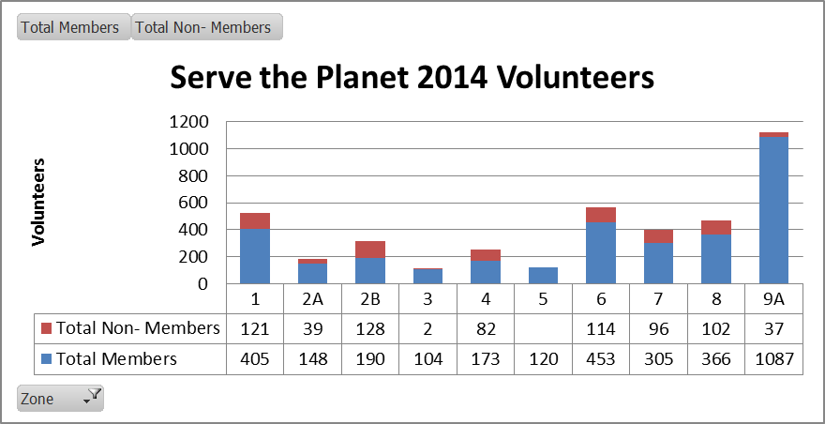
Serve the Planet 2014 Participation
4072 individuals participated. 721 non-members.
Zone 9B report due on 20th November. Some countries e.g. Malaysia completing projects in Nov.

Slide 8
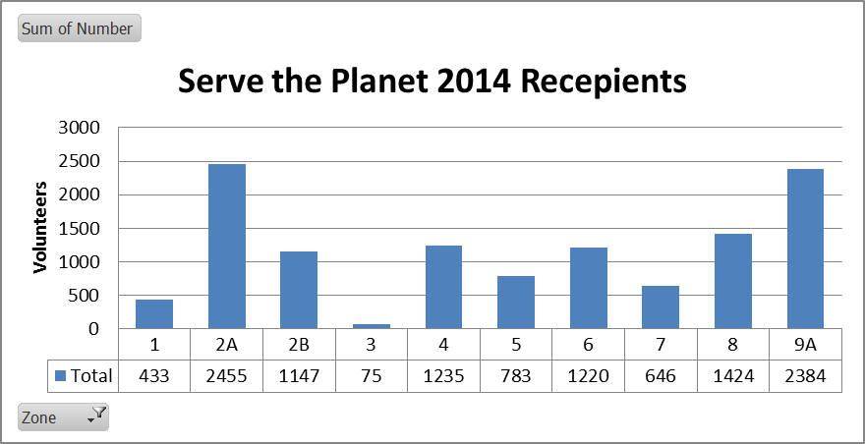
Serve the Planet 2014 Participation
11802 people served in Serve the Planet 2014
Zone 3 completes with a Christmas project in Philippines. Numbers will be higher than 11,802.

Slide 9
Glimpses
Serve the Planet 2014
Photo quality has improved

Slide 10
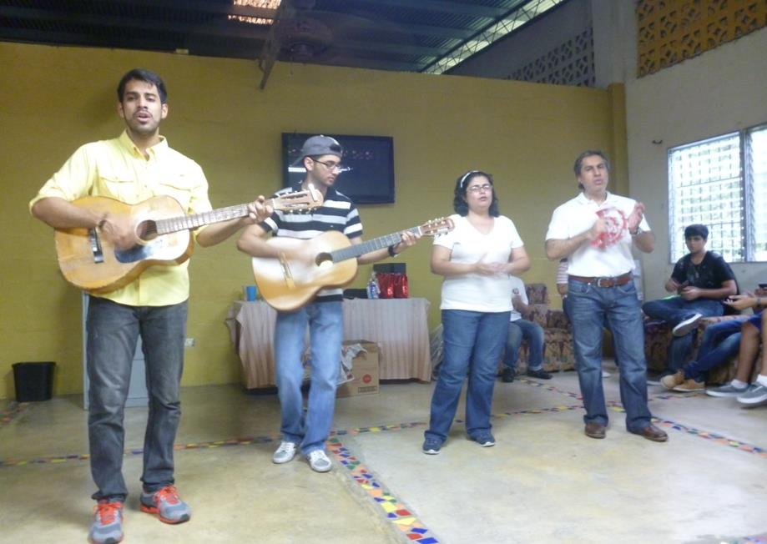
Panama

Slide 11
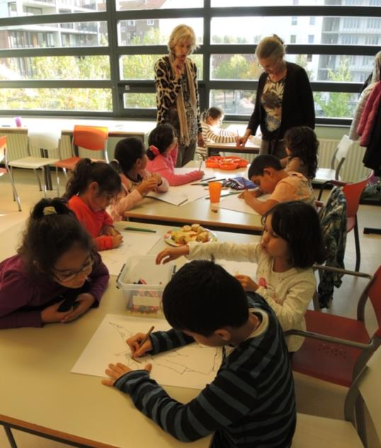
Netherlands

Slide 12
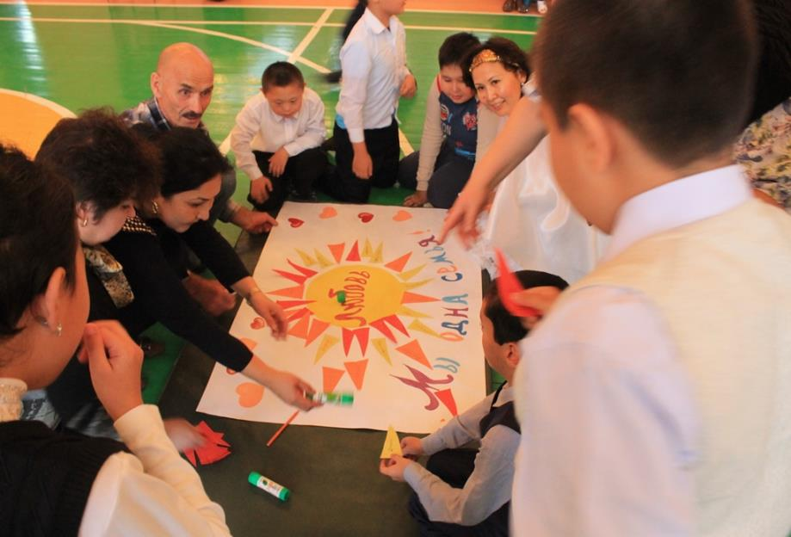
Kazaksthan

Slide 13
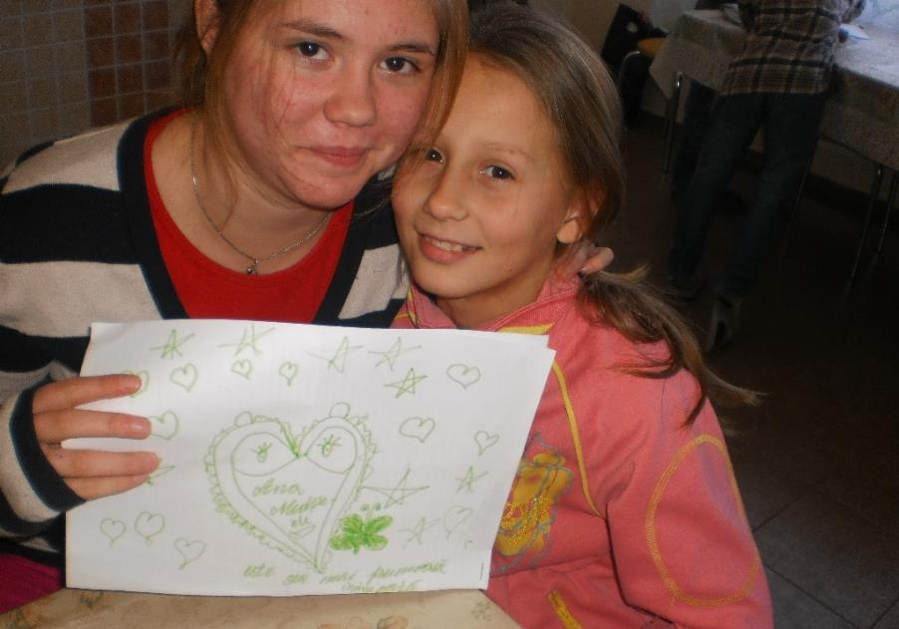
Moldova

Slide 14
Serve the Planet 2014 – Final Report
Next Steps
Short presentation on 20th November in the Sai Kulwant Hall
23rd November – final deadline for all information.
Compilation of report with pictures and statistics. One slide per country, categorised by zone.
Summary will be sent to Zone Youth Coordinators and Zone Chairs to verify by 15th Dec, 2014.
Final Report issued by 31st Jan, 2015

Slide 15
Human Values
2015
Global Service Project of the Sathya Sai International Organization

Slide 16
Serve the Planet 2015
Theme and Suggestions
Suggestions
  Start Early, Drive Slowly, Arrive Safely.
  Engage COMMUNITY and public; use outreach mediums.
  Serve the Planet needs to be a COMMUNITY activity not a centre activity.
  Recipients have to be outside of the SSIO.
2015 Theme: Human Values

Slide 17
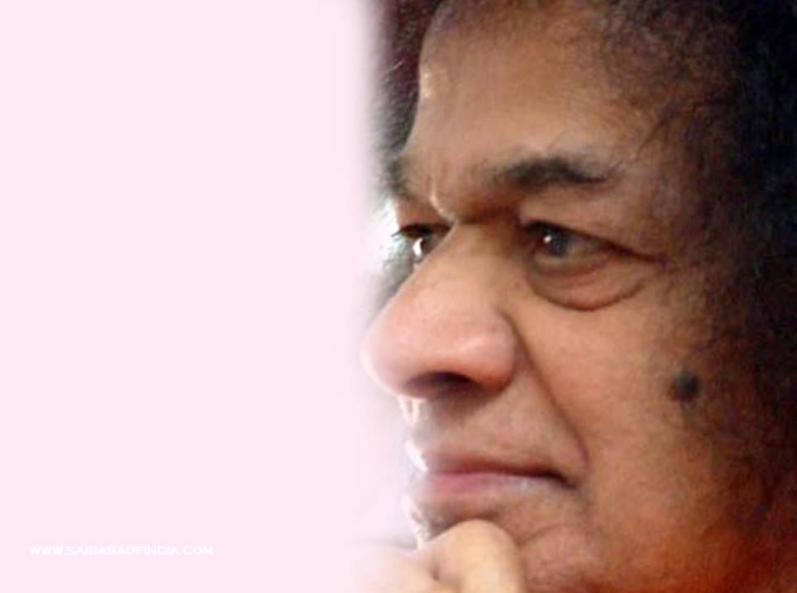
Sathya Sai International Youth Leadership Programme
(SSYILP)
Notes:
Respected elders, brothers and sisters, Sai Ram.
Thank you giving me a few minutes to share with the update on the youth leadership programme.
In July Dr. Joe and I talked a bit about the programme and its need. However as some of you were not present it may be prudent to just give a quick update on how this programme come about and then will give you a progress report. Dr. Joe will then give a update on the modules.
Please kindly request to keep all questions till the end of the entire presentation

Slide 18
The way forward…
Progress update
  Booklet with course content compiled.
  Program being reviewed currently.
  Nominations review in progress
Program Reviewers
  Dr Gosselin, Dr. Harvey and Dr. Johnson
Modules – online and residential course in Prasanthi Nilayam in November 2015
Notes:
Progress report – change name, candidates booklet – apx 160 pages. Acknowledge the hard work by Dr. Joe, Dr. Harvey, Dr. Gosselin and Dr. Johnson assisting aparna and I in compiling the work not to mention the additional 9 authors who submitted some outstanding work. Plan to complete most of the reviews during our time here and submit a draft for Dr. Reddy shortly.
Modules – 5 online (have tested the software and run two practice sessions) and 3 modules delivered through 5 day residential in November 2015. Based on feedback by some of you we have changed from July 2015 to cater for youth to also partake in the WC.

Slide 19
Action item for Zone Chairs
Identify youth leaders to participate in programme commencing early 2015
Confirm submission before 30th November 2014.
Application forms will be issued on 23rd November 2014.
Notes:
Four YL each zone – inc ZYCs who we would preferably like to partake unless there is exceptional reasons why they cannot – COMMITMENT – DR. REDDY AVAILBILITY AND ABILITY
In total expected around 40 – 45 youth. Will require commitment. After graduating will take up project for the SSIO

Slide 20
Programme Design
Modules 1-5, and 9 offered online.
5 day residential modes for 6-8 in Prasanthi Nilayam before Birthday celebrations 2015
  Day 1: Review of Module 1-5 and 9
  Day 2: Module 6 - Communication
  Day 3: Module 7 - Group Dynamics
  Day 4: Module 8 - Project Management
  Day 5: Putting it all together and course evaluation
Notes:
Day one will be a review and time to test competencies for first 5 modules
Modules 6-8 will each have one full day to introduce and work thru these modules with interactive workshops, break out sessions, and other group exercises to help bring out each person’s inner wisdom. We basically will be using Swami’s educare method of education.

Slide 21
Sathya Sai International Youth Festival
2016
Offered at the divine lotus feet of Sri Sathya Sai Baba

Slide 22
Contents
Vision & Objectives
Guiding Principles
Festival Design
Daily Journey & Schedule
Festival Committee Structure
Implementation Roadmap
Next Steps

Slide 23
Vision
Through a festival, encourage youth to learn and practise human values as defined by the life and teachings of Sathya Sai Baba.
Objective
1
2
3
4
…to celebrate the joy of being called to Sai at a young age
…to celebrate the life, teachings and philosophies of our beloved Swami
…to preserve and share His life and His Messages for future generations
…to give youth of today guidance on practicing human values and spirituality in their lives

Slide 24
Guiding Principles
1
2
3
4
…to celebrate the joy of being called to Sai at a young age
…to celebrate the life, teachings and philosophies of our beloved Swami
…to preserve and share His life and His Messages for future generations
…to give youth of today guidance on practicing human values and spirituality in their lives
Showcase creative talents and abilities
Experiences and stories of notable devotees
Creation of new literature, music, art and poetry
Choose a spiritual path
Experience the joy of ‘walking the path’
To bring the thrill of being in Puttaparthi to “life”
Use digital technology to share and preserve content
Experience world enriched with human values

Slide 25
Festival Design
“Personal Choice”
Youth have one segment daily where they can choose how they start their day. They can choose to attend the following workshops:
Bhajans and Namasmarna
Yoga for Health and Spirituality
Guided Meditation
Human Values in daily life, and career
Leading and Volunteering in Sai Service Projects
“Musical Mela”
Each night a concert will be held after evening darshan:
Opening night – Sai Students
Second night – International Youth performances
Third night – Guest Artists
“Story time”
Sai youth and Sai Students can share stories about special intimate moments with Sai.
“Divine Directions”
Each day prominent devotees share their knowledge about Swami’s directions for the youth
“Youth Exhibition”
A multi-media rich exhibition held in the Poorna Chandra hall, presenting:
Art, Drama, Literature, Musical Offerings
Service activities that are taking place and that took place in the lead up to the conference.
“Parthi Guide”
A “Lonely Planet” style publication as a guide book / e-book. At leisure Youth can use it to go on a tour around the ashram.
“My Journey”
Sharing of youth experiences with Sai through short talks and publications.

Slide 26



Daily Journey
This daily journey model incorporated into the sadhana plan
Celebration
Inspiration
A Daily journey from sunrise to sunset
Exploration
Meditation
Contemplation
Concentration

Slide 27
Daily Schedule
Morning
5:30Am-10:30Am
Afternoon
12:00Pm-4:00Pm
Evening
5:30Pm-9:30Pm
Suprabhatham, Vedam & Nagar Sankirtan
Lunch
Vedam, Bhajans & Darshan
Vedam, Bhajans & Darshan
Youth Exhibition
Boys
Story time
Combined
Breakfast
Youth Exhibition
Girls
Musical Mela
Combined
Personal Choice
Concurrent Session
Divine Directions
Combined
Dinner

Slide 28
Festival Committee Structure
Festival Coordinator
To be Appointed
Committees
Registration
Venue
Media
Accommodation
Food & Beverage
Finance
Program
Volunteers
Health

Slide 29
Next Steps
Strategy & Design
Jan 2015
Concept Sign-off (Nov 23 2014)
Finalisation of WYC core team (Dec 20 2014)
Shortlist of program hosts, speakers, and facilitators (Dec 20 2014)
Finalisation of Sadhana program and festival design (Jan 30)

Slide 30
Questions and Comments
Shivendra Kumar
Kumar.shivend@gmail.com
Whats App/ Viber/ Cell: +61 405 805 485
Skype: shivendra2005

