Slide 1
Medical Activities SSIO
Sathya Sai International Medical Committee

Slide 2
Magnitude of Global Medical Work
Clinics: 100,000 patients, 28 clinics, 9 countries
Camps: 72,000 patients, 144 camps, 35 countries
Mobile Clinics: 32,000 patients, 4 countries
Blood Donation: 10,000 pints of blood, 100 blood donation camps, 6 countries
Volunteers: More than 3,500, 6 continents
India
53 doctors and dentists rotated, 6,900 patients
Prasanthinilayam: 2 medical camps, 5,900 patients

Slide 3
Impact and Efficiency
SSIMC – 172,000 patients, 35 countries, $46,000
Advertising and fundraising expenses - $0.00
Expense - $0.27 per patient
A large medical NGO – 9 million patients, 70 countries, $220,000,000
Advertising and fundraising expenses - $25,000,000 Expense - $24 per patient

Slide 4
Recognition
Commendation - National Blood Bank, Nepal
SSIO “Most Significant Blood Donor Group”
Award – Ministry of Health, Botswana
“Best Blood Donating Church”
Award – Ministry of Health, Kuwait
“Best Organisation for Blood Donations”
Award – Ministry of Health, Mauritius
Best Blood Donor
Award – Ministry of Health, Oman
Best Blood Donor
Recognition– South Africa
Blood Donation
Proclamation - St. Louis Missouri, USA
“Sathya Sai Free Medical Camp Day”

Slide 5
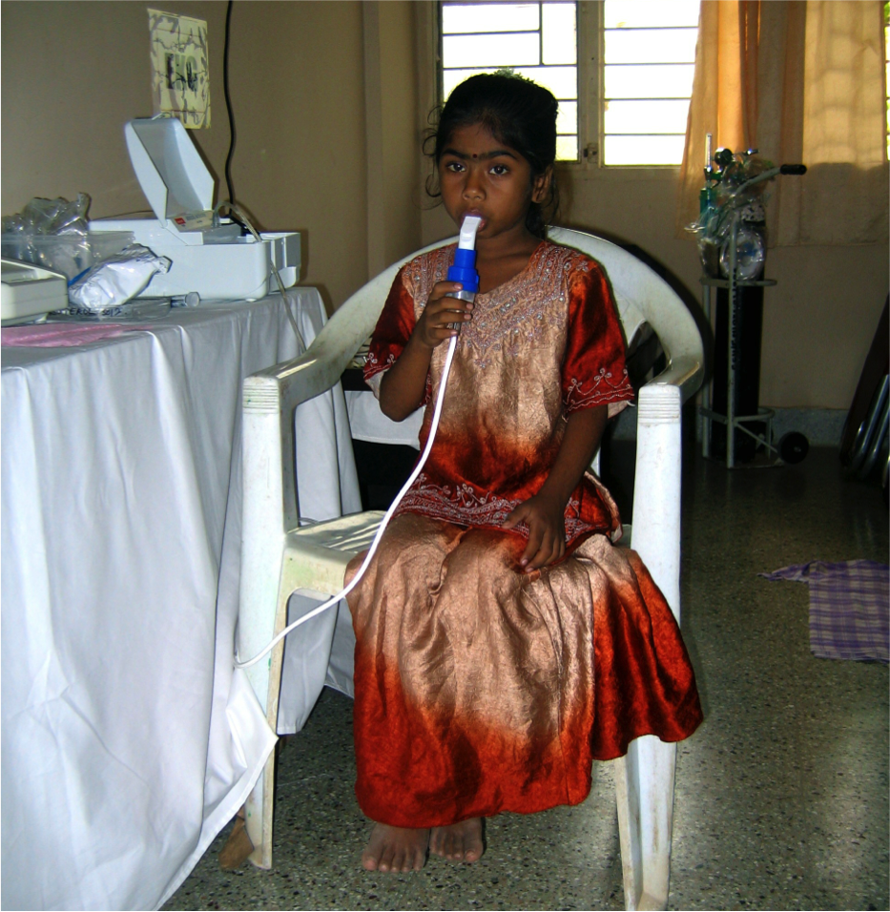
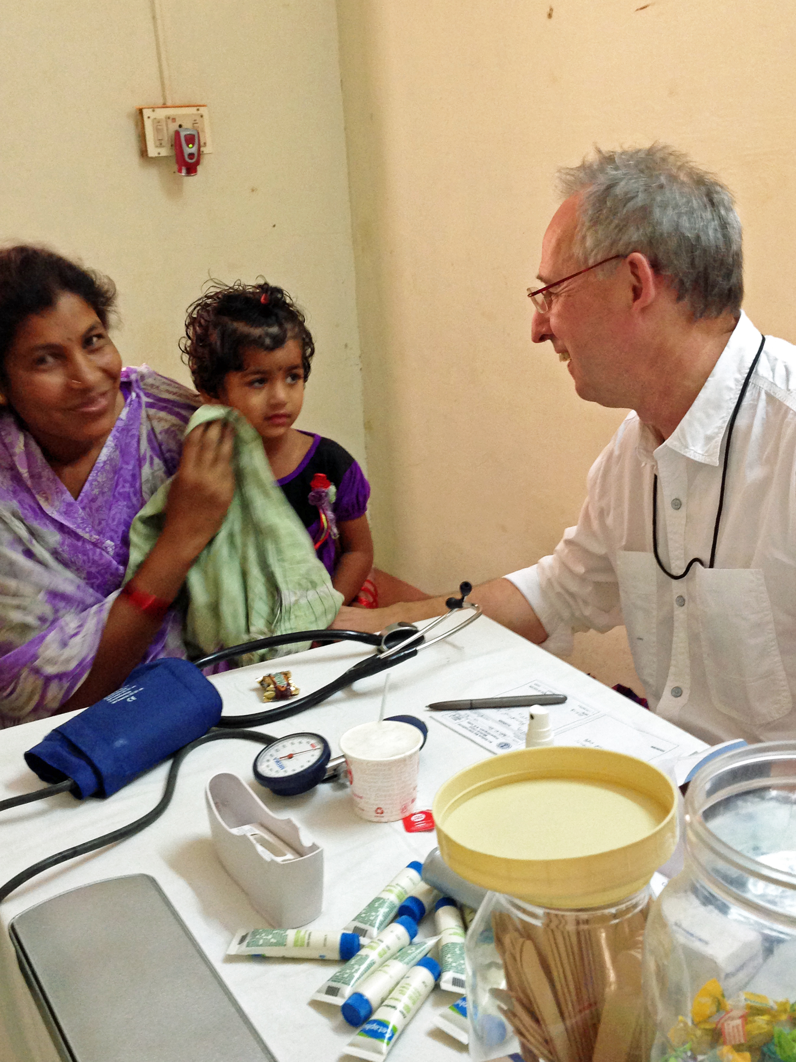
Prasanthinilayam

Slide 6
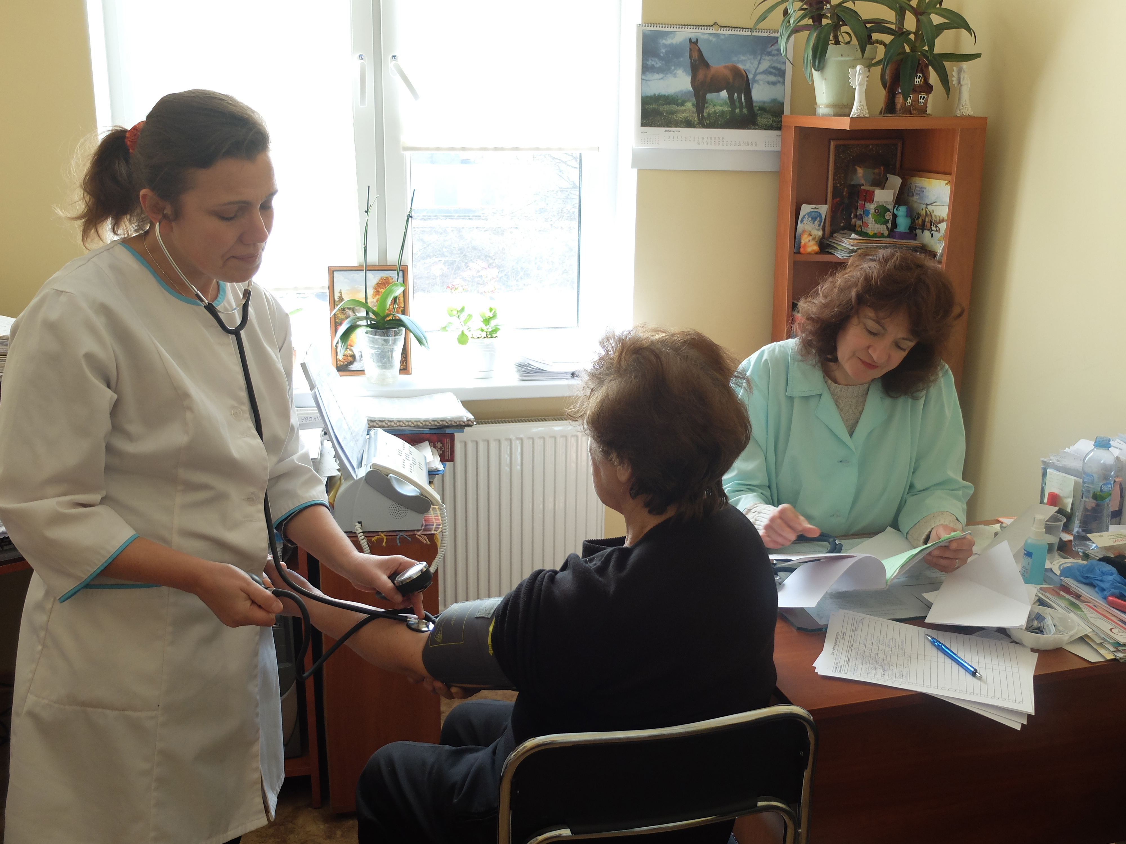
Medical Camps
Kazakhstan
125 volunteers including doctors
2 medical camps, 5,721 patients
3 Healthcare teams visited 10 villages in a 60 Km radius

Slide 7
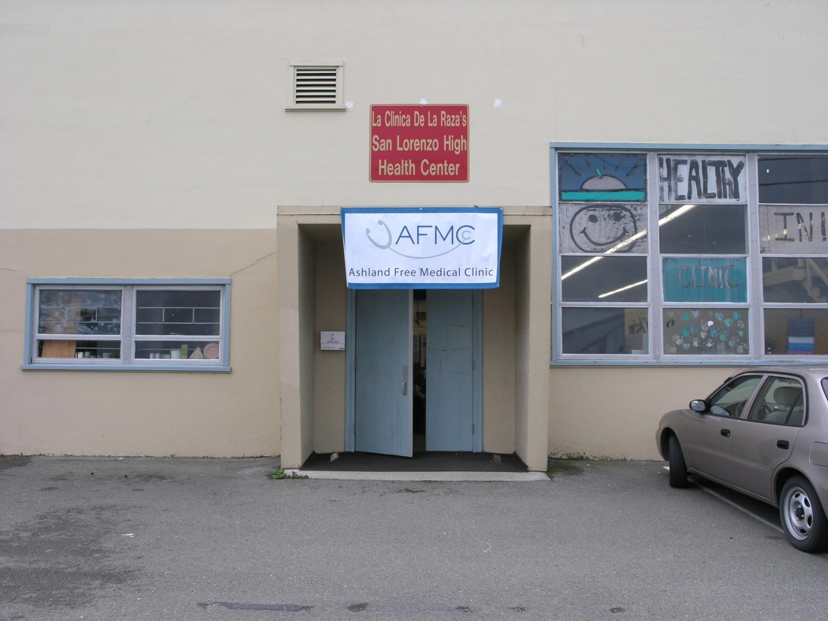

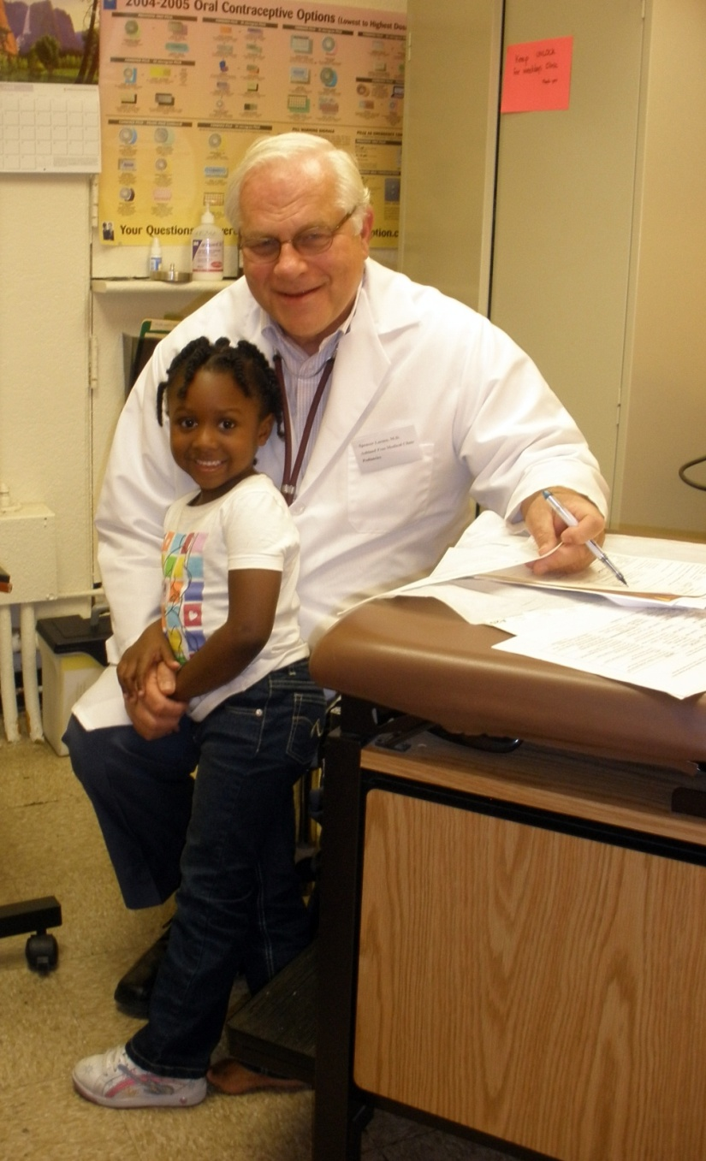
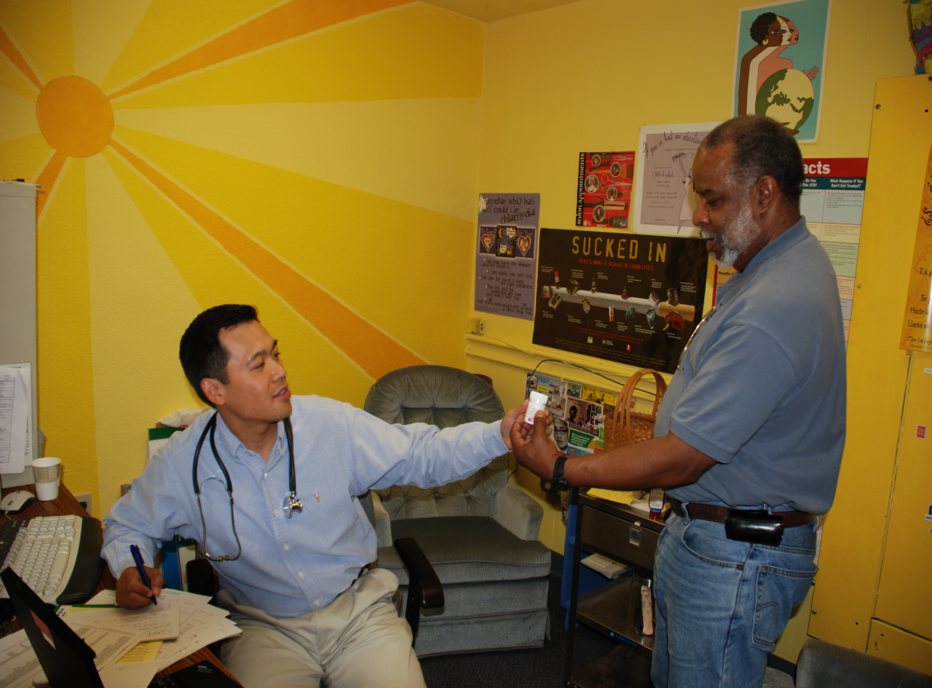
Medical Clinic

Slide 8
Medical Supplies
Shipment of goods and supplies to India valued at US$ 233,875
Medicines and transportation of medicines to Philippines valued at US$ 46,000
Total 2013-2014 global: US$ 279,875
Since 2009, Grand total: US$ 3.2 Million

Slide 9
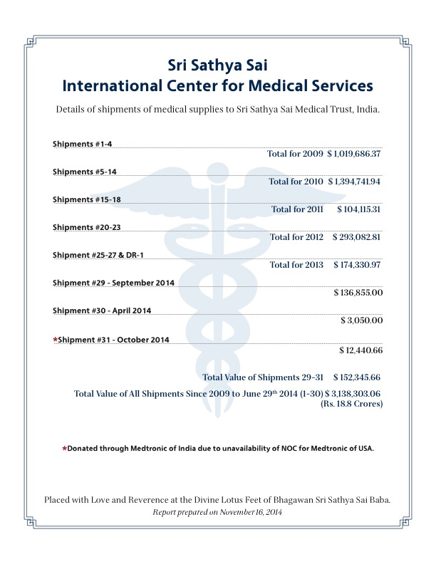
Medical Supplies

Slide 10
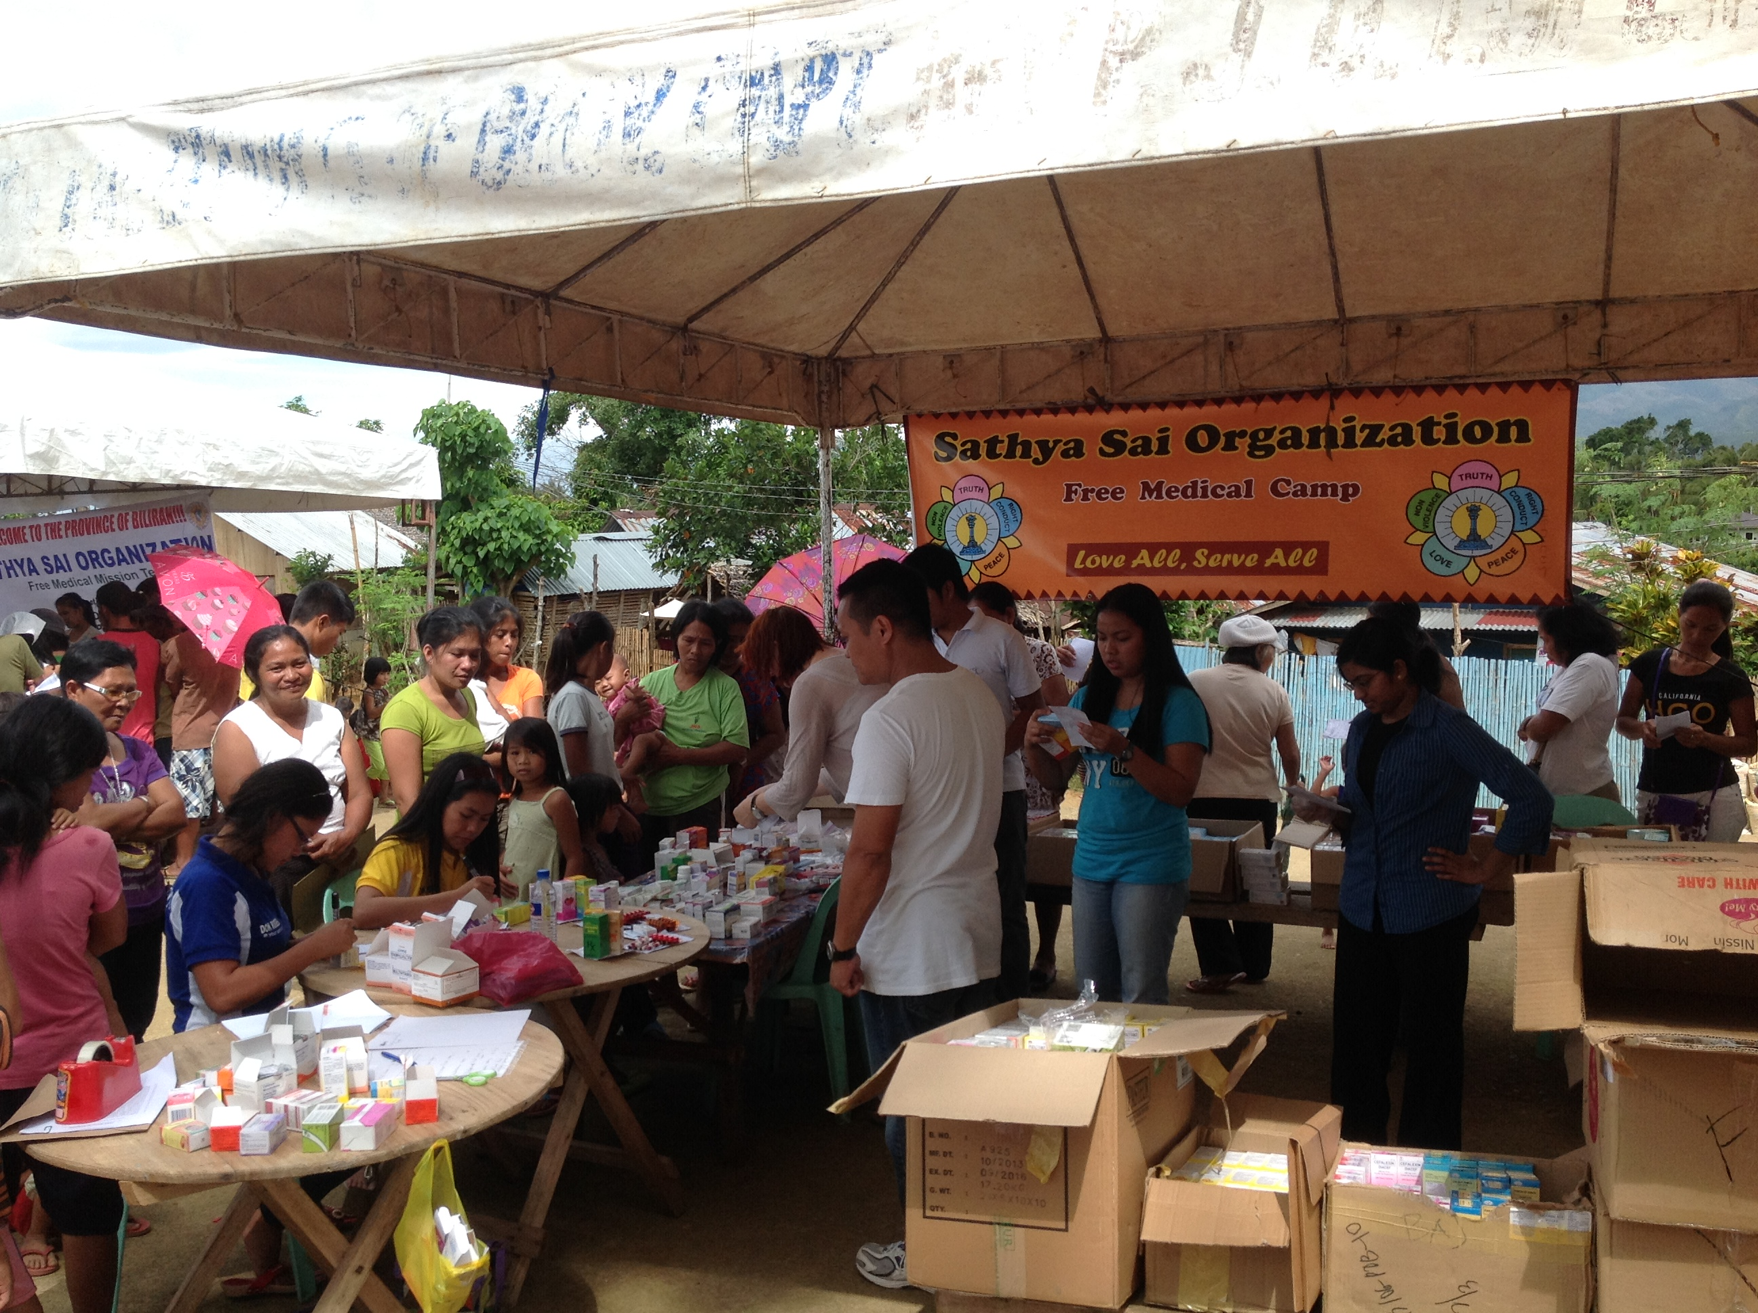
Philippines
November 2013 – Typhoon
December 2013 – SSIO visits Philippines
February 2014 – Medical Camps begin
Patients: 6,620
Medicines: About 1.5 tons
Wheelchairs: 9 villages

Slide 11
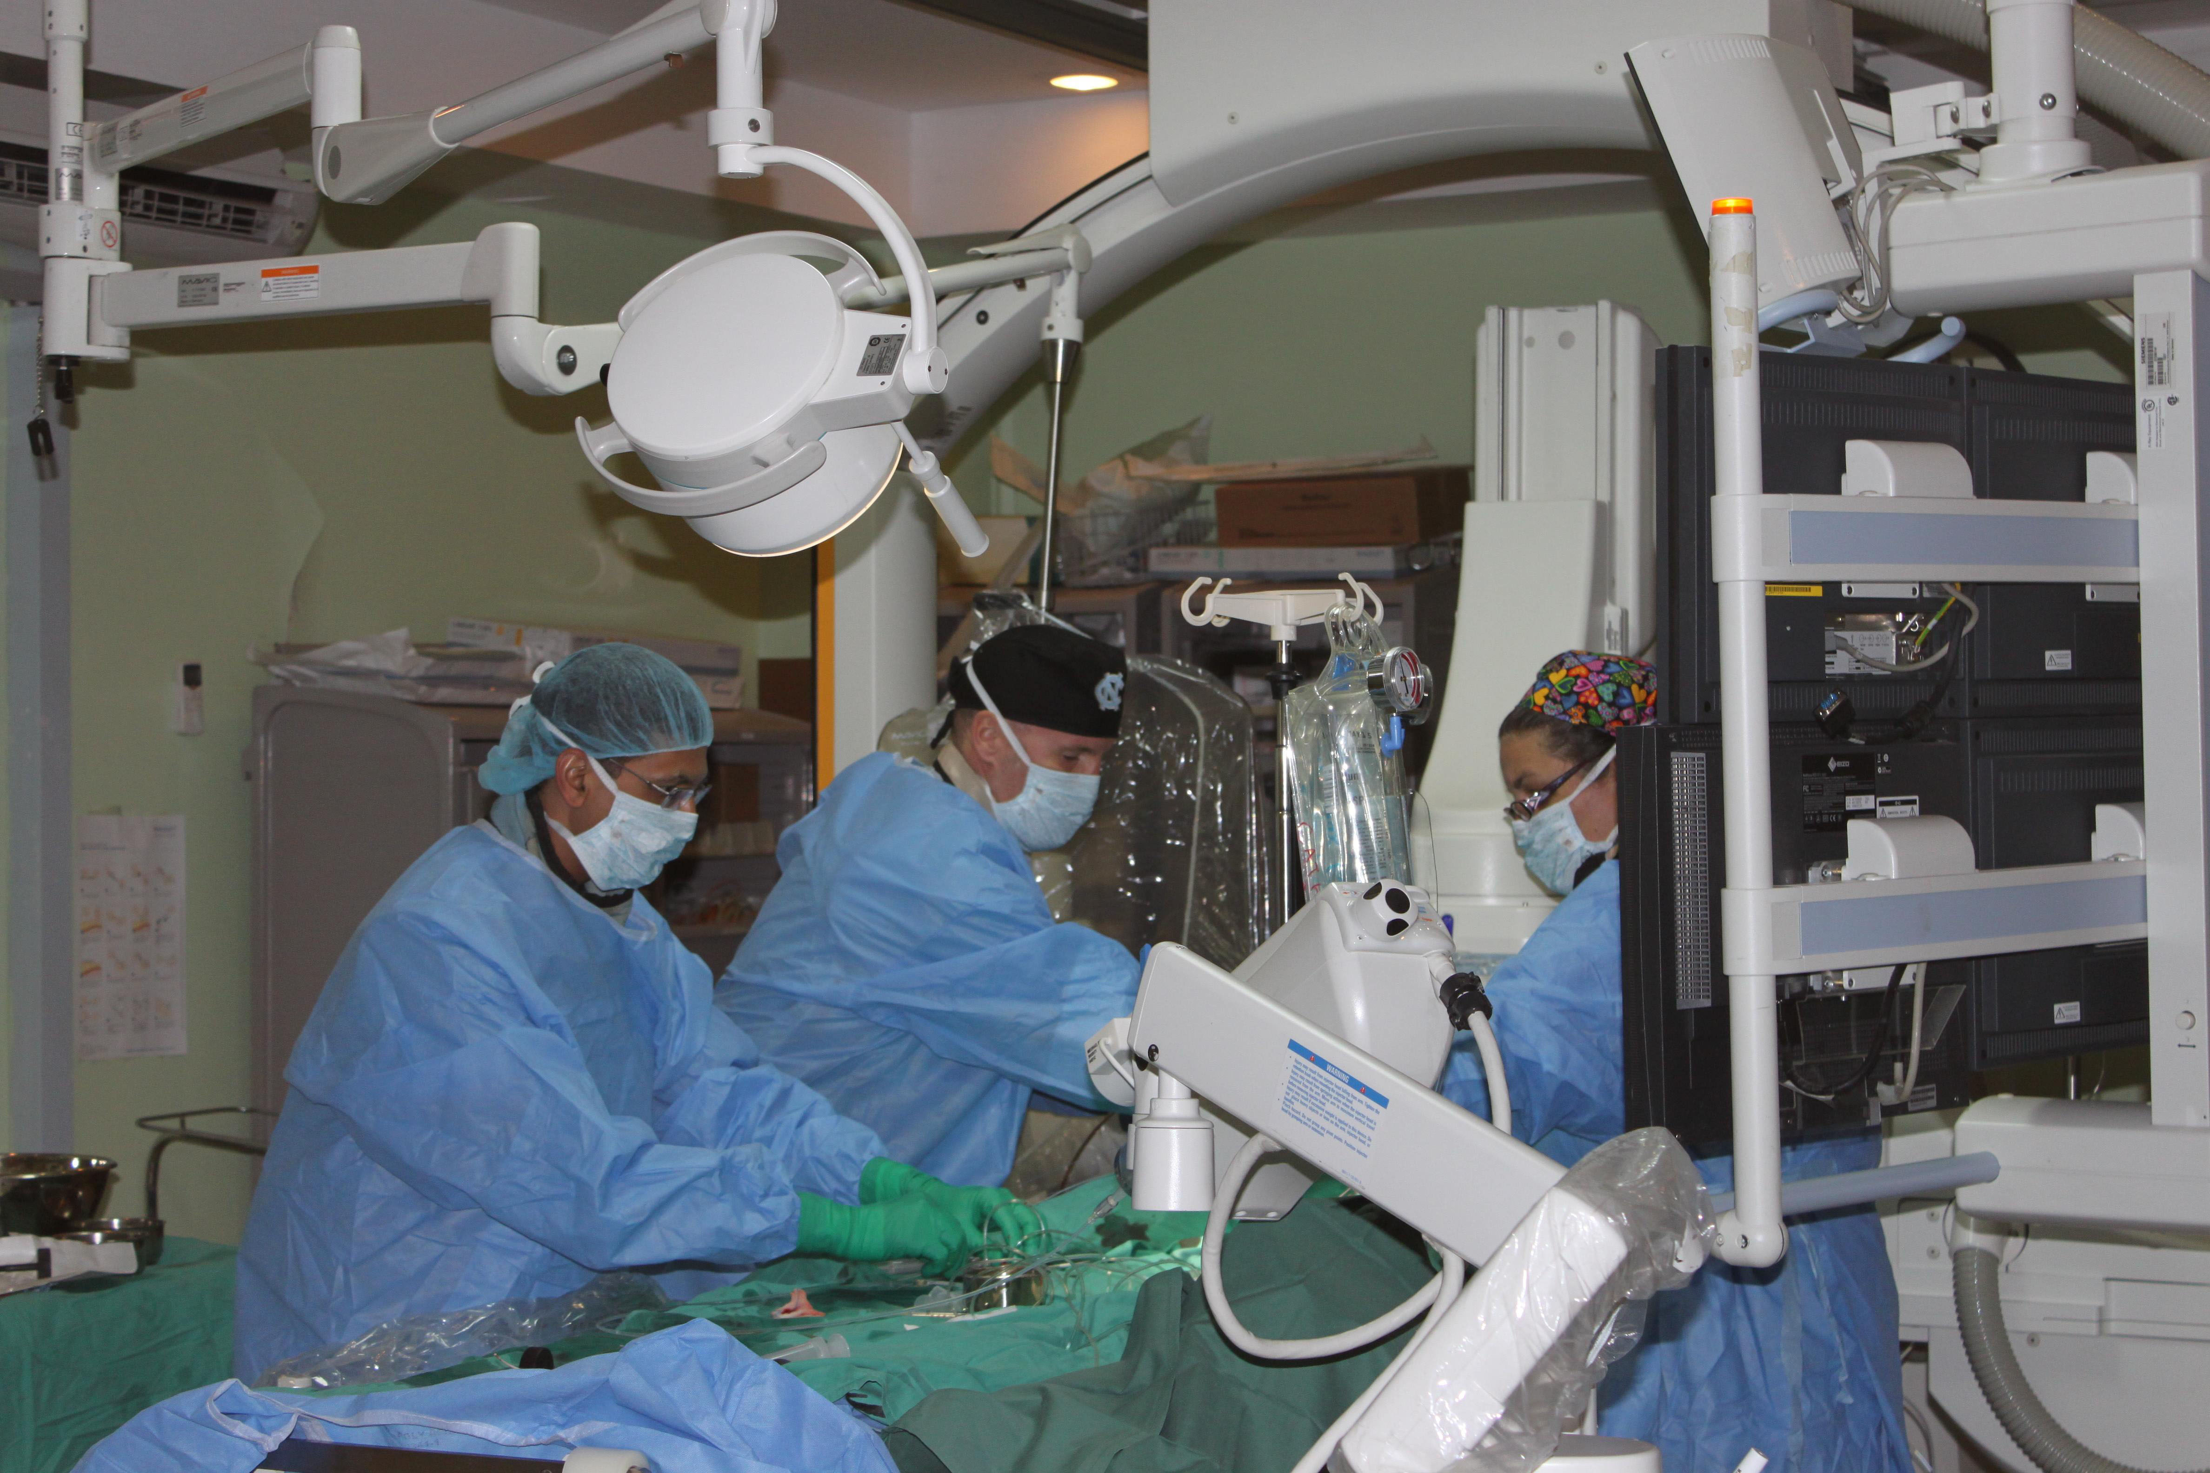
Trinidad
Children:
114 babies seen, 25 cardiac interventional procedures
Adults:
68 angioplasties

Slide 12
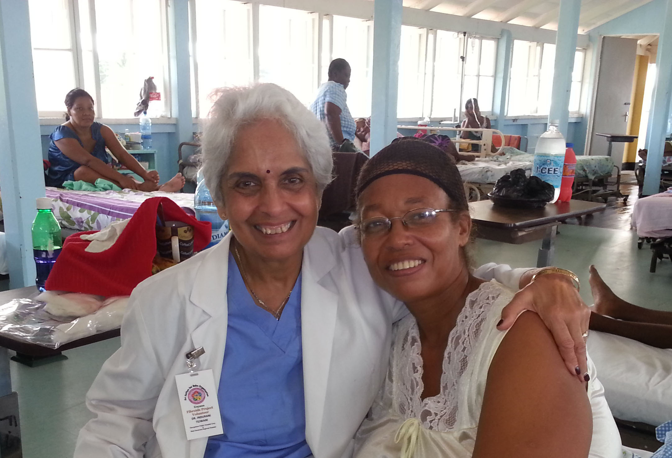
Guyana
At the invitation of the President of Guyana
52 uterine fibroid surgeries performed

Slide 13
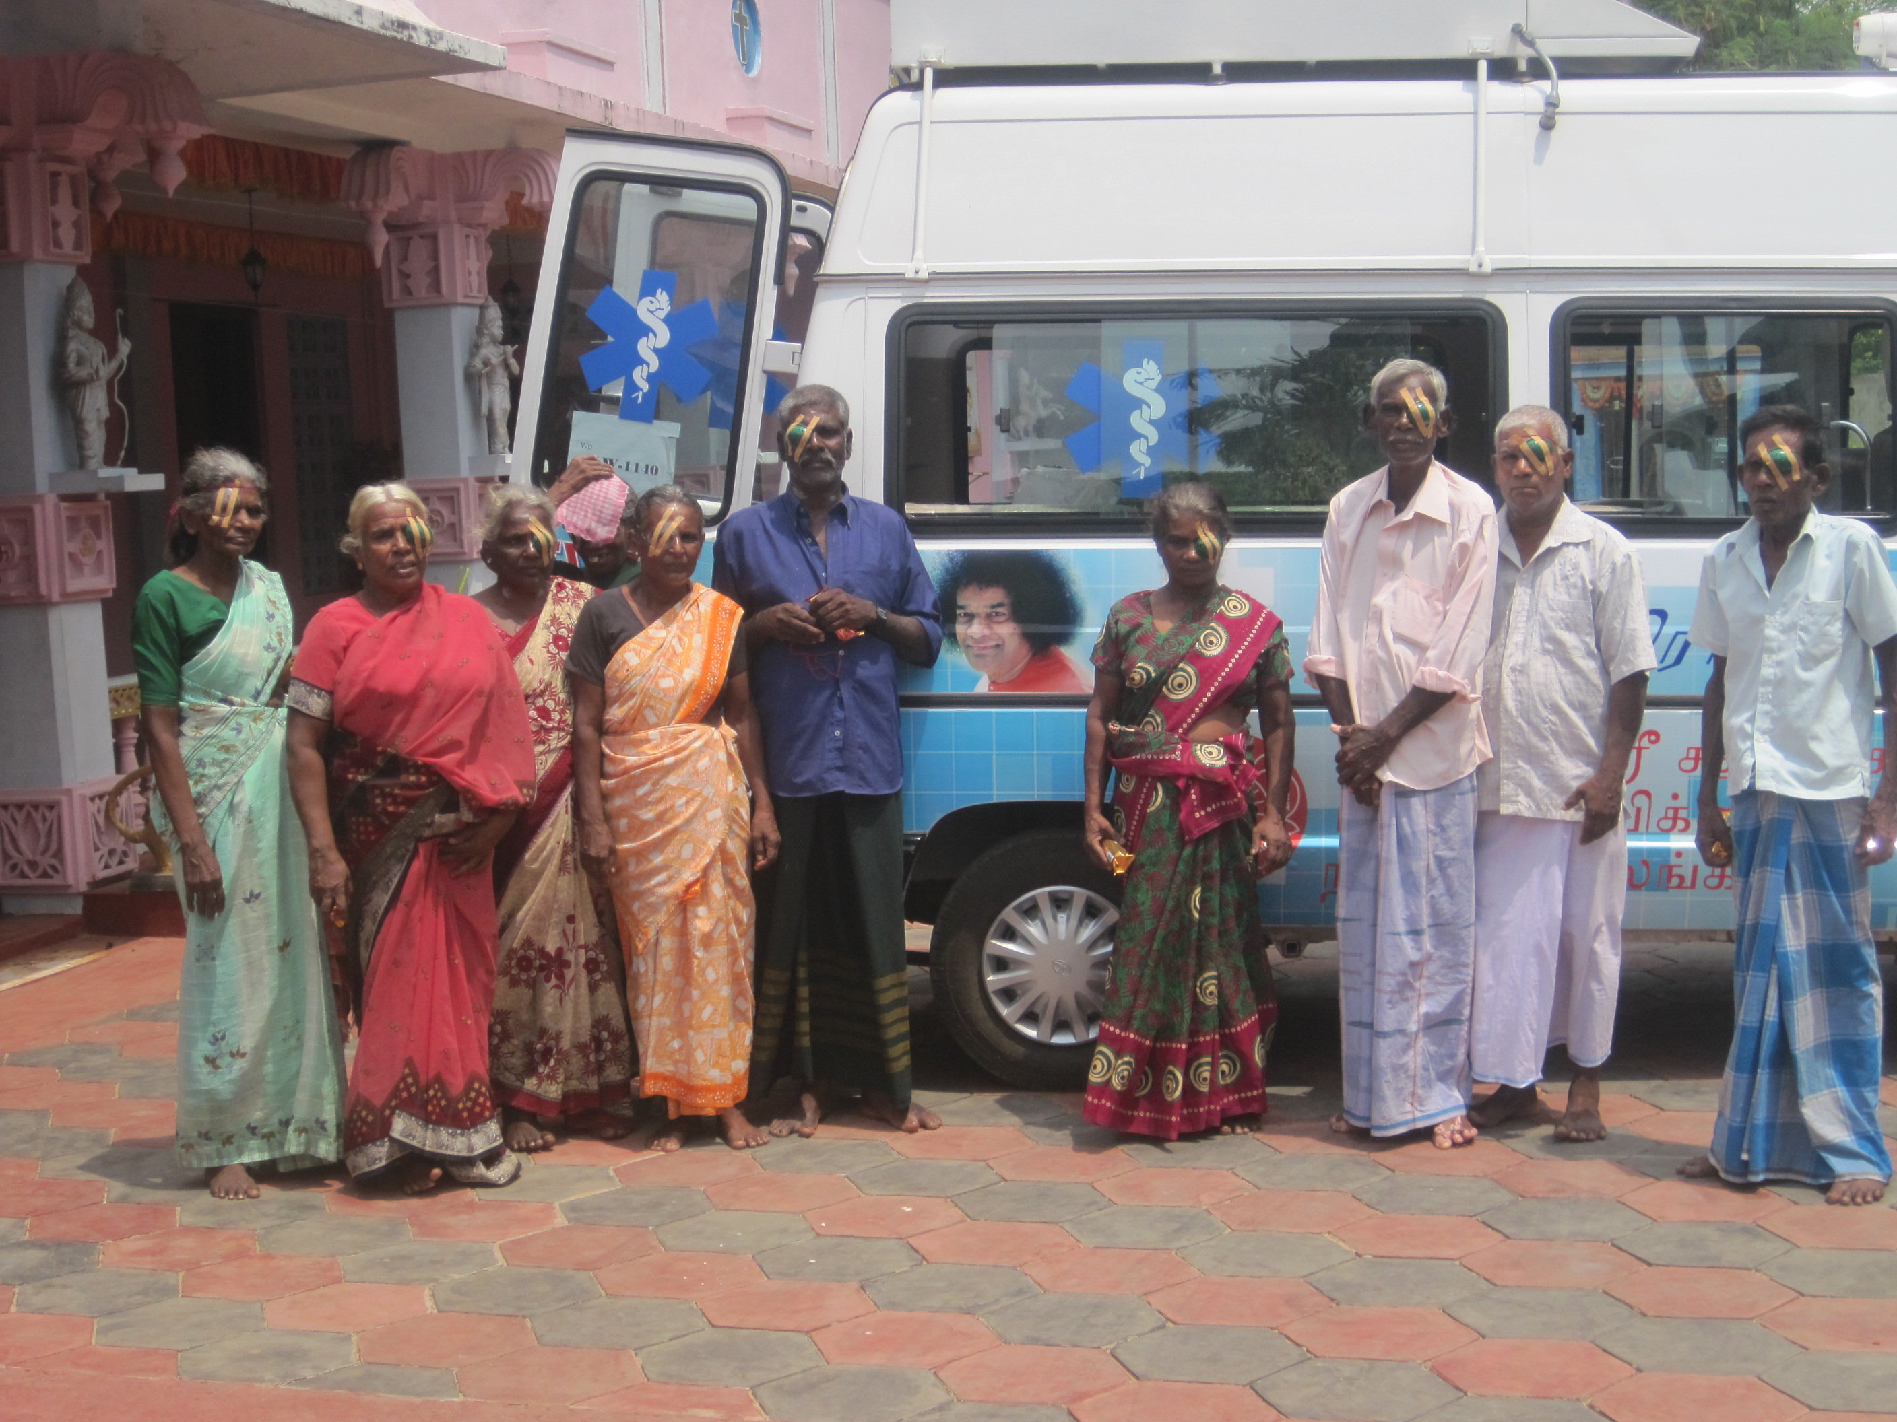
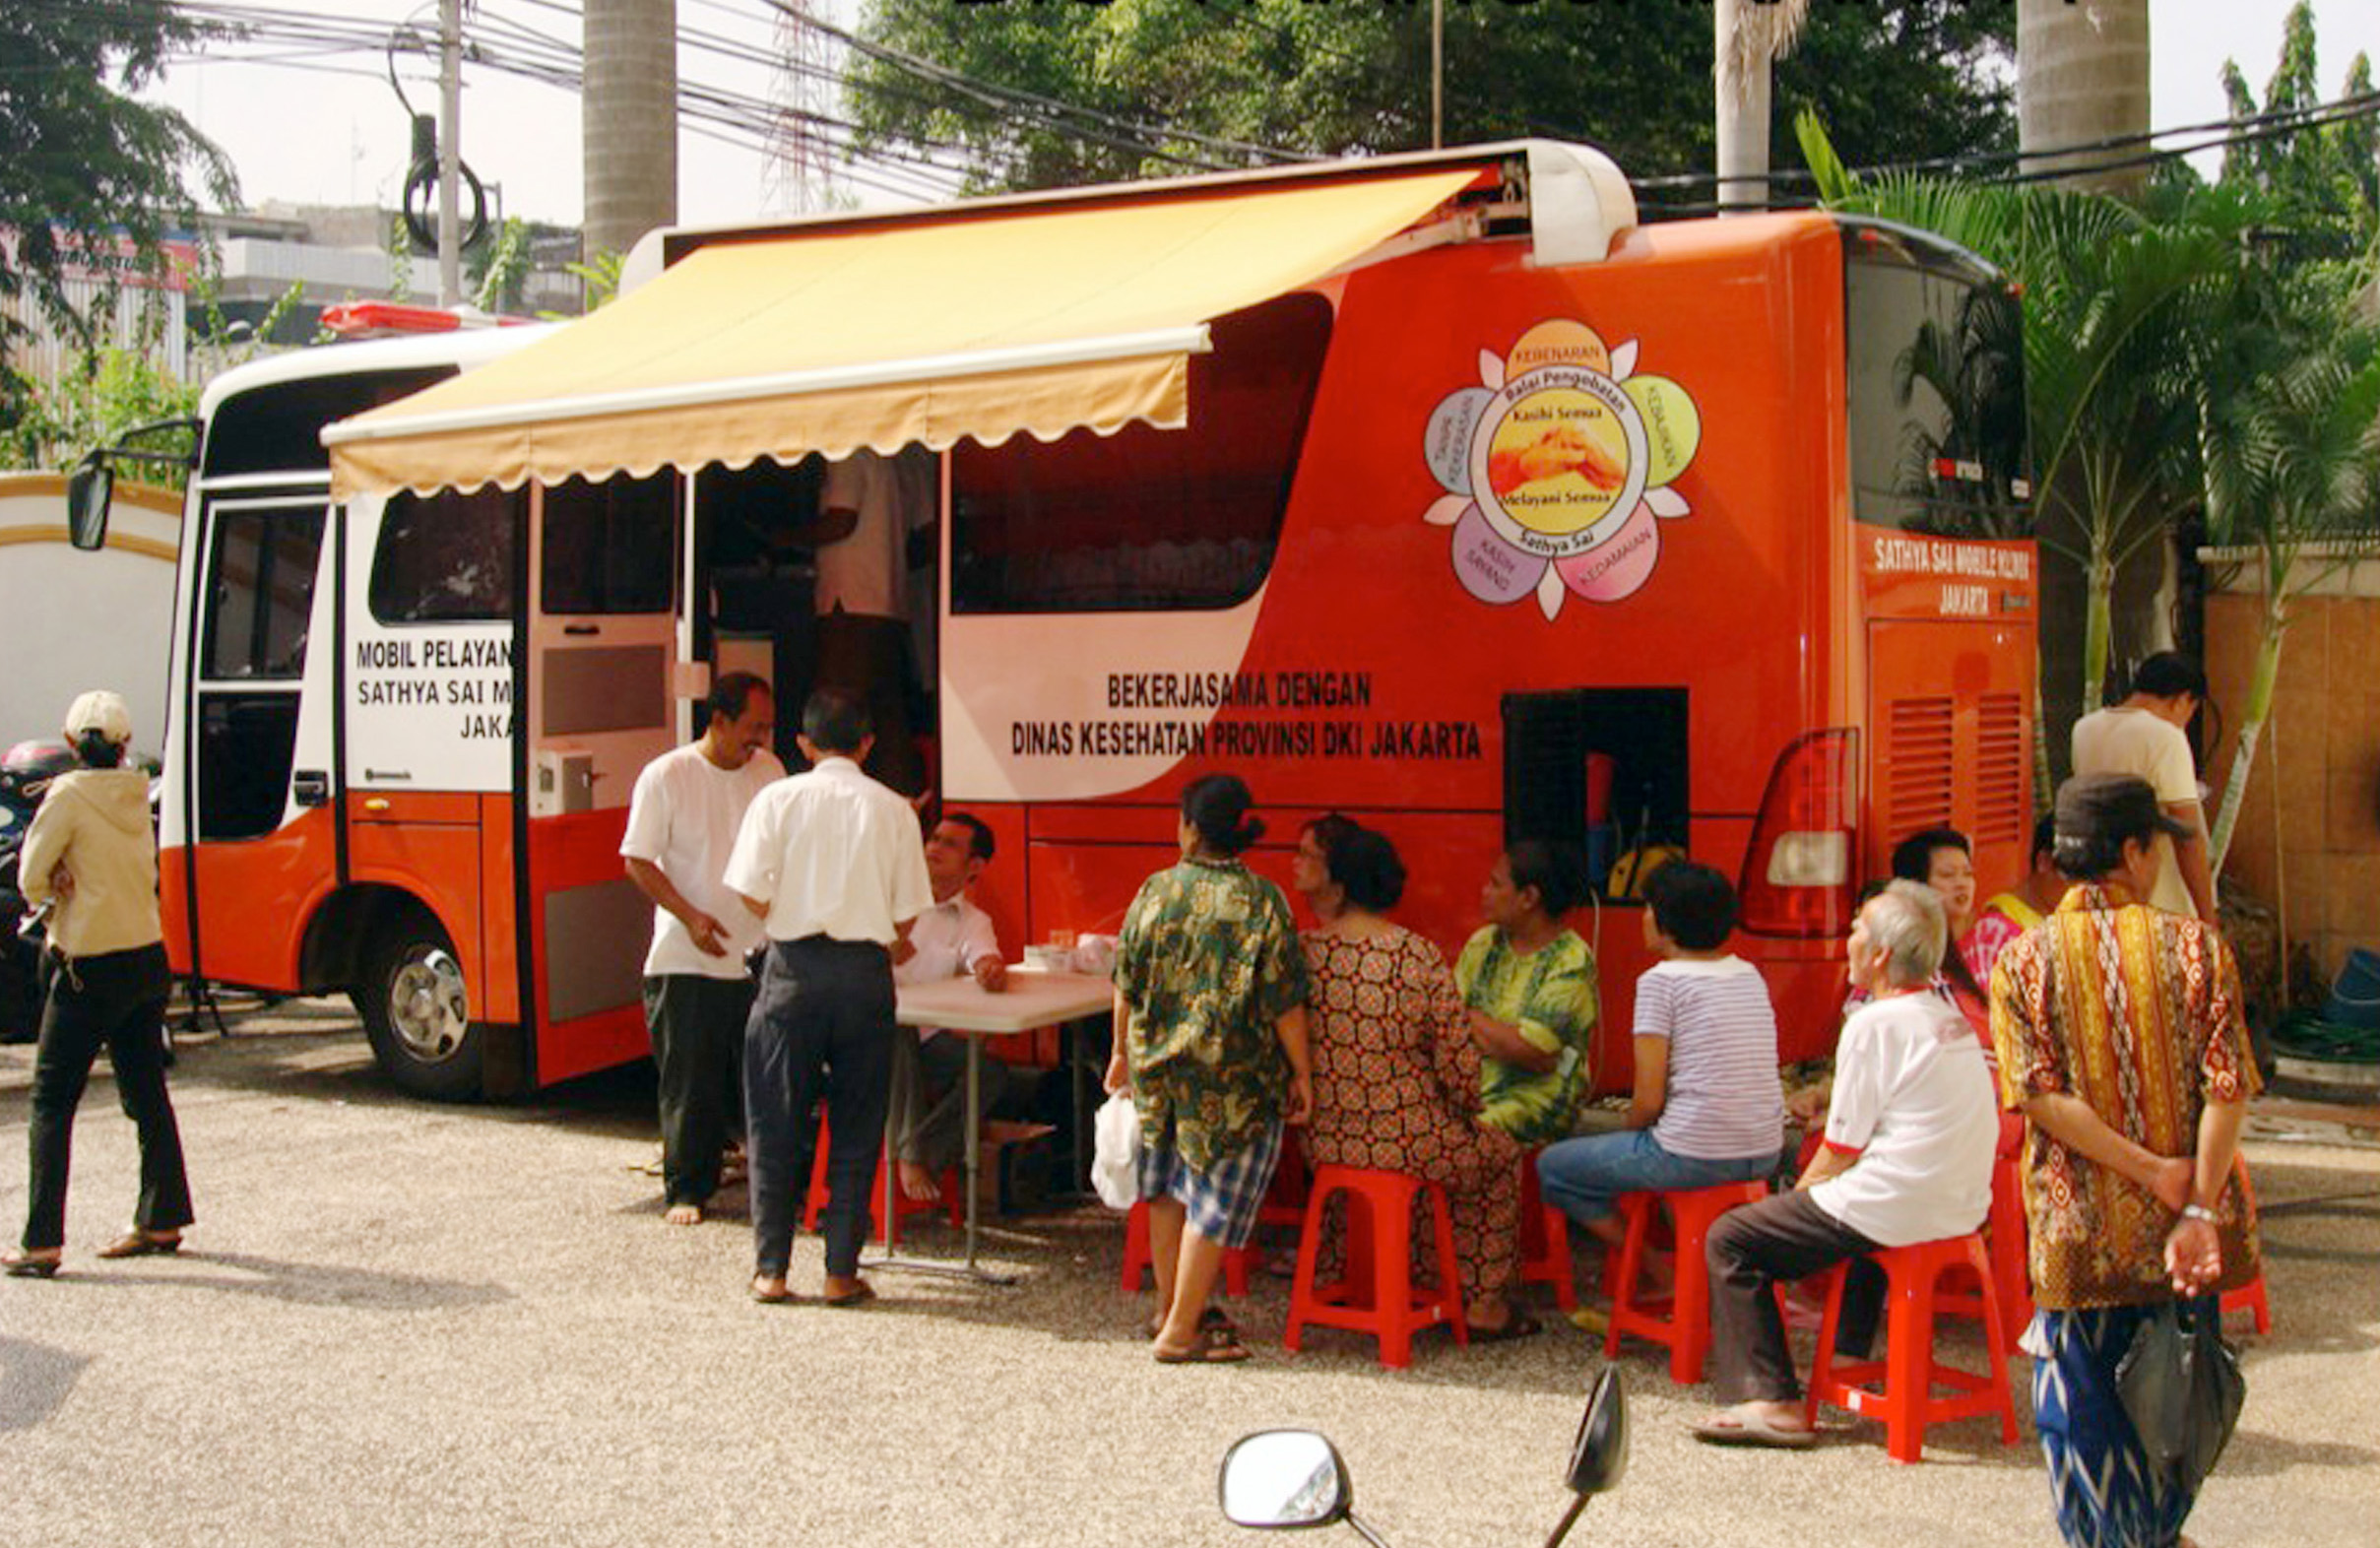
Mobile Clinics
4 countries – Indonesia, South Africa, Oman, Sri Lanka
32,000 patients

Slide 14
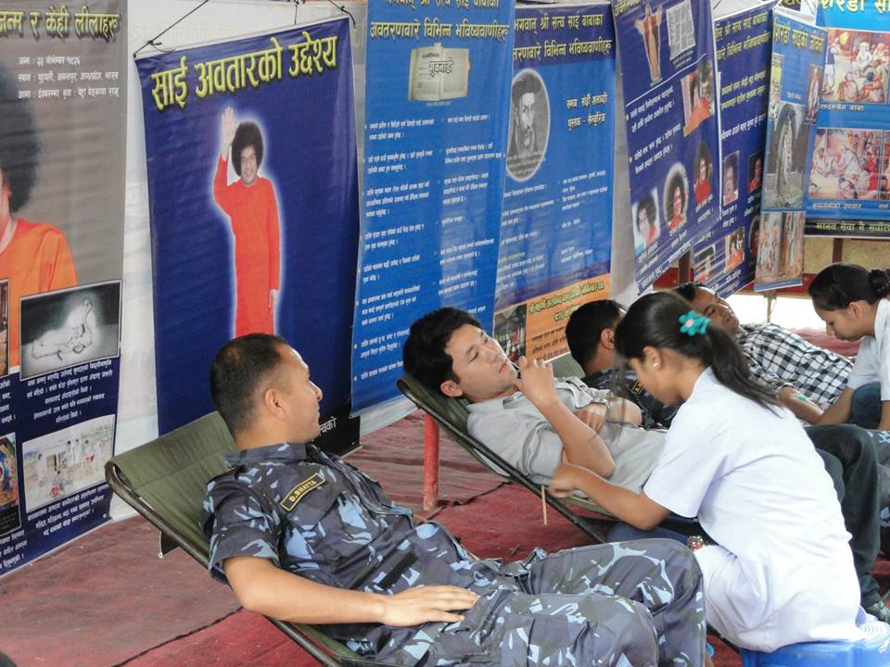
Blood Donation
10,000 pints of blood, 100 blood donation camps, 6 countries
Awards in each of the 6 countries

Slide 15
Jai Sai Ram

