Slide 1
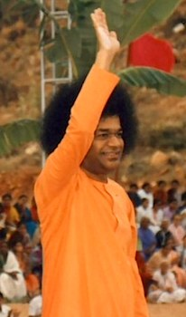
SSIO Media Coordination Committee Progress Report
November 2014

Slide 2
Status Update
Media Committee formed Nov 2013
Members: Alida Parkes, Pravin Wagh, Ashok Sakhrani, and Anupom Ganguli
Zone Media Coordinators and Senior Officers
Web Seminars held for all 11 Zones in October 2014 – Over 50 participants
SSIO 2013-14 Annual Report prepared
Two New Initiatives in 2014
Introductory Videos (3) – under preparation
Sathya Sai Universe Website – Launched April 2014 – Updated Regularly
Articles, Pictures, and Video Quality Improving – Thank You!

Slide 3

Reports, Photographs, Videos
Some Zones are submitting excellent material
Media Coordinators need support
Senior Leaders need to help and provide guidance
Quality of articles, pictures, videos – very important to review
Media Team Inbox: MediaTeam@sssio.org

Slide 4
Process for Sharing Media Material
Generation of Report
Review and Transmission
Distribution of Report, Article, Story..

Slide 5
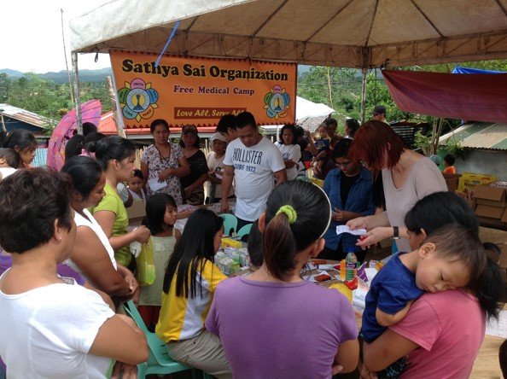
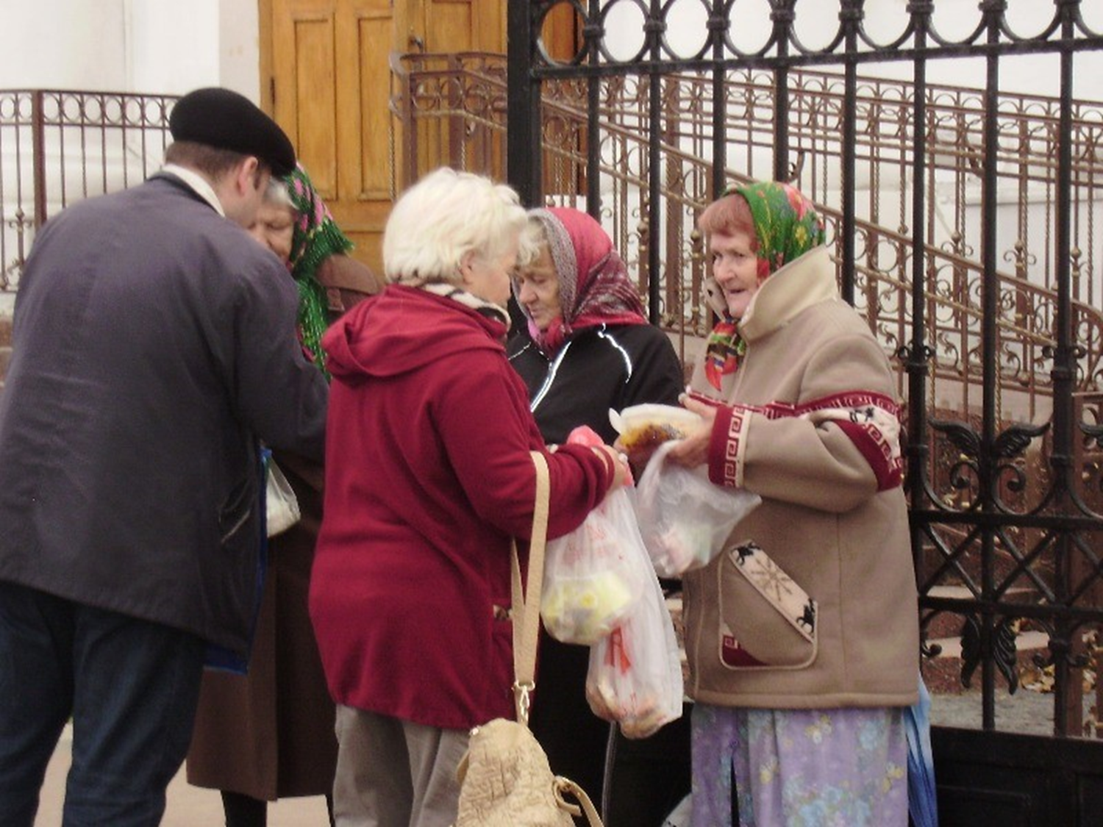
YOUR ZONAL TEAM OF SPECIALISTS
WRITERS – prepare appropriate articles
EDITORS – professional, accurate, attention to detail
VIDEOGRAPHERS – high quality videos
PHOTOGRAPHERS – high quality images

Slide 6
PLAN AHEAD
Identify events, programmes every Quarter
Assign volunteer(s) to:
Collect facts and figures
Take high-resolution (4MP or higher) pictures
Prepare article in 100 – 300 words
Review & Submit within 30 days
Review by National President, Central Coordinator, Zone Chair to review
Send to MediaTeam@sssio.org, with a copy to Dr. Reddy

Slide 7
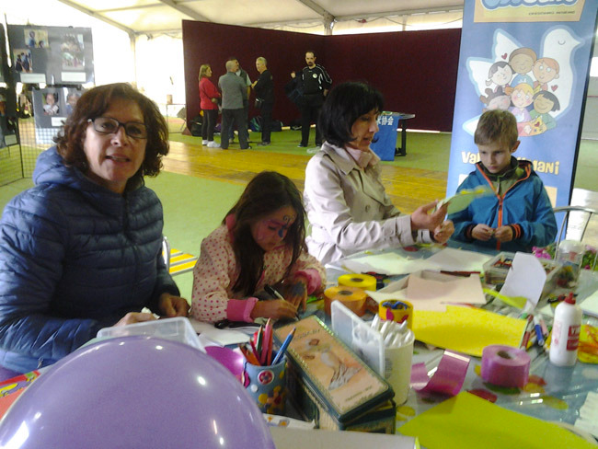
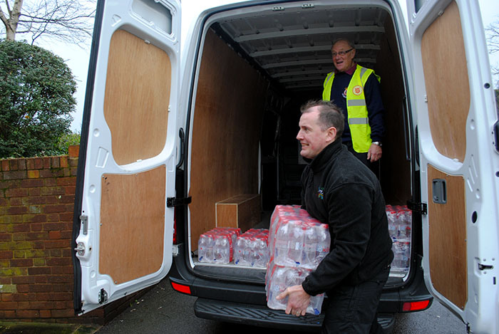
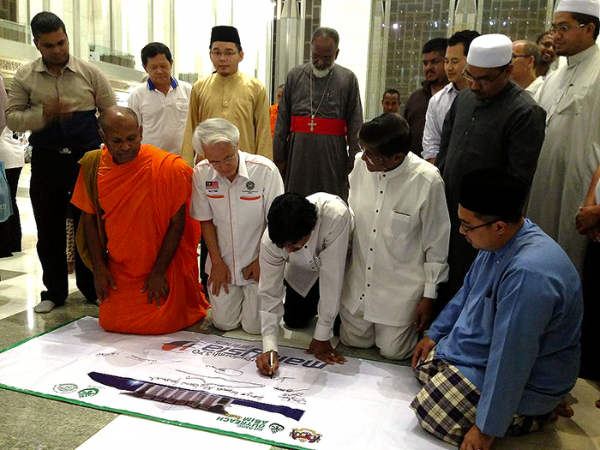
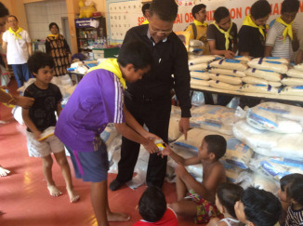
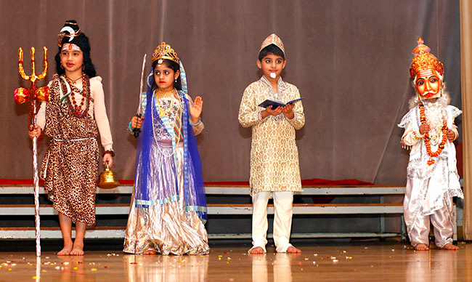
Sathya Sai Universe
Website launched in April 2014: updated regularly
Special Features: Latest Articles; Google Translator
Videos coming Next
Please add saiuniverse.sathyasai.org to your website, email, other media….
Kindly distribute updates to Centres, Groups, devotees

Slide 8
New Video Project
Producing 3 Videos: Introduce SSIO
Introduction, Structure, Centres, Activities, Websites
12-, 6-, and 3-min. long: English
Suitable for Devotees and Public
For use by all Zones (with subtitles, if needed)
Received video clips from S. Africa, Zambia, Hong Kong, Greece, Italy, USA,…
Under Preparation… Stay Tuned!

Slide 9
Video Clips still Needed
Meeting Newcomers – Guests introduced to Centre, Sai literature, and activities, etc.
Members doing service activities (e.g. packing food, preparing food)
Sathya Sai Mobile Clinics, Camps, Neurosurgery, Operations, etc.
Disaster Relief Examples:
USA Hurricane Sandy,
Haiti Earthquake,
Philippines Typhoon Haiyan (Yolanda),
Balkans Floods, etc.

Slide 10
2013-2014 SSIO Annual Report
April 2013 – March 2014
Zone Reports
Educational, Health, and Youth Activities Reports
Offered to Swami at 89th Birthday Celebration
Thanks to Everyone who helped with Photos, Reports, Review…

