Slide 1
Education Committee Report
Marianne Meyer
Hymon Johnson
Doris Hampton
Dalton Amorim
Srinivas Raghavan
Artong Jumsai
Genoveve Kanu
Pal Dhall

Slide 2
Current status
Currently 39 Sathya Sai Schools and 30 ISSEs
Schools and ISSEs take around 20 years to become established
Wonderful work all around the world is being done both in the SSE and SSEHV through Sathya Sai Schools and ISSEs
New applications for an ISSEs and Sathya Sai Schools

Slide 3
Post Conference Progress Report
Several ISSEs and Sathya Schools have become well established and are gaining wide recognition
Not all ISSEs and Schools are at the same level of development
Exchange of expertise and assistance by EC is enhancing the institutions that need further development

Slide 4
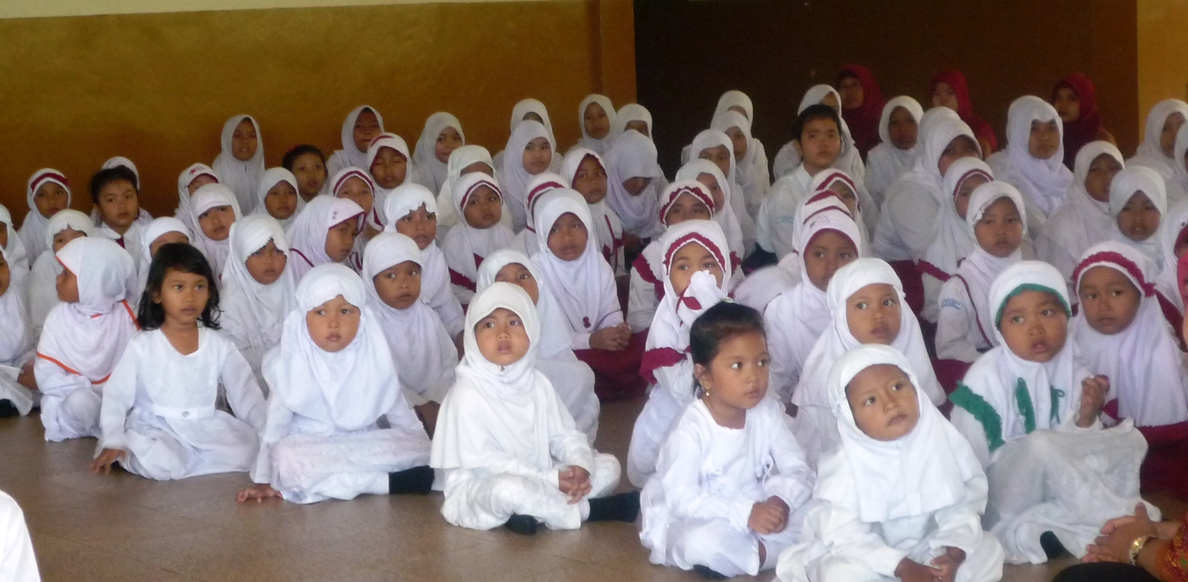

Slide 5
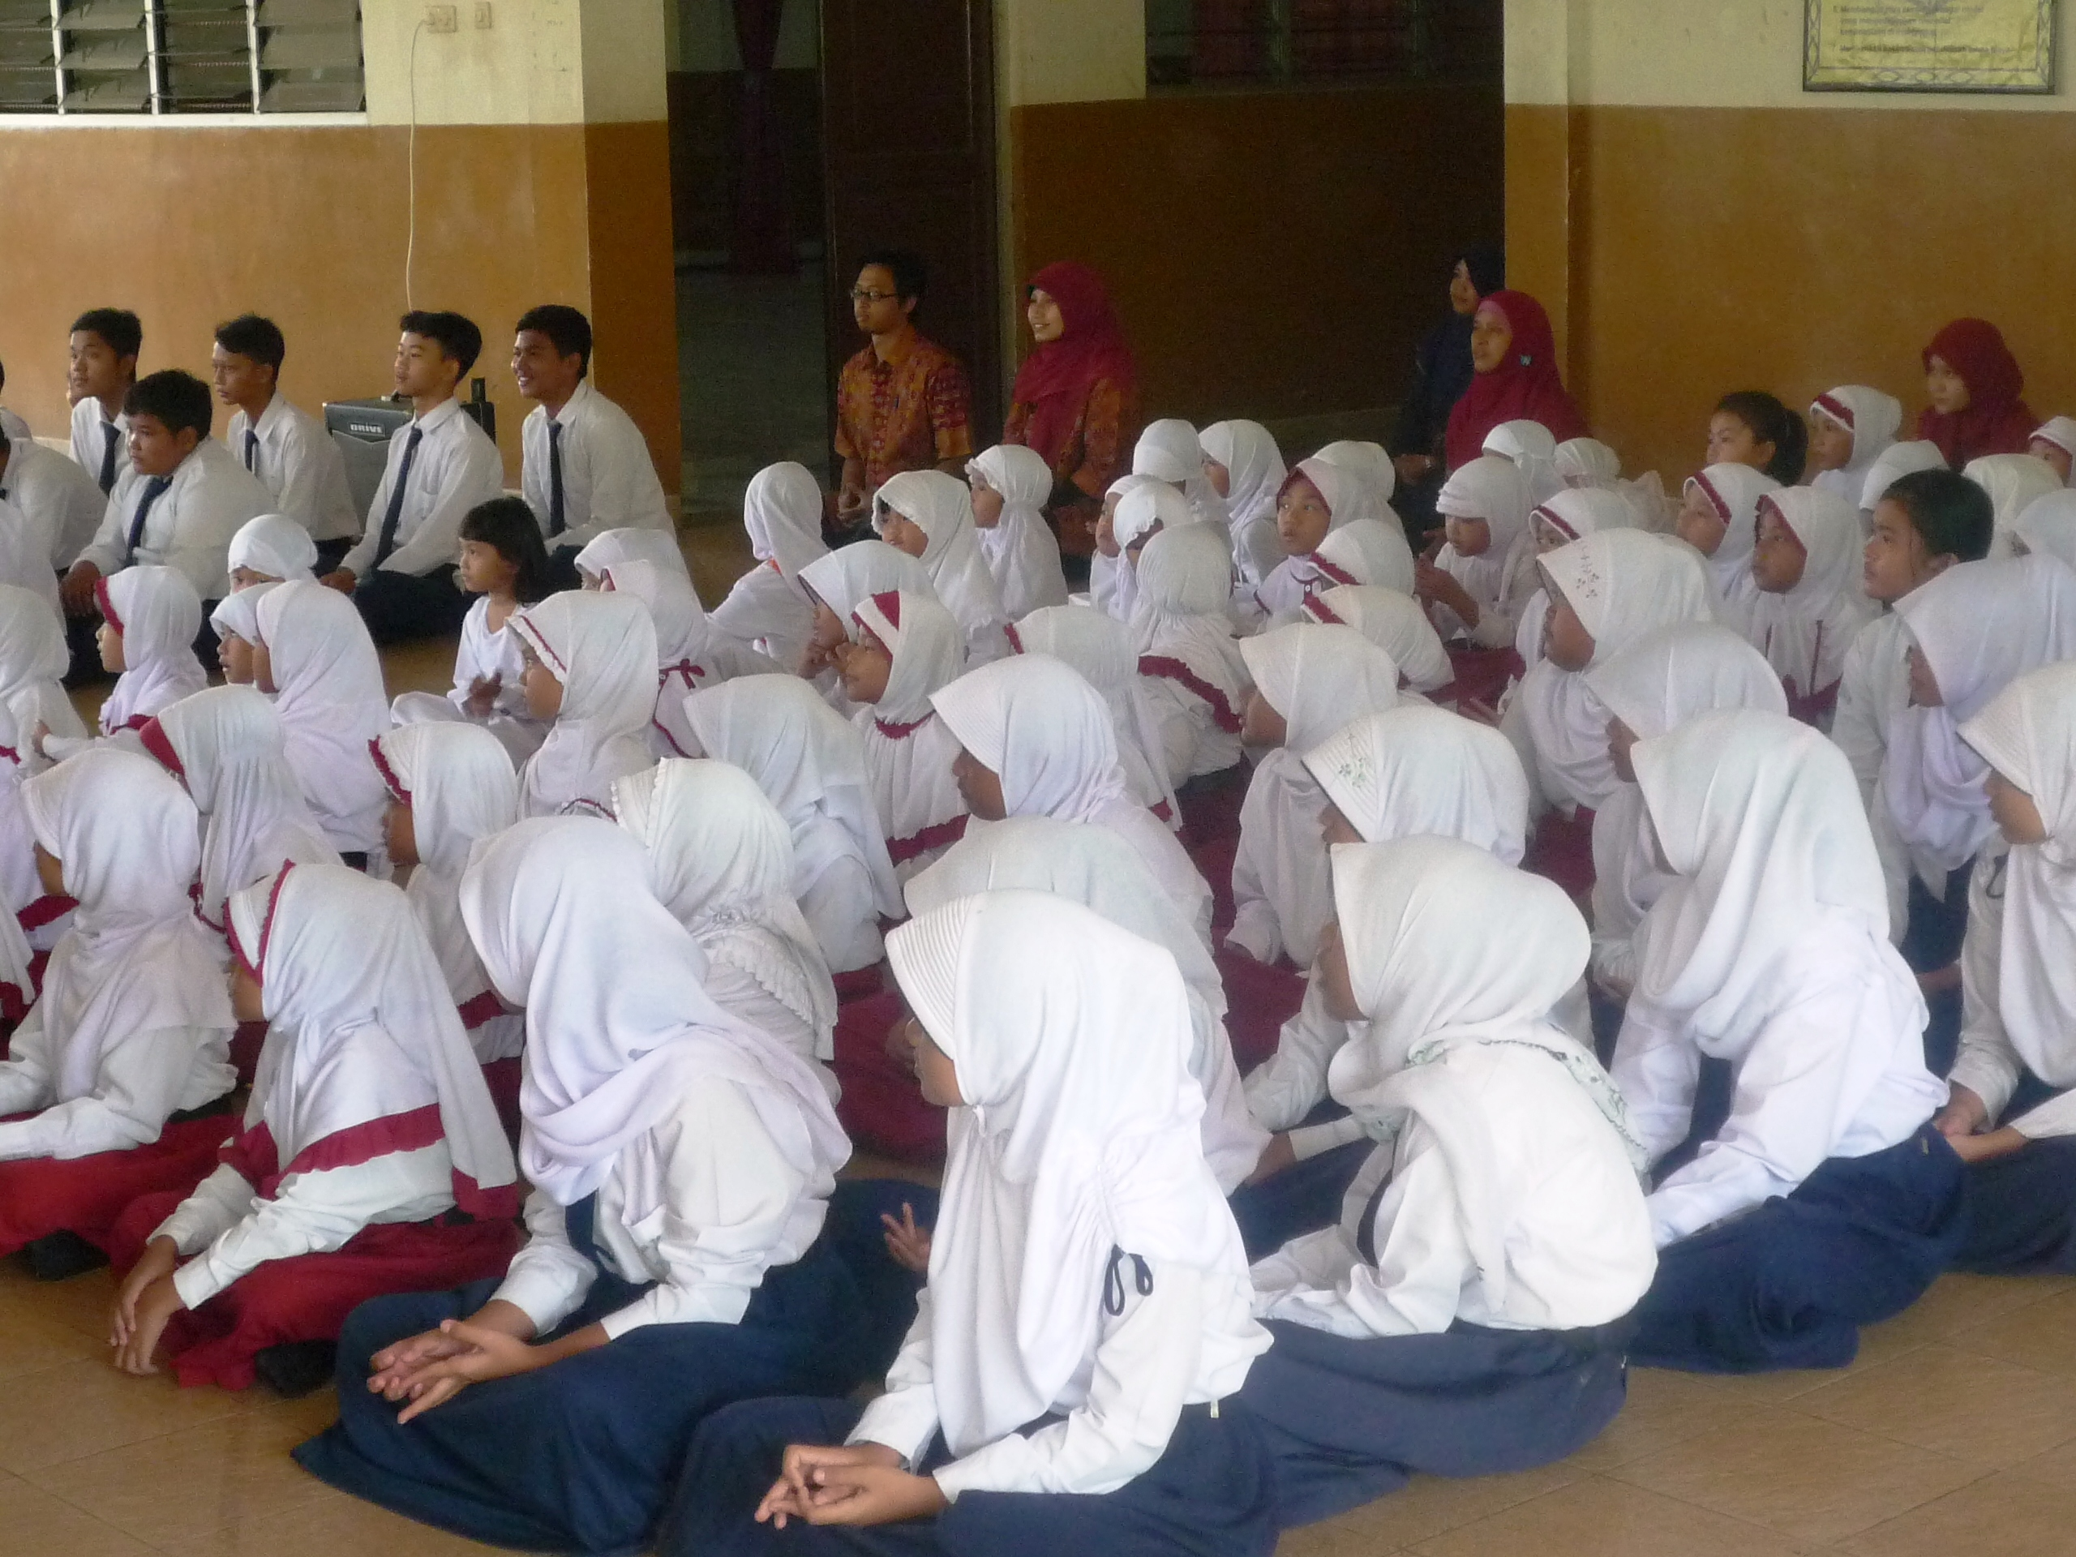

Slide 6
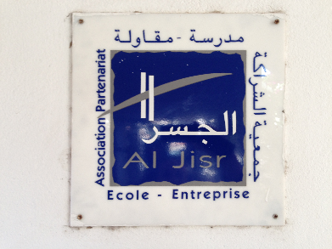
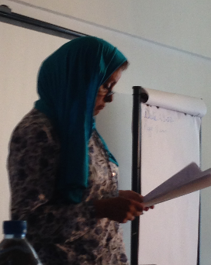
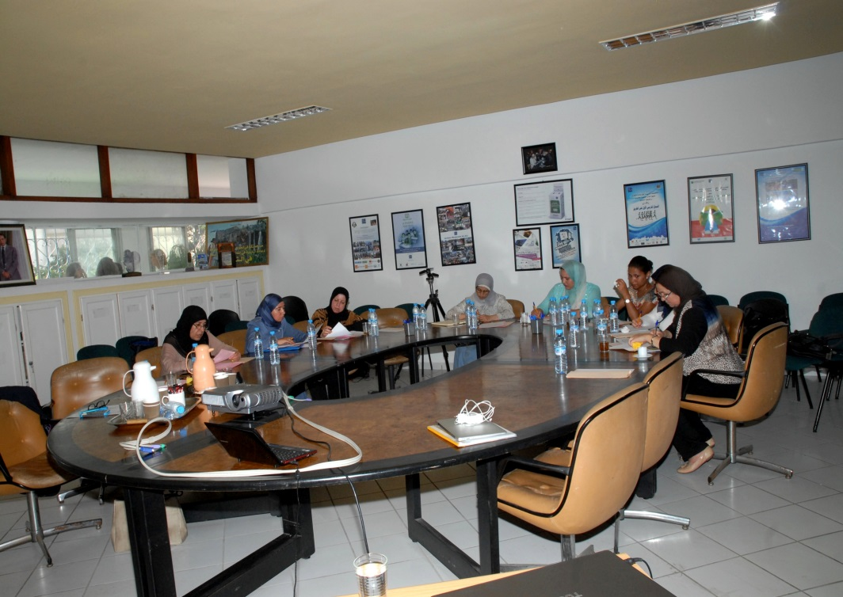
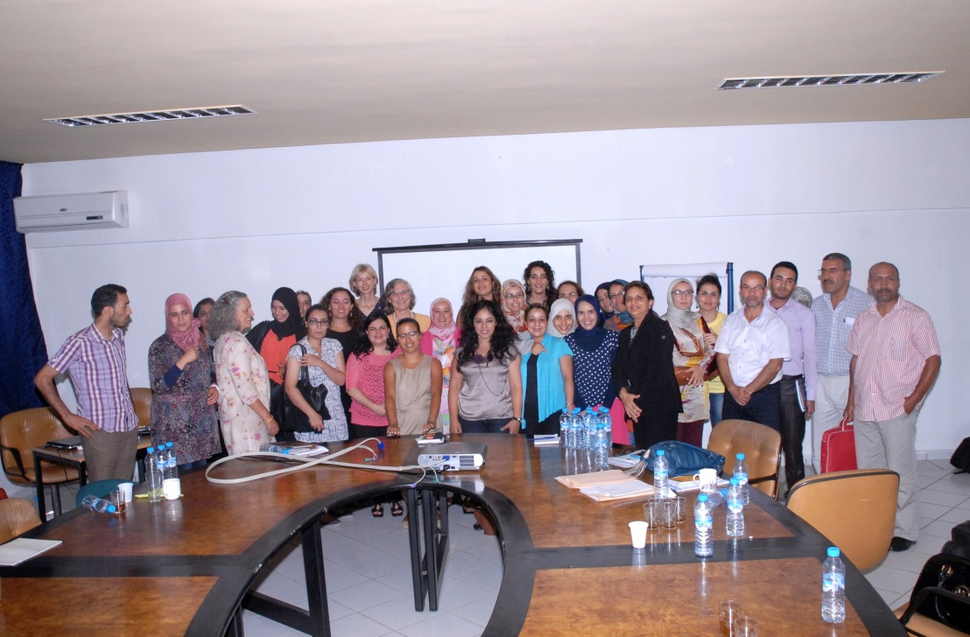
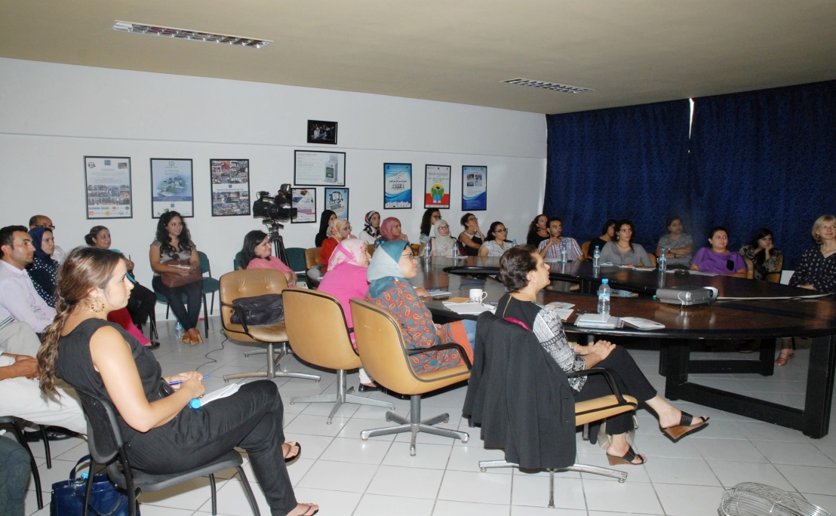
2 Seminars in Morocco in cooperation with the organisation Al Jisr & a Private school

Slide 7
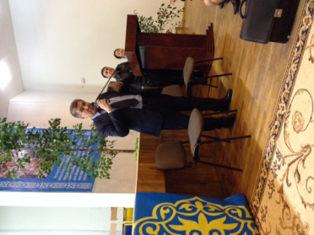
SSEHV Seminars in Kazakhstan in cooperation with The “Bobek” National Research, Education, and Health Improving Centre, Almaty
Course 1 Module 1:
250 participants
Course 1 Module 2:
50 participants
Teachers and directors of the “Bobek” Centre
Teachers from Higher Educational Institutions
Public school teachers from all over Kazakhstan
National teacher trainers
Shunaev Zh.S.
General director of Bobek Centre

Slide 8
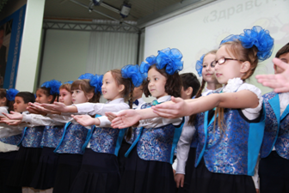
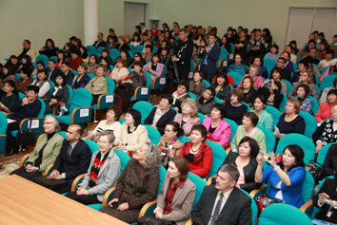
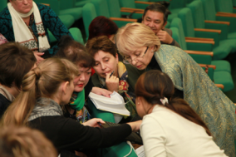
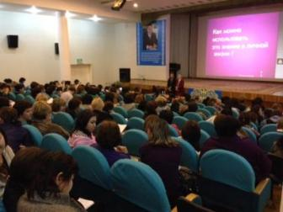
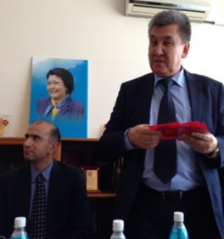

Slide 9
Future Directions
Through collaborative work with the various ISSEs EC is planning to gain wider recognition for SSEHV
This will be achieved through promoting innovative new SSEHV programs and high quality research
An accreditation process for the Schools is being planned
Conference on SSE is being considered for Guru Poorinima, 2015

Slide 10

European Sathya Sai Education
Seminar Activities of the ESSE Institute
July – October 2014

Slide 11
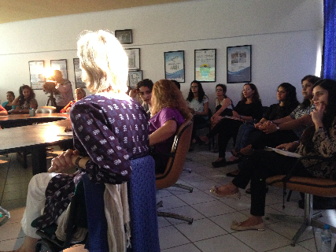
Seminars in Morocco in cooperation with the organisation Al Jisr
Course for public school teachers
Course for volunteers

Slide 12
SSEHV Seminars in Kazakhstan in cooperation with Bobek Institute in Almaty
Course 1 Module 1:
250 participants
Course 1 Module 2:
50 participants
Public school teachers,
National teacher trainers, and
University teachers participated
General director of Bobek institute

