Slide 1
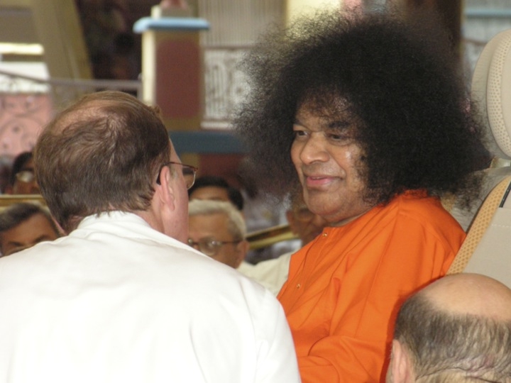
Sai Baba’s Teachings on Communication

Slide 2
Why should we focus on communication ???

Slide 3
Do you ever have a problem ?
With people understanding you
With people getting upset by what you said
You have a hard time making an apology or you make an apology… and make things worse

Slide 4
Do you ever have a problem ?
You give people good advice and they do not seem to appreciate it or act like they did not even want or need your advice.
Your communication with friends or family members is not as good as you would like it to be.

Slide 5
Today’s goal
Improve our communication with everyone we meet
Notes:
If we all focus together on Swami’s teachings
And ask for His help and Grace
This workshop will give us new insight and new skills

Slide 6
How are we going to do this?
Rule #1
Remember who we are speaking to
Which is our Dearest Swami
When we do this
Love will be the basis of all our communication.

Slide 7

It is not always easy !!!
Notes:
Some people are really hard to deal with and communication with them is very challenging

Slide 8
It is not always easy !!!

Slide 9
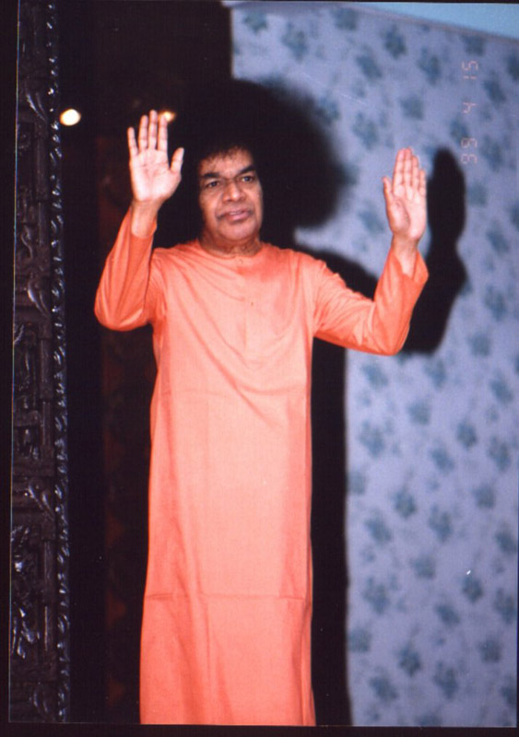
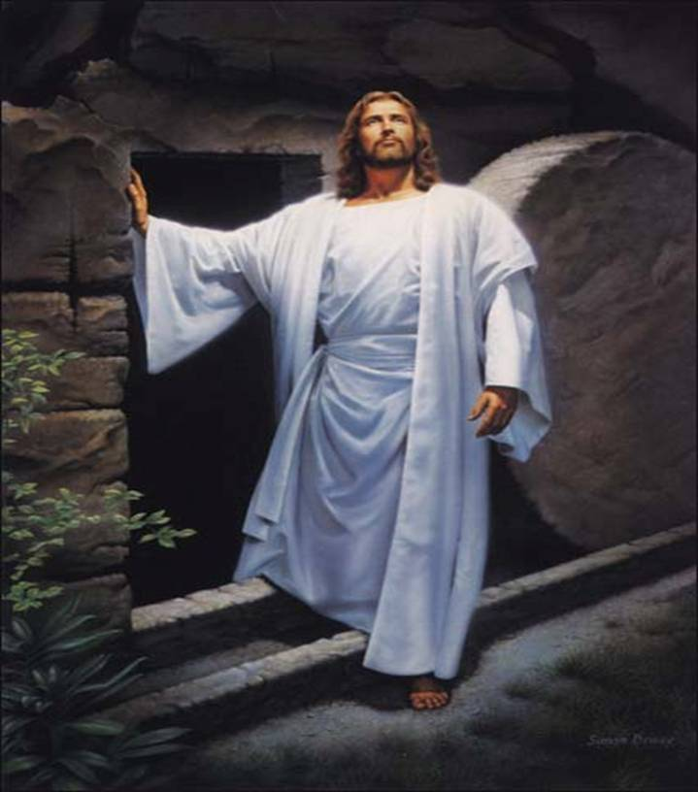
Love All, Serve All
Swami and Jesus
Notes:
God is present in each and every person. As Sai devotees we know Swami is present in the person we are speaking to. Other people may worship Jesus in others as the preferred form. For people who have a hard time picturing Divinity in others, they might imagine someone who is near and dear to them such as their Dearest Mother or Grandmother and speak to them with the reverence and respect they would do to someone who they hold in very high esteem.

Slide 10
Most Powerful Method of Communication?
OUR ACTIONS
“Your actions speak so loudly, I cannot hear what you are saying!”
Parents are all well are of this.
Notes:
Children do not listen to to their pareents
Swami is Gold Standard.
Built 4 amazing hospitals where the highest quality of care is provided and it is delivered with love and compassion. In addition to the medicines that you prescribe, also give patients the capsule of love, that will speed their progress and help their healing. Your service to your patient’s is my Padnamaskar…I cannot give you anything higher than that
Build many educational institutions in India from primary education to post grad such as PhD’s in many fields. All education free of care and most importantly taught by loving and dedicated teachers. Students learn the the 5 human values in addition to all the usual academic things. The students from India and other countries like Zambia and Canada have all earned high honor by having their school ranked at the top of their country and even more importantly the students who graduate are student who practice the 5 human values of love, truth, right action, peace and non violence and they use their knowledge and skills to help those in need in their local communities and their work ethic and work excellence has helped them become leaders in the Sai organization as well as their place of employment and their communities
Swami’s did not tell the government that they should provide free drinking water to those who had been suffering for lack of pure drinking water for decades. Instead he quietly and in record time contructed massive projects in India that ended up providing pure and free drinking water to over 11 million people and then the trust quitely handed over this to the government to continue this program once the infrastructure had been set up.

Slide 11
Swami’s teachings
Lead by example - Love all, serve all
Help ever, hurt never

Slide 12
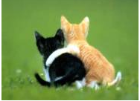
Words to Remember
I’ve learned that people will forget what we said
People will forget what we did
But people will never forget how we made them feel
1972
Notes:
Story of my patient with Alzheimers or story of the doctor I saw in 1972 and who greeted me with a warm smile and I still remember her positive energy, enthusiasm and the kind way she treated me over 40 years ago.
Swami’s advice on why we should never speak cause an injury (mental/emotional) unkind words. If you accidentally you break someone’s bones, it will heal with time, but if you injure someone by speaking unkind words, that wound can fester for a lifetime.

Slide 13
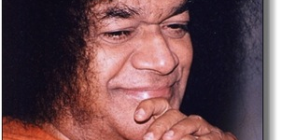
We only have one chance for a First Impression !!!
Notes:
When we smile…love bubbles up in us.
Best way to make a heart to heart connection
Universal Language

Slide 14
How to make an apology
Make it “Short and Sweet”
No excuses

Slide 15
Do people ever look at things differently than you do ?
Notes:
exercise

Slide 16

We all have our perspective
Notes:
Swami has said that if he speaks to a room or a hall full of people, there will be as many different interpretations of what he said as there are people in the room or hall

Slide 17
How should we respond when someone has a different viewpoint?
We should not be surprised
We should show respect for their viewpoint

Slide 18
Email Communication Tips

Slide 19
#1 Never use email to resolve major differences of opinion
Why ?
Notes:
Especially if strong emotional content present

Slide 20
Never use email to try and resolve major differences of opinion
Attempting conflict resolutions via email almost always make things worse
Notes:
There are many good reasons why we want to take the easy way out #1 email is faster and more efficient #2 We may feel we don’ have the time to talk or speak with this other person #3 This person may be hard to deal with on the phone or in person. It does not matter, trying to resolve by email just does not work and you will likely have to end up speaking to them anyway and after angry emails are exchanged your conversation will be much more difficult.

Slide 21

Talking in Person always best

Slide 22
In person not always possible
Many of you live a distance from the person you are communicating with
So what is the next best option???

Slide 23

Talking on the phone or via Skype is the next best
Notes:
This is best way in most situations… but many people still have a problem with this. Why

Slide 24
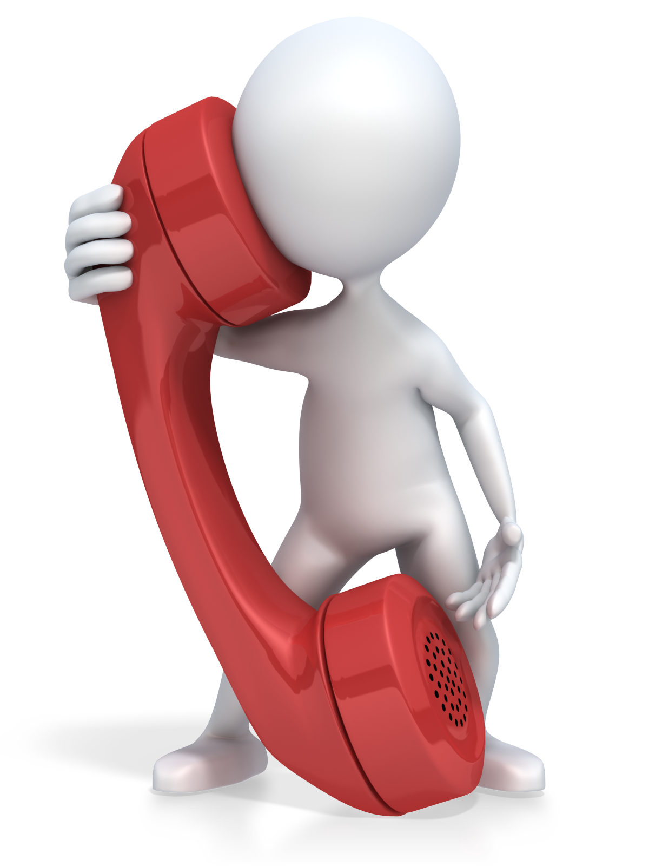
Now what to say ?

Slide 25
One approach to help resolve different opinions on the phone
1.) Listen… Is there more?
2.) Summarize what they are saying 3.) Acknowledge emotions
4.) Validate what they are saying (Respect)
Notes:
First understanding\, Then Adjustment

Slide 26

Be Careful when you come to bridge
Notes:
This is also practicing Swami’s teaching, We cannot always oblige…We can always speak obligingly

Slide 27
After Bridge say
Don’t negate by saying But
Acknowledge and validate
Then we can say, “And”
Followed by our viewpoint
Notes:
This is also practicing Swami’s teaching, We cannot always oblige…We can always speak obligingly

Slide 28
Be Careful when you come to bridge
BUT– Indicates disapproval, negates compliments, is judgmental and discourages brainstorming and sharing of ideas
AND – shows respect, re-enforces a compliment, and encourages brainstorming and sharing of ideas
Notes:
Have Interpreter read after BUT and after AND

Slide 29
#2 Never say anything negative about another person
Never say anything negative about another person in an email.
We should not criticize others
When we do, we are criticizing God.
Notes:
It may go to many other people and sometimes end up in people’s email box all over the world, and most of the time it makes it back to the person we spoke about negatively

Slide 30
You read an email and see a major conflict of opinion
Time for a test
To see if I am explaining things properly

Slide 31

You are tempted to send an email to try to resolve a major problem
Notes:
Basically this shows us trying to send an email when we are upset or angry

Slide 32
What should you do ?
Do not send
If you do want to send… send it to yourself and not to others
Wait a little while and calm down
Sleep on in
Remember that trying to resolve a significant problem via email does not work !

Slide 33
You are about to say something negative about someone

Slide 34
What should you do ?
Remember
Saying something negative by email is a permanent record and may travel around the world
The person you are speaking to will likely hear about it sooner or later
When we criticize another person, we are actually criticizing God
Notes:
Congratulations 100% test
Now the real test will come when you and I got to work on Monday
And we open our inbox with 100-200… or more emails. That will be the true test.

Slide 35
3. Keep email short and sweet.
Best to outline a few bullet points.
Short concise emails take more time to write.
This will be appreciated by readers and shows respect for their time.
Notes:
Quote from Mark Twain

Slide 36
3. If we say something negative
(not recommended)
Never make things worse by BCCing to their boss / supervisor or others
Another tip is to first calm down, or sleep on things, or read a few time before sending. Hopefully we will not send negative email
Or before sending to others just send negative email to yourself and imagine how it would feel if you were the person being criticized.
Notes:
Praise in public and give suggestions for improvement in private. Also suggestions for improvement not likely to succeed if we have not already developed a positive emotional bank account with that person, which means we have pointed out the good things they have done many times in the past.

Slide 37
4. Giving compliments by email is encouraged
When you compliment someone in an email, remember to CC as many others as appropriate, for example their center president, and other officers or devotees.
Notes:
Praise in public and give suggestions for improvement in private. Also suggestions for improvement not likely to succeed if we have not already developed a positive emotional bank account with that person, which means we have pointed out the good things they have done many times in the past.

Slide 38
5. Subject line should be simple and summarize content of email
Also do not forget to put something in Subject line.
If email chain changes topic, change the subject line heading.
If all emails tied together, we may need to start another email in order to change the subject line heading
All This will help us when searching for a specific email topic in the future.

Slide 39
6. CC only those who need to know
Do not include others, use your best judgment
Don’t forget to CC those that need to know
Forward an email to those who need to know if they were not initially included

Slide 40
7. If you Forward an email to someone
Let them know why you are doing this.
For example, “I forgot to copy you on this email initially.”

Slide 41
8. Do not share Sai Organization email addresses
This can best be accomplished by putting all the email addresses in BCC section.
Next in the body of the email, mention who is receiving. “To all center members” or to which ever group you are sending to.
Notes:
8. Email address lists have been used for commercial purposes or other ways that we don’t want.
9. When we do so inappropriately it clutters us many peoples inboxes. When working in small groups it is sometimes needed.

Slide 42
9. When we refer to an attachment in our email
We should double check to make sure we have attached the document or pictures we meant to attach to this email.

Slide 43
10. Be careful about copying and pasting
The info we copy and paste may be incorrect.
Or out of date and no longer useful
Or may have something negative or something we would normally not place in email.

Slide 44
11. For official e-mail correspondence
Our signature should reflect our official position.
An example
Dr. Joe Phaneuf
Chairman, USA Medical Committee
Notes:
12. Use good judgment in deciding if email is official and formal versus non official and informal

Slide 45
12. Be Very Careful about hitting the Reply All Button !
Most of the time it should not be done
It may clutter up the inbox of hundreds of people who do not need to know
It is appropriate to hit the Reply All Button for many smaller groups or at other times. We should think twice before doing.

Slide 46
13. All Capital Letters
IS THE EMAIL EQUIVALENT OF SHOUTING AT SOMEONE

Slide 47
14. In future we may all have an official Sai Organization email address
In Mexico they already have this.
The President of the Sathya Sai Organization in Mexico is Oscar Morado Ochao.
For official email correspondence he uses presidencia.nal@sathyasai.org.mx
Notes:
12. For now just use one address, in future we will each have an official Sai Organization email address which we will use for official Sai organization emails. And this should only be one email address.

Slide 48
15. Just Use One Email Address
Multiple email addresses for same person causes more problems than we can imagine.
One example would be when we receive an email from someone and use the last email address they have used to search for past emails from them.
Notes:
12. For now just use one address, in future we will each have an official Sai Organization email address which we will use for official Sai organization emails.

Slide 49
Before we speak, we should make sure that we
Speak the Truth
Speak the Truth in a pleasing way
Avoid speaking a truth which is hurtful
Notes:
This applies to spoken word face to face or on the phone or via email or twitter facebook etc. Why is this important? Swami has said that if we injure someone accidentally and break one of their bone, it will heal with time and they will be OK, but if we hurt someone with
Unkind words, the wound we cause may fester for a lifetime. So we need to be very careful before we speak and not say something that is unkind or will hurt another person

Slide 50
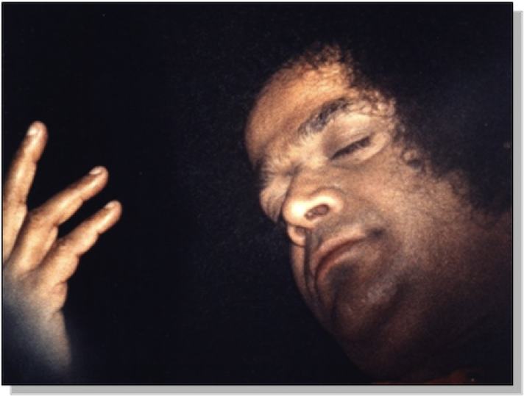
Avoid speaking a truth that is hurtful
Sometimes ….. Silence is Golden

Slide 51
When we find faults in others
What do we normally do?
Answer – we blame them, we may talk about them to others, or think about their faults and forget that we may just be projecting faults we have within ourselves
What should we do

Slide 52
When we find faults in others
Good chance we have this fault in us
See good in others
Look for faults in ourselves
Should be lenient when judging others, harsh when judging our own actions
Notes:
When you see a

Slide 53
First Understanding,
Then Adjustment
What has Sai Baba taught us?
First some reflections of our own behaviors which may leave room for improvement.

Slide 54
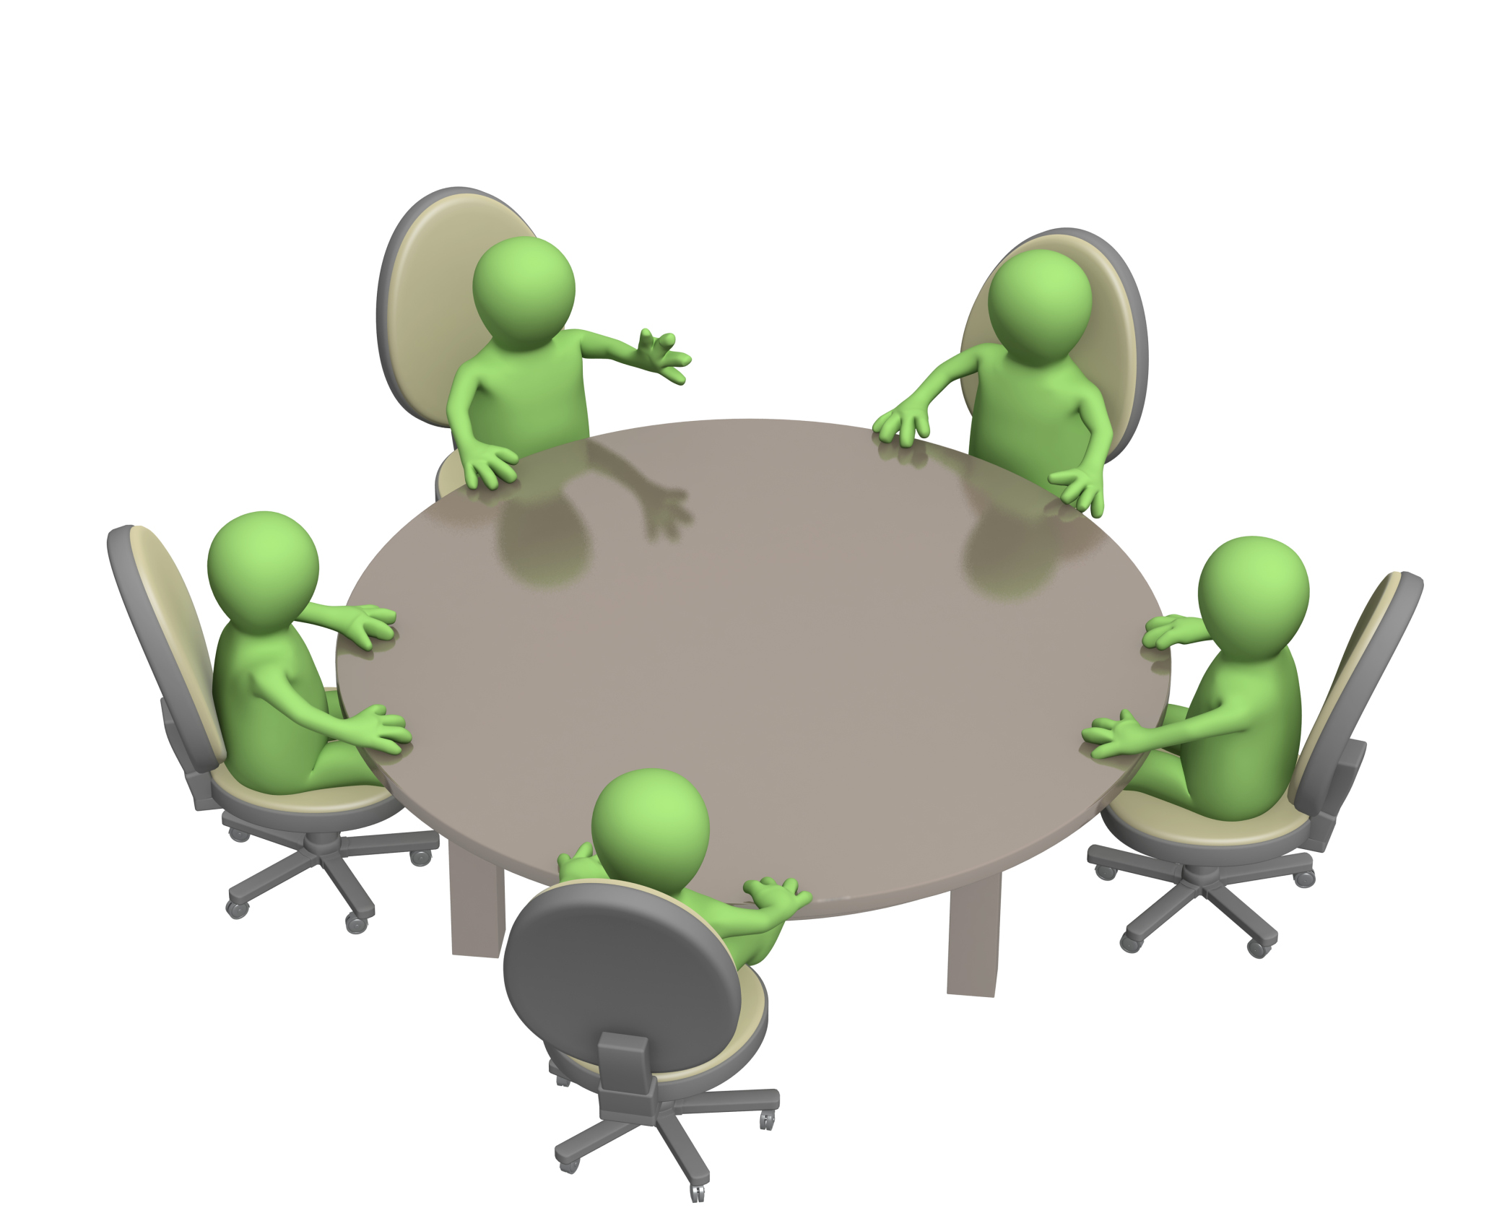
This person is speaking and … he thinks his colleagues are listening
Notes:
People are sitting at table during a brainstorming session on how to develop a better product… It could also be a very common situation
At Sai centers during study circle

Slide 55
I can hardly wait until it’s my turn to speak

Slide 56
As soon as he pauses for just a second, I am going to speak
I can hardly wait until it’s my turn to speak

Slide 57
Good example of
Not really listening to speaker
Thinking about something else
Especially what we want to say next

Slide 58
I had such a hard time today at school …
Notes:
Woman relating a very painful experience she just had with her boss

Slide 59
Don’t worry about it. It’s OK

Slide 60
Example of
Down playing or trivializing another persons difficulty
No expression of empathy or love

Slide 61
I’m having such a hard time with organizing our retreat

Slide 62
No problem. This is what you need to do
Notes:
Woman relating a very painful experience she just had with her boss

Slide 63
Thanks, but I just wanted you to listen and not solve my problem

Slide 64
Good example of
Giving advice
When it is not wanted, or needed
And we did not really listen long enough to give advice in the first place.

Slide 65
I am really overwhelmed with my responsibilities at home. It is getting really hard to study for school.

Slide 66
That reminds me of my life. I
I’m also working full time job and I don’t have much time to study for my classes either.

Slide 67
Hijacking conversation
Yes, that reminds me of…
And bring attention to ourselves rather than focusing on the person who is sharing a difficult experience

Slide 68
First Understanding,
Then Adjustment
First Understanding
How do we listen to make sure we understand?

Slide 69
60 second
Listen and do not interrupt
However it is active listening which means… you can
Nod
Say “yes” “uh ha” “Tell me more”
You can also empathize such as “That sounds difficult” or “I’m sorry to hear that”.
However please do not give your advise or say “that reminds me of and bring attention back to yourself.
Notes:
First up with person next to you
If you are unable to do that you can be an observer or raise your hand and pair up with another person if possible
We do want as many of you to do this exercise as possible
Now that you are paired up or being an observer
The person with the longest hair will now be the one who speaks, the other is the listener
OK now Listeners… here are your instructions.. When I say go, listen…

Slide 70
30 second
Now the person who is listening should summarize what the other person has said to see if they have understood properly
Notes:
First up with person next to you
If you are unable to do that you can be an observer or raise your hand and pair up with another person if possible
We do want as many of you to do this exercise as possible
Now that you are paired up or being an observer
The person with the longest hair will now be the one who speaks, the other is the listener
OK now Listeners… here are your instructions.. When I say go, listen…

Slide 71
What is a technique to make sure we have understood another person?
Listen carefully
Repeat back (Summarize)
“Sounds like …”, “Seems like …”
Notes:
Be careful when you are naming emotions, Sounds like you are angry or That sounds upsetting to you you.

Slide 72
Why is this a good idea?
No matter how well we think we know someone
Not summarizing or checking for understanding is risky
Nothing is so simple…that it cannot be misunderstood !

Slide 73
You have just listened to your friend tell you about a painful experience

Slide 74
The Power of Empathy
To watch the nice video we shared, please go to the following link
https://www.youtube.com/watch?v=1Evwgu369Jw

Slide 75
How to ask permission to give advice
Would you be interested in hearing what others have found helpful in this situation?
Would you like some help in solving this problem?

Slide 76
Better Way
I am so sorry to hear that… can I help in some way?
Notes:
It is better to first
Express empathy… and then ask if they need help

Slide 77
Do you ever feel pressured to say Yes?
I will have to think about that
Please let me check my schedule and get back to you on that
Under promise and over deliver
Notes:
Some possible alternatives when you don’t know how to answer someone.

Slide 78
How to receive criticism

Slide 79
How to receive criticism
Step #1 Is it correct? Yes
Be Grateful
If Yes, work on self improvement
Notes:
It is not always easy…it is some times painful. It is what we have to do if we want to improve ourselves.

Slide 80
How to receive criticism
Step #2
If after careful reflection
It’s not true

Slide 81
God is testing us
Beautiful Gold jewelry
Nail in the wall
Pass test before graduating to next grade

Slide 82

University of Life we need to pass many tests

Slide 83
We cannot always oblige, what we can always do… is speak obligingly
Always a nice way to say NO
Always end on positive: “I really wish I could do__________,
Now what I can do is …”
Notes:
You cannot always accommodate but you can always speak accommodatingly

Slide 84
How to respect others and encourage sharing of ideas

Slide 85
Avoid using “But” as a connector after making a positive comment
Yes, but …
It tends to negate or diminish what precedes it
Discourages sharing of ideas

Slide 86
Yes, AND ...
Keeps things positive
Shows respect
Encourages people to share ideas

Slide 87
Example
Juanita, based on what you just said, I can see why you think XYZ is the best approach
Thanks for sharing … And, I have another idea which we may want to consider

Slide 88
These listening skills will help when someone is angry
Sometimes just being quiet and listening is all that is required
That sounds really upsetting
That must be really difficult, I am so sorry to hear that happened to you

Slide 89
Now lets ramp up the level of difficulty !
Not just a different viewpoint
Significant disagreement with emotional content (hot button issue, sore spot issue)
Major conflict … time for Conflict resolution

Slide 90
Now, take a deep breath !
1.) Get Curious rather than Furious
Notes:
Get curious rather than furious, This will help us practice Swami’s teaching “First Understanding….. Then adjusment

Slide 91
Now, take a deep breath !
1.) “Tell me More” “Anything Else?”
2.) Acknowledge their emotions
“That sounds upsetting”
3.) Summarize “Sounds like you are having difficulty with …”
4.) Validate their feelings & thinking
Notes:
Get curious rather than furious, This will help us practice Swami’s teaching “First Understanding….. Then adjusment

Slide 92
Now be careful

Slide 93
Now be careful
“Maria, based on what you have told me, I can see why you want XYZ…”
You are now at the bridge
“And, from my experience I believe…”
“Would you be willing to consider?”

Slide 94
Another Take Home Message
Rule #1
Remember who we are speaking to
God or Divinity which resides in everyone
This helps to make sure Love is the basis of all our communication

Slide 95
Take home point
Never try conflict resolution via email
Do not put anything negative in emails
Yes, AND shows respect and useful for
Conversations, Brainstorming, Conflict Resolution

Slide 96
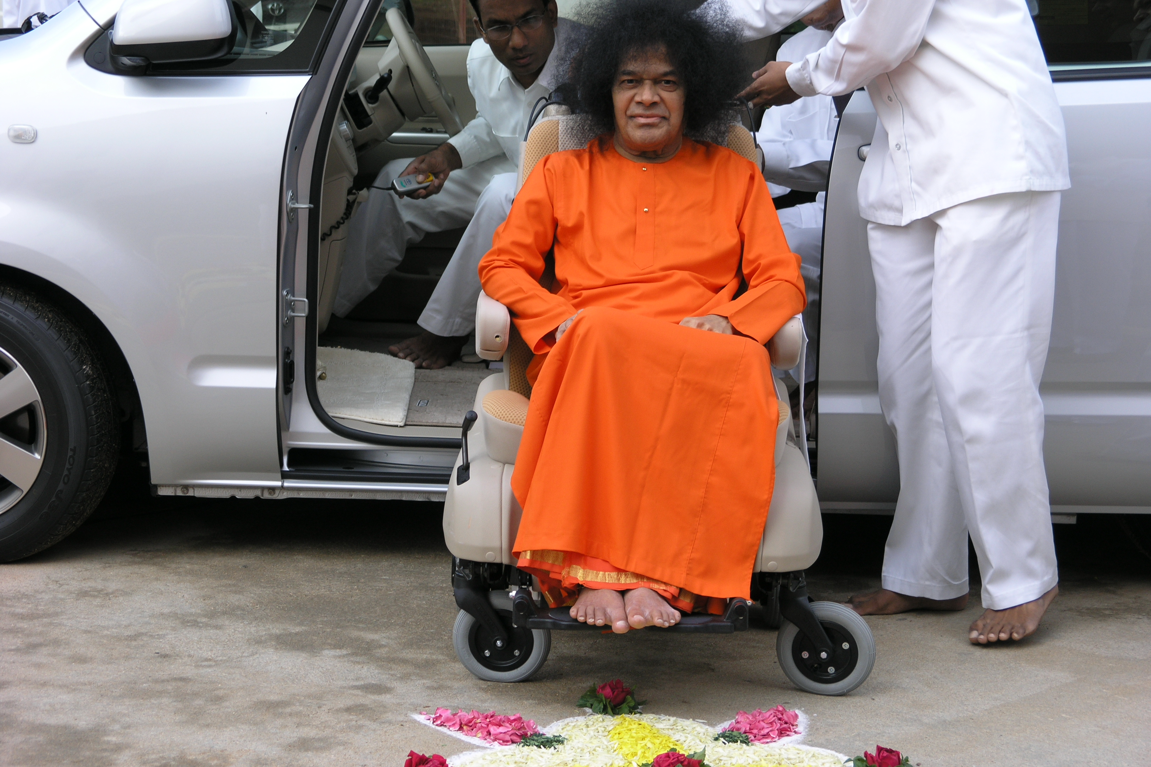
Notes:
96
The best part about Rule#1 which is remembering who we are speaking to is that when we remember we are speaking to our Dearest Swami…
We get a chance to speak with Swami… interact with Swami… and have Swami’s Darshan all day long.
What could be better than that ?
We all have a chance to let this divine light shine forth and we can be beacons of light and love everywhere we go.
By practicing:
Love All, Serve All, and
Help Ever, Hurt Never.
We each have a chance to speak with Swami, interact with Swami, and have His Darshan
With each and every person we meet
All day long…
If only we Remember!

Slide 97
When we remember that we are speaking to our Dearest Swami
We get a chance to speak with Swami

Slide 98
When we remember that we are speaking to our Dearest Swami
We get a chance to interact with Swami

Slide 99
When we remember that we are speaking to our Dearest Swami
We get a chance to have Swami’s Darshan … All day long !!!

